Slide 1
Welcome to Book Club!
Week 8

Slide 2
Agenda
01
02
03
Check In
Chapter Summaries + Discussion Questions
Crossword + Would You Rather

Slide 3
Weekly Check In
Highs and Lows
Any upcoming plans / vacations??

Slide 4
Character List
Nora Seed: Main character
Mrs Elm: The librarian
Ingrid Skirbekk: Professor of Geoscience International Polar Research Institute
Hugo Lefevre: Nora’s new acquaintance
Peter: The eldest of the group
Rune: Described as a big boulder of a man of the group
Lorenzo Conte: Nora’s grandfather on her mother’s side
Patricia Brown: Nora’s grandmother on her mother’s side
Geoff: Nora’s grandfather on her father’s side
Donna: Nora’s mother, Lorenzo and Patricia’s child

Slide 5
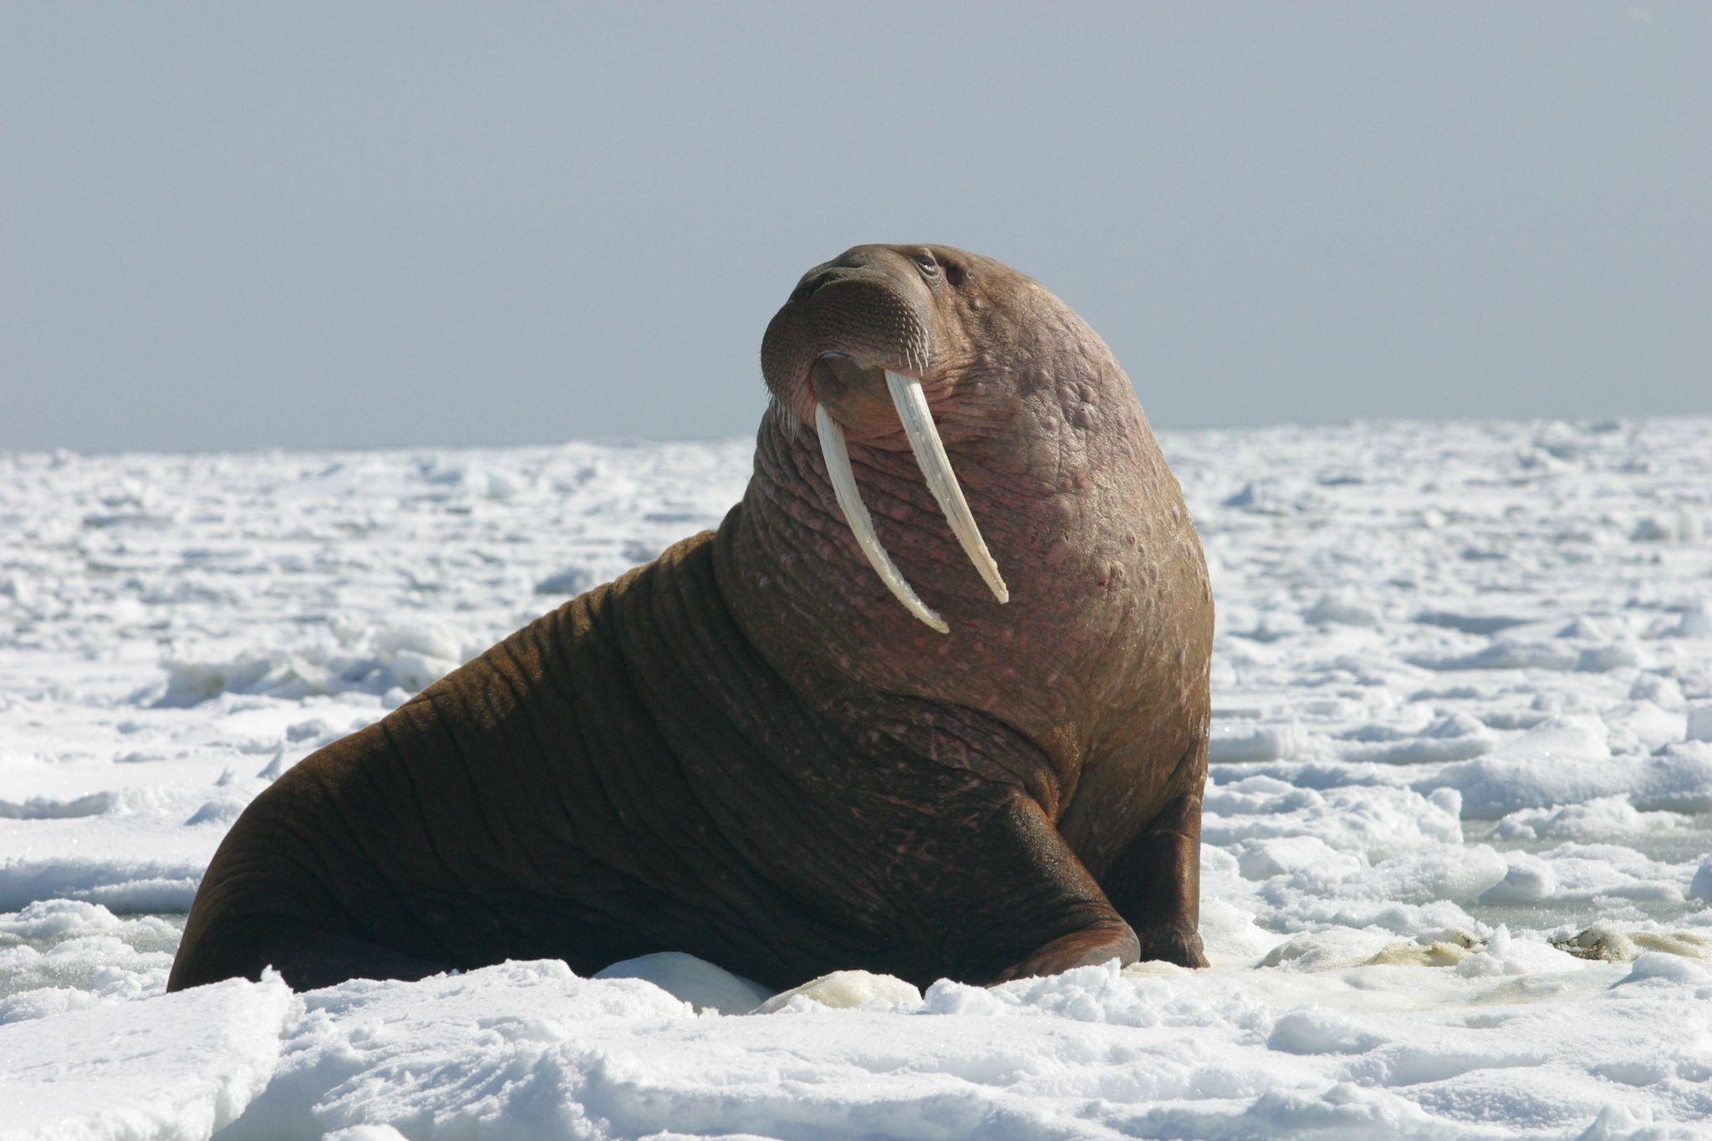
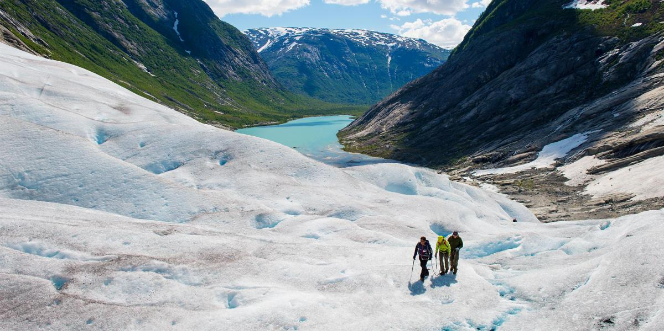
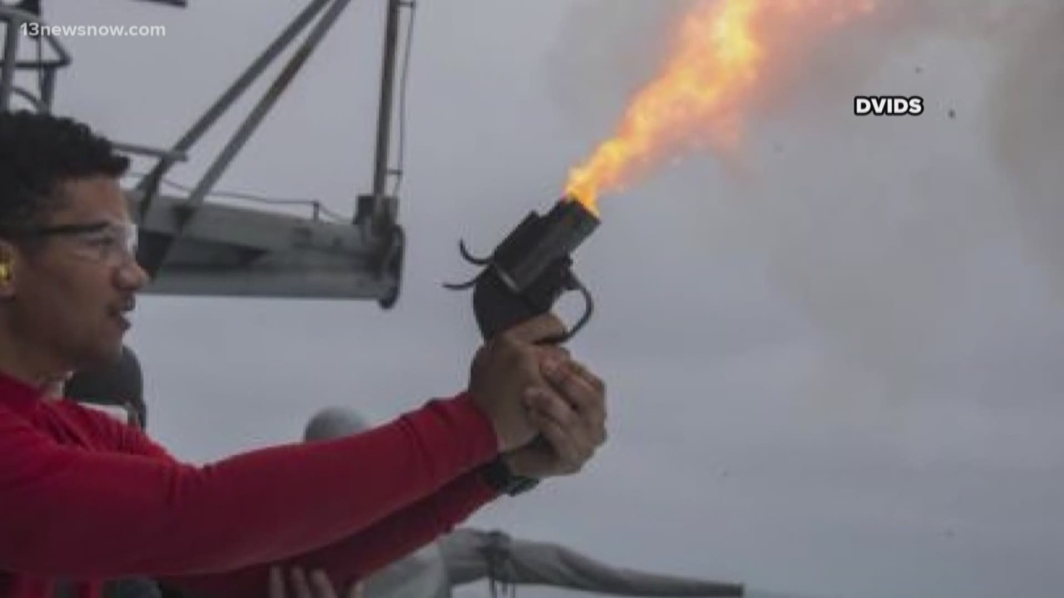
Walking In Circles

Slide 6
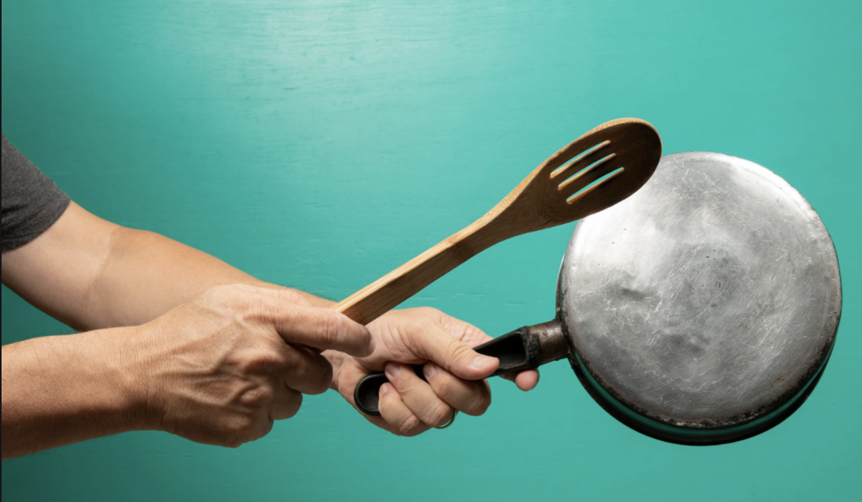
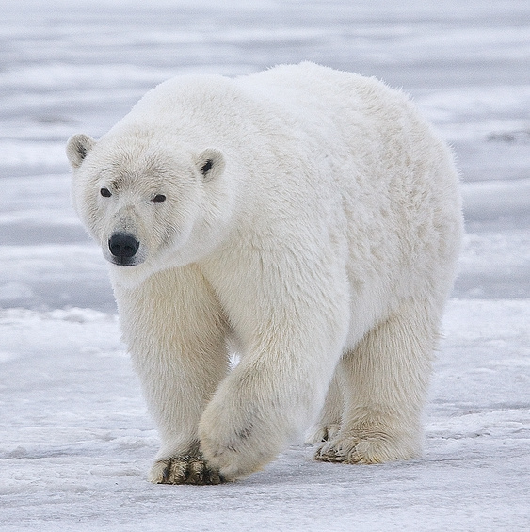
The Frustration Of Not Finding a Library When You Really Need One

Slide 7
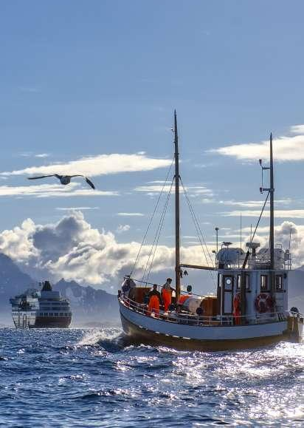
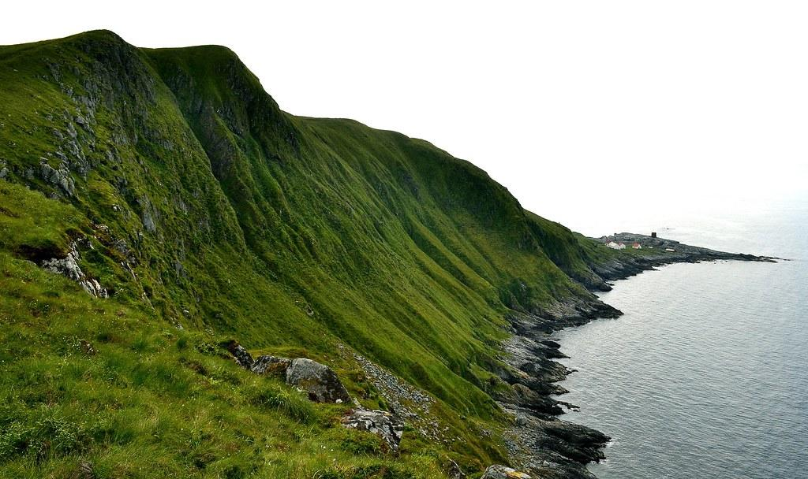
Island

Slide 8
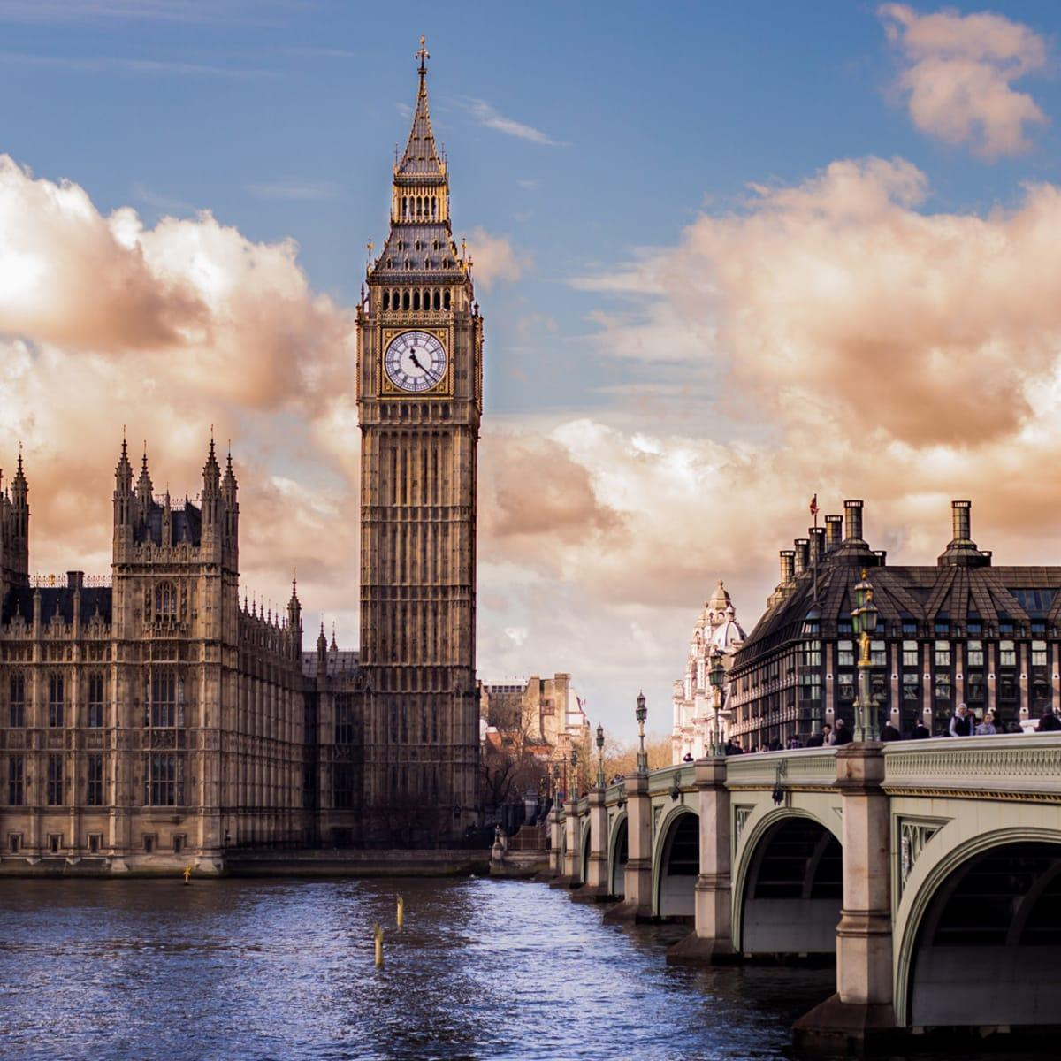
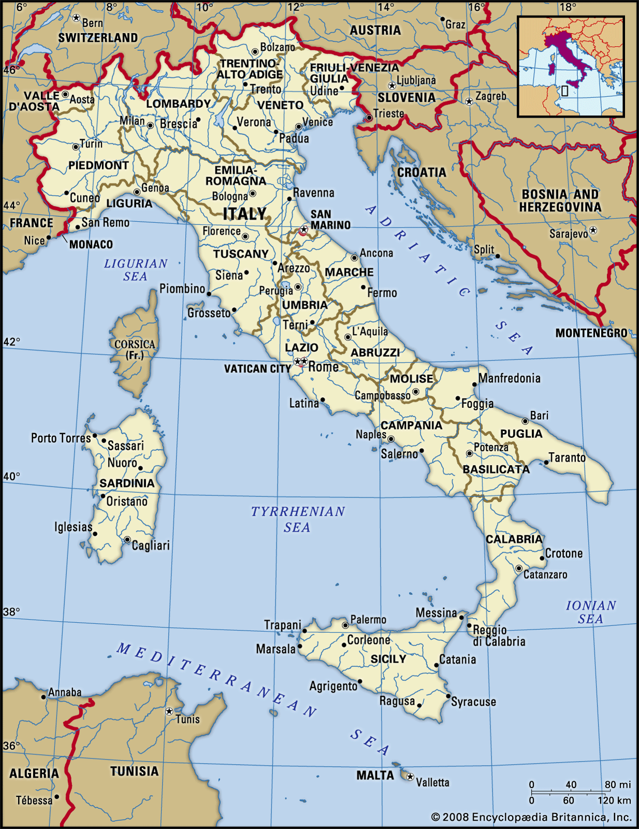
Permafrost

Slide 9
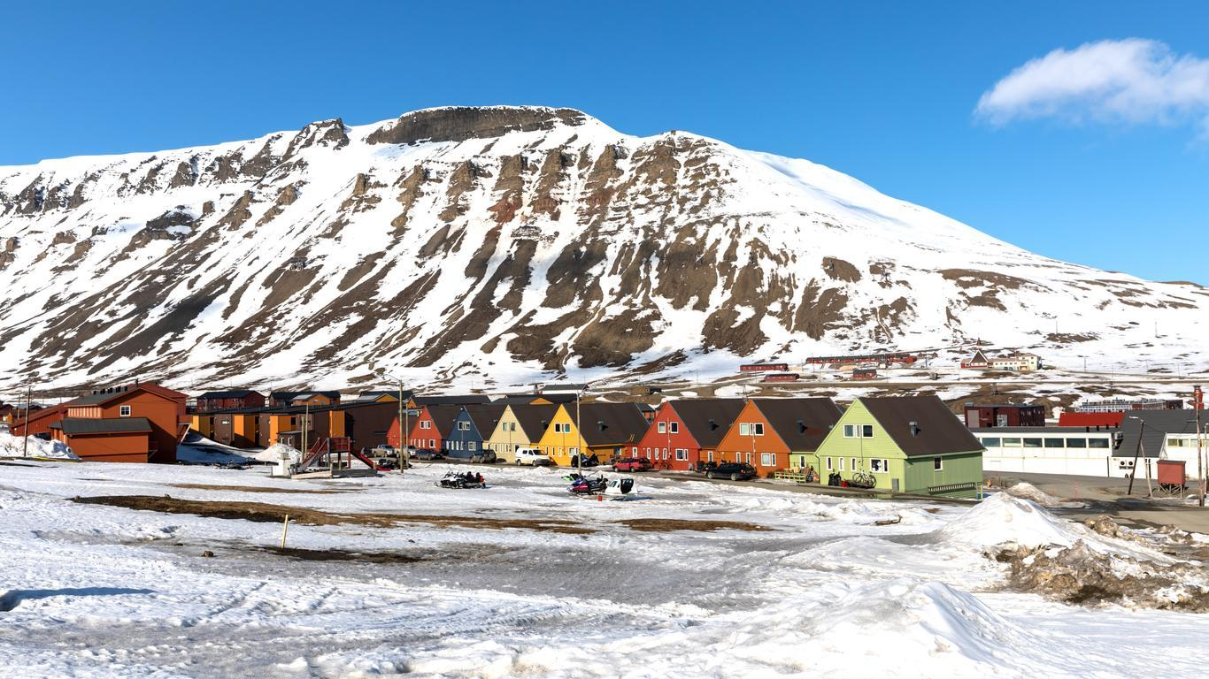
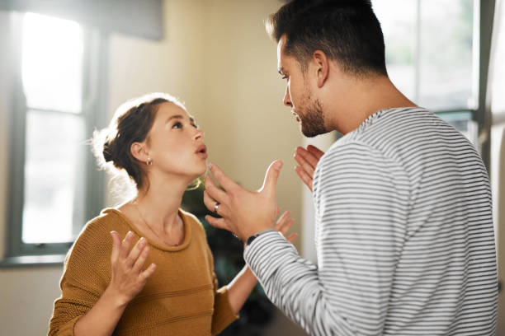
One Night In Longyearbyen

Slide 10
Expectation

Slide 11
Multiple Choice #1
In the chapter “The Frustration Of Not Finding a Library When You Really Need One”, Nora becomes terrified of what?
She worries she will never be able to be happy.
She thinks she will be trapped on Bear Island forever.
She sees a polar bear and freezes.
She falls and is unable to get up and scared no one will find her.

Slide 12
Discussion Question #1
In the chapter “The Frustration Of Not Finding a Library When You Really Need One”, Nora becomes terrified of what? She eventually is able to overcome her fear, and takes control of the situation. Have you ever been in a situation where you were terrified but needed to overcome your fear?

Slide 13
Multiple Choice #2
How does Nora feel when she is left alone on Bear Island.
Scared of being lonely forever
Connected to the environment
Angry at her mother for always fighting with her
Sad that she was not able to fire the flare gun

Slide 14
Discussion Question #2
How does Nora feel when she is left alone on Bear Island. Have you ever been to a place where you felt connected to the world or environment?

Slide 15
Multiple Choice #3
In the chapter, “Walking in Circles”, what does Ash talk to Nora about in the hospital?
Why did they stopped being friends.
The best ways to teach piano lessons.
How cat food can affect your cat’s health.
Not to google health symptoms because it does more harm than good.

Slide 16
Discussion Question #3
In the chapter, “Walking in Circles”, what does Ash talk to Nora about in the hospital? Have you ever done what he tells Nora not to do because it does more harm than good?

Slide 17
Multiple Choice #4
What does the chapter title “Expectations” signify?
Nora worries that she’ll never live up to her expectations.
Nora wishes Ingred didn’t set high expectations for her.
Peter says his expectations of Nora were not met.
Nora says Norway exceeded her expectations.

Slide 18
Discussion Question #4
What does the chapter title “Expectations” signify? Have you ever felt like you didn’t live up to your expectations in a situation? Do you set high expectations for yourself?

Slide 19
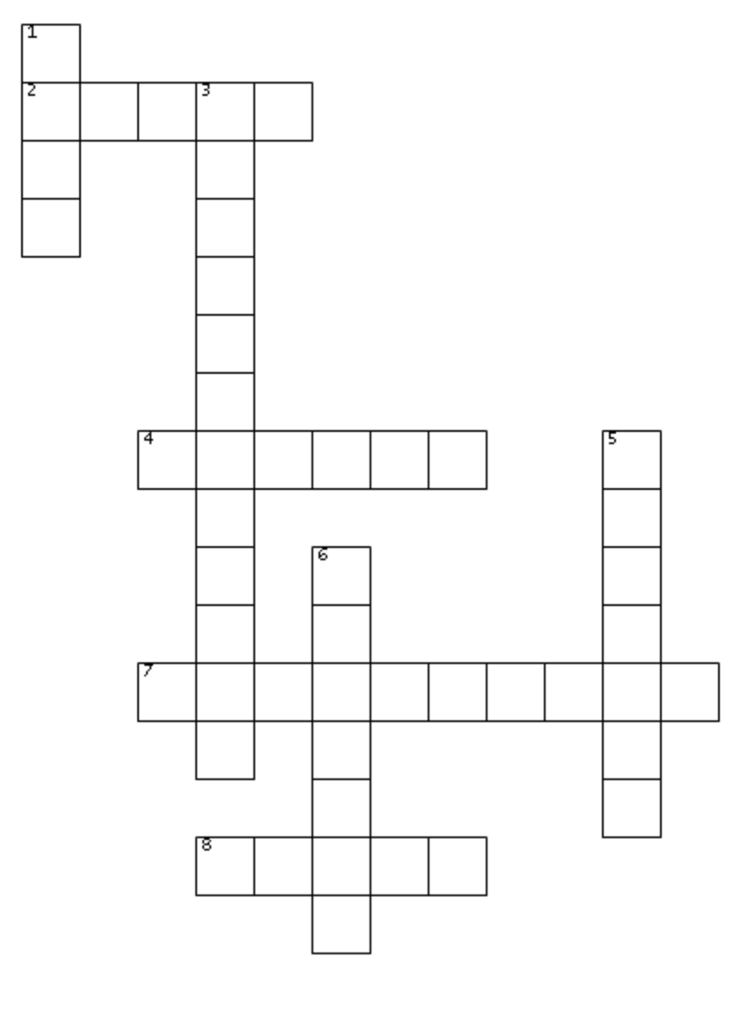
-Crossword-
1 Down:
The number of days Hugo says he’s been living in this universe

Slide 20
-Crossword-
F
I
V
E
1 Down:
The number of days Hugo says he’s been living in this universe

Slide 21
-Crossword-
F
I
V
E
2 Across:
The country where Nora’s grandfather on her mother’s side is from

Slide 22
-Crossword-
F
I
T
A
L
Y
V
E
2 Across:
The country where Nora’s grandfather on her mother’s side is from

Slide 23
-Crossword-
F
I
T
A
L
Y
V
E
3 Down:
The name of the northernmost city in Norway

Slide 24
-Crossword-
F
I
T
A
L
Y
V
O
E
N
G
Y
E
3 Down:
The name of the northernmost city in Norway
A
R
B
Y
E
N

Slide 25
-Crossword-
F
I
T
A
L
Y
V
O
E
N
G
Y
E
4 Across:
The animal Nora mistakes as a Polar Bear
A
R
B
Y
E
N

Slide 26
-Crossword-
F
I
T
A
L
Y
V
O
E
N
G
Y
E
4 Across:
The animal Nora mistakes as a Polar Bear
W
A
L
R
U
S
R
B
Y
E
N

Slide 27
-Crossword-
F
I
T
A
L
Y
V
O
E
N
G
Y
E
5 Down:
The name of Nora’s grandfather on her mother’s side
W
A
L
R
U
S
R
B
Y
E
N

Slide 28
-Crossword-
F
I
T
A
L
Y
V
O
E
N
G
Y
E
5 Down:
The name of Nora’s grandfather on her mother’s side
W
A
L
R
U
S
L
R
O
B
R
Y
E
E
N
N
Z
O

Slide 29
-Crossword-
F
I
T
A
L
Y
V
O
E
N
G
Y
E
6 Down:
What Ash worked as in the hospital
W
A
L
R
U
S
L
R
O
B
R
Y
E
E
N
N
Z
O

Slide 30
-Crossword-
F
I
T
A
L
Y
V
O
E
N
G
Y
E
6 Down:
What Ash worked as in the hospital
W
A
L
R
U
S
L
R
O
B
S
R
Y
U
E
E
R
N
N
G
Z
E
O
O
N

Slide 31
-Crossword-
F
I
T
A
L
Y
V
O
E
N
G
Y
E
7 Across:
The name of the island where Nora sees a Polar Bear
W
A
L
R
U
S
L
R
O
B
S
R
Y
U
E
E
R
N
N
G
Z
E
O
O
N

Slide 32
-Crossword-
F
I
T
A
L
Y
V
O
E
N
G
Y
E
7 Across:
The name of the island where Nora sees a Polar Bear
W
A
L
R
U
S
L
R
O
B
S
R
Y
U
E
B
E
A
R
I
S
L
A
N
D
N
G
Z
E
O
O
N

Slide 33
-Crossword-
F
I
T
A
L
Y
V
O
E
N
G
Y
E
8 Across:
The name of Nora’s grandfather on her father’s side
W
A
L
R
U
S
L
R
O
B
S
R
Y
U
E
B
E
A
R
I
S
L
A
N
D
N
G
Z
E
O
O
N

Slide 34
-Crossword-
F
I
T
A
L
Y
V
O
E
N
G
Y
E
8 Across:
The name of Nora’s grandfather on her father’s side
W
A
L
R
U
S
L
R
O
B
S
R
Y
U
E
B
E
A
R
I
S
L
A
N
D
N
G
Z
E
O
G
E
O
F
F
N

Slide 35
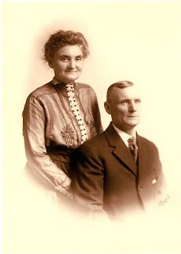
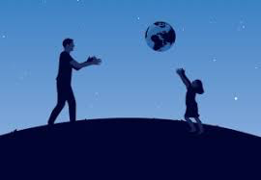
Would you Rather
Meet future generations of your family
Meet your past ancestors

Slide 36
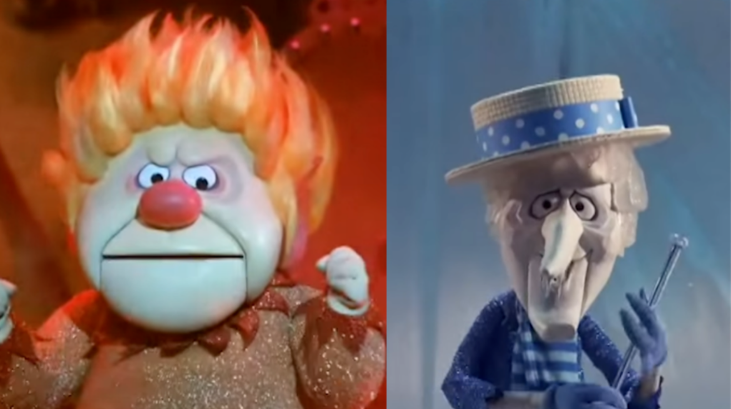
Would you Rather
Always be hot
Always be cold

Slide 37
HOMEWORK
NEXT WEEK IS SPRING BREAK
NO BOOK CLUB
FOR FRIDAY 3/25:
LIFE AND DEATH AND THE QUANTUM WAVE FUNCTION TO WILD AND FREE
PGS. 144-156
EMAIL WITH ANY QUESTIONS!
Thank you!

