Slide 1
Welcome Back to Book Club
Week 7

Slide 2
Agenda
Check in
Character List
Chapter Summaries
Discussion Questions
Crossword
Would You Rather
Homework

Slide 3
Weekly Check In
Highs and lows of the week
What is your favorite item you’ve bought this year?

Slide 4
Character List
Nora Seed: Main character
Mrs Elm: The librarian
Joe: Nora’s older brother
Ewan: Joe’s husband
Ravi: Joe’s friend - attends Nora’s speech
Ingrid Skirbekk: Professor of Geoscience International Polar Research Institute
Hugo Lefevre: Nora’s new acquaintance

Slide 5
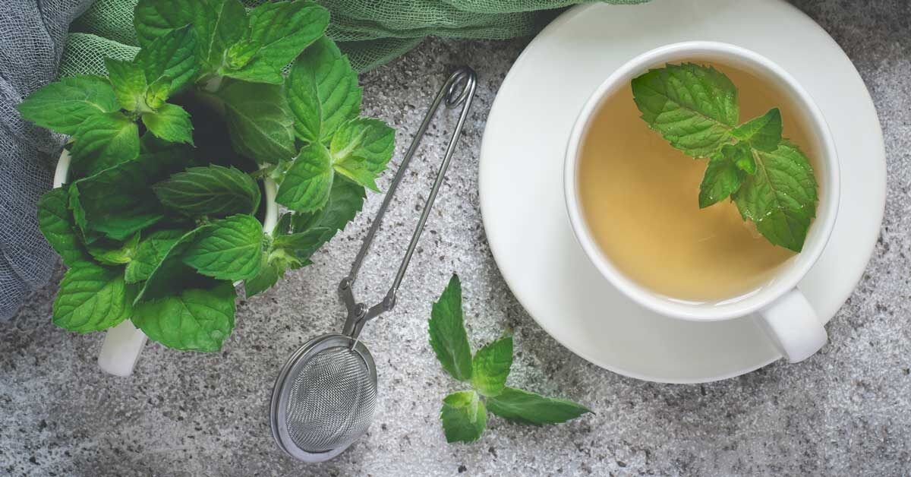
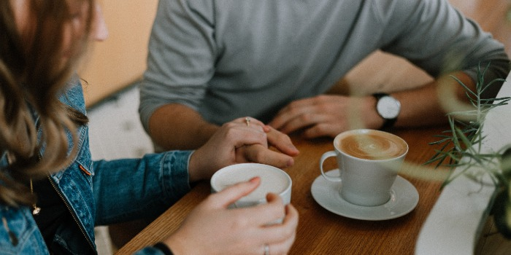
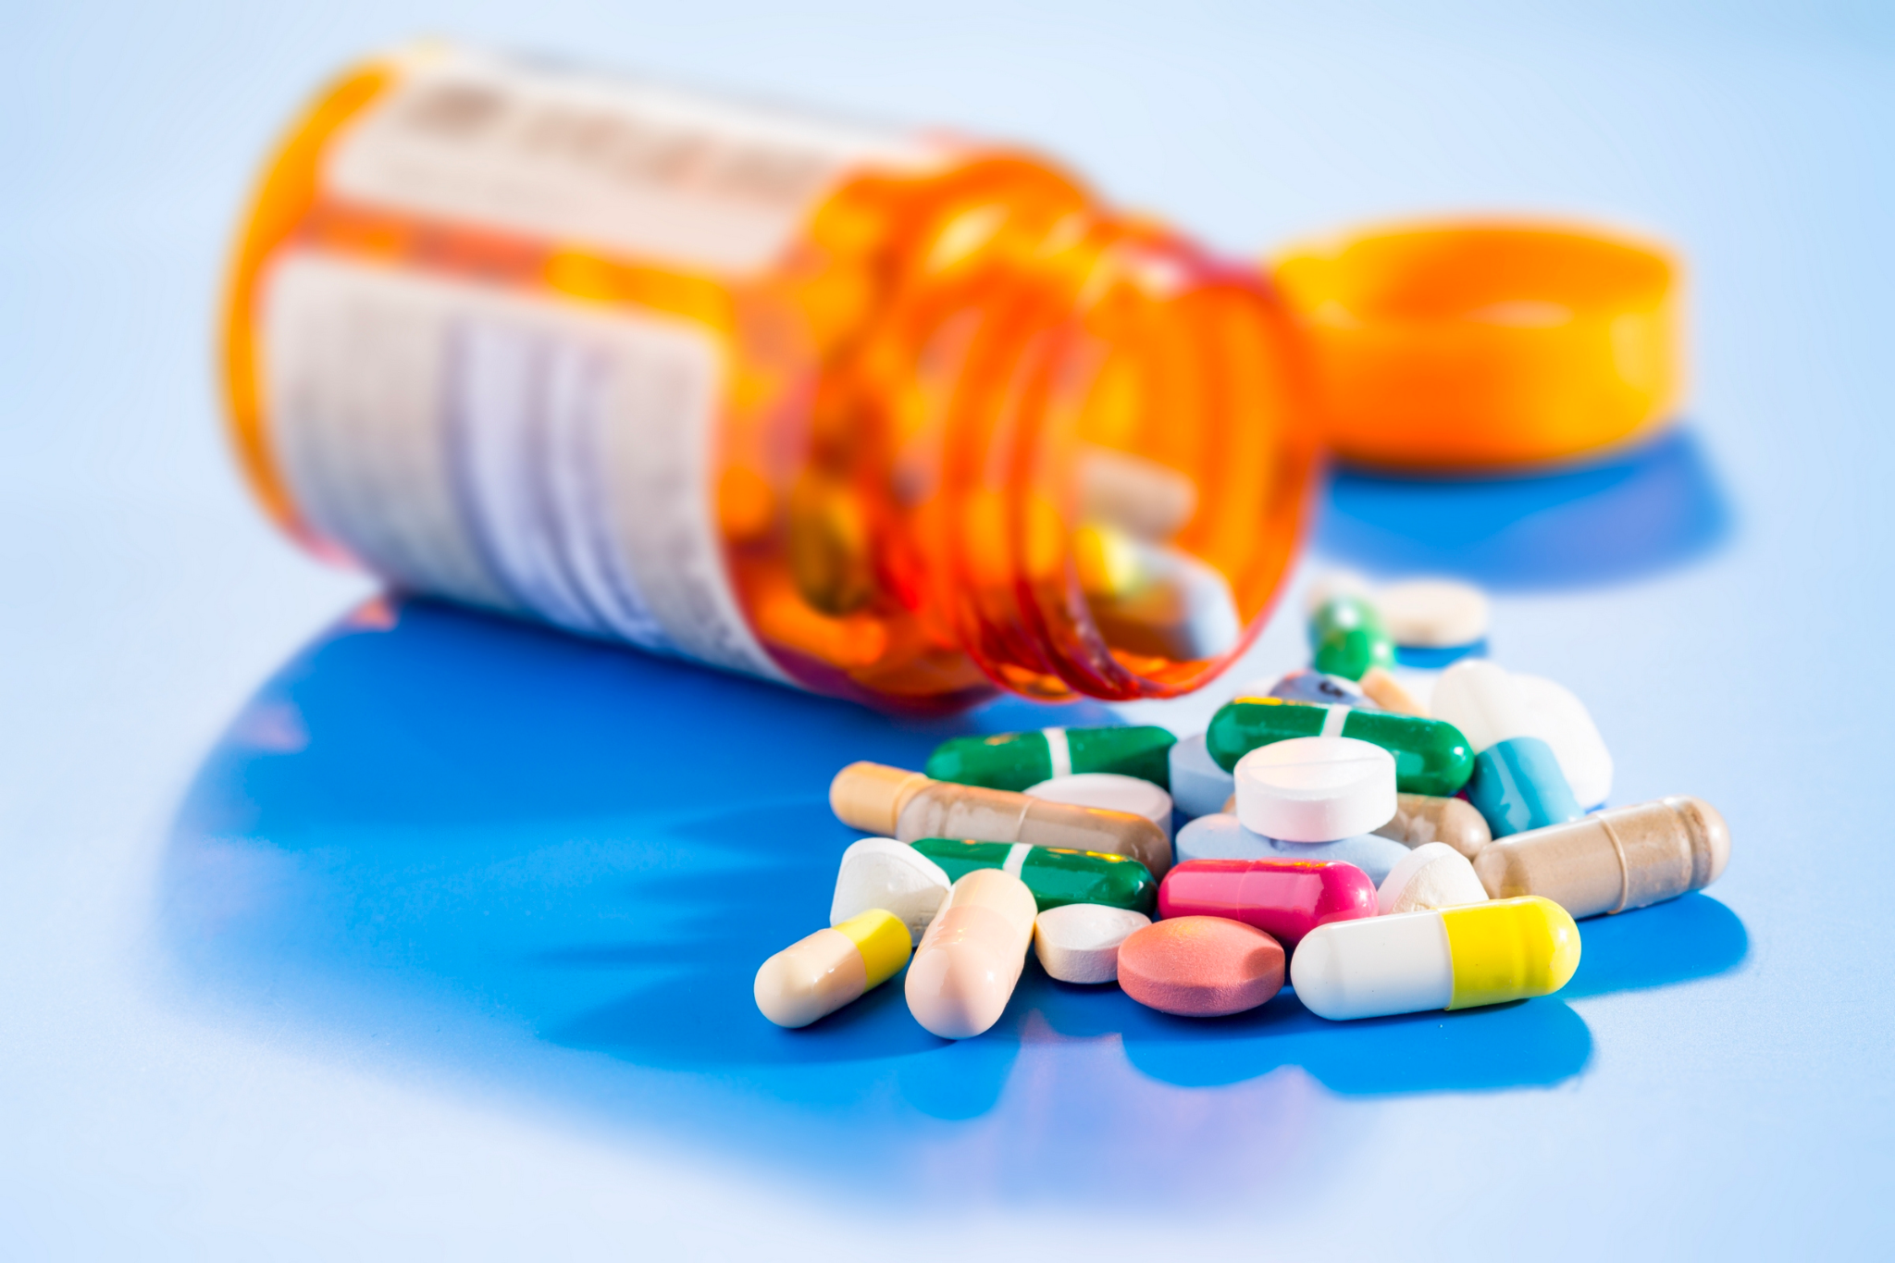
Peppermint Tea

Slide 6
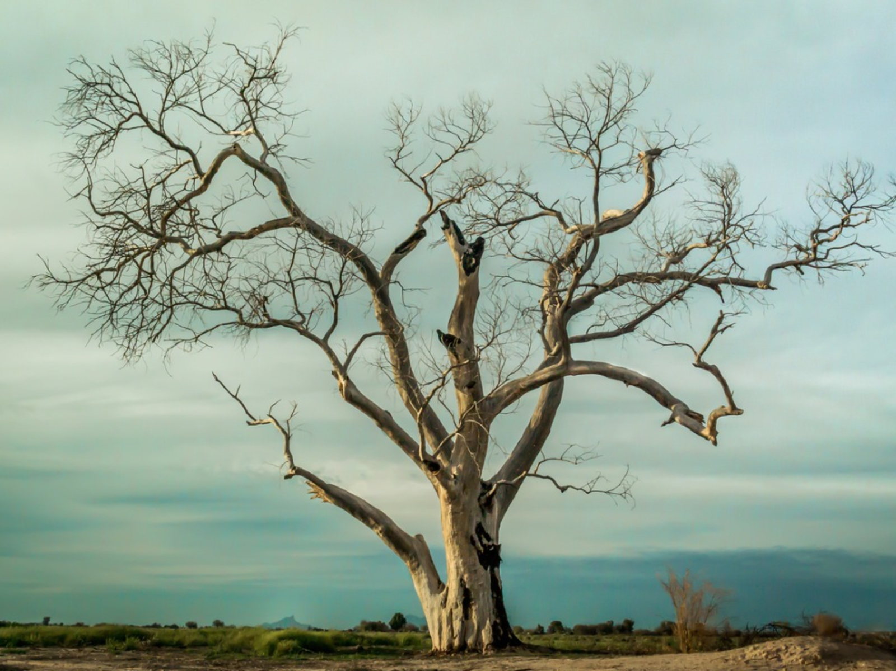
The Tree That Is Our Life

Slide 7
System Error

Slide 8
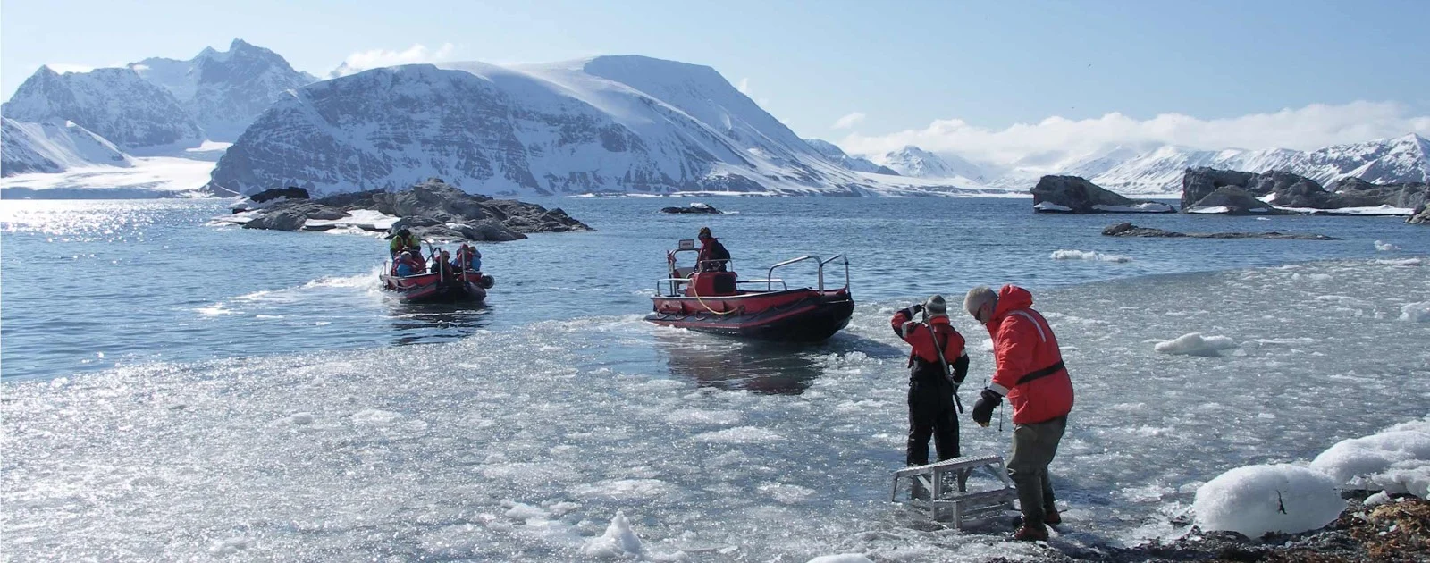
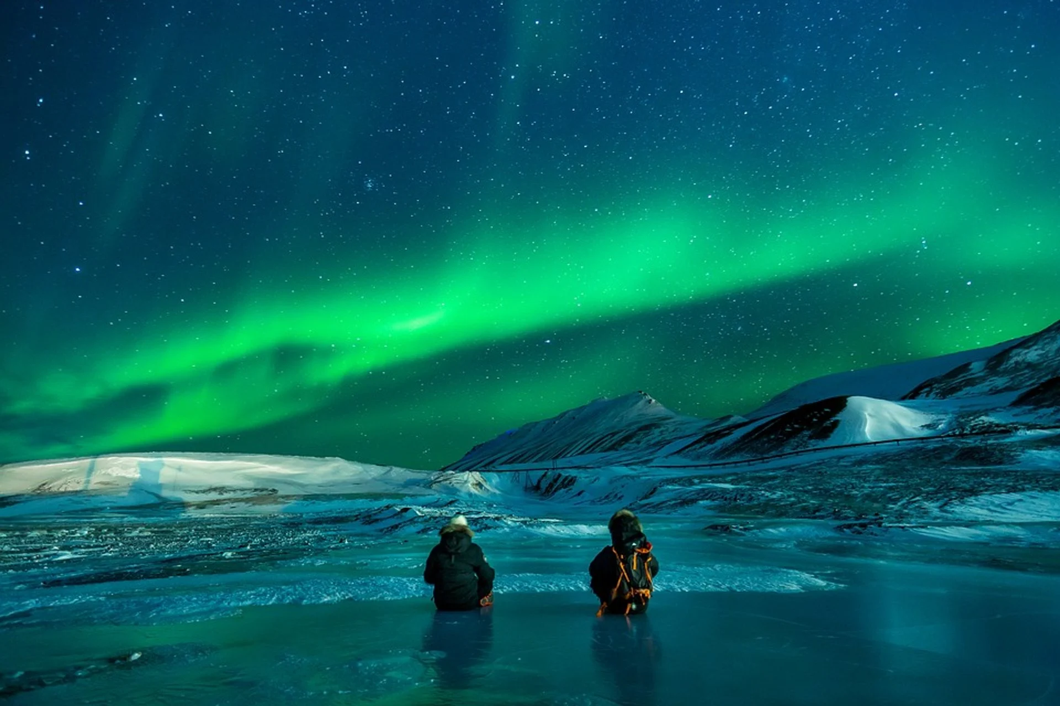
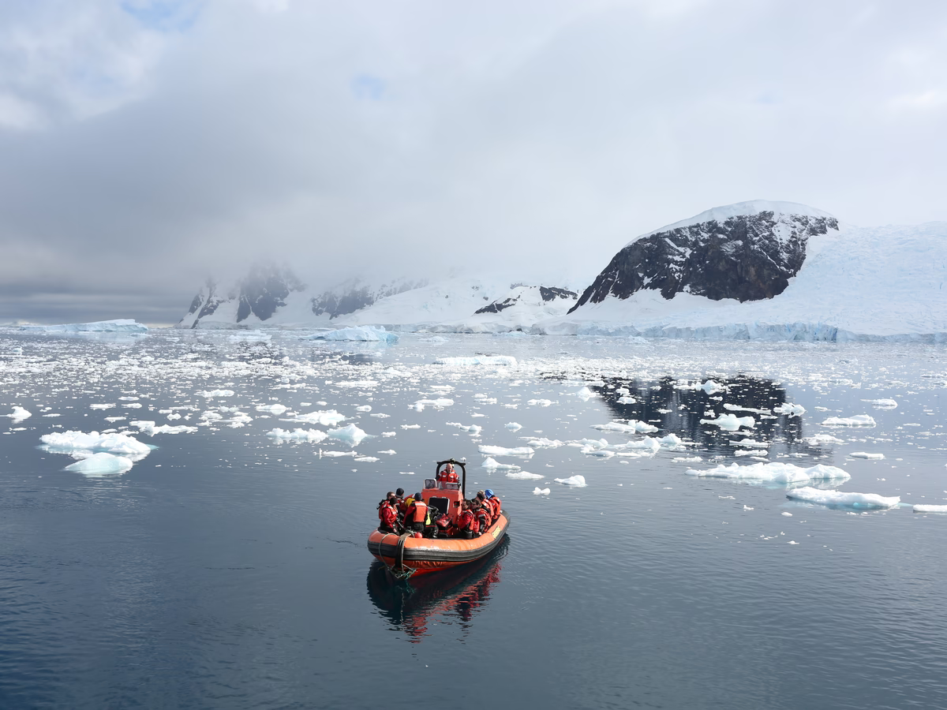
Svalbard

Slide 9
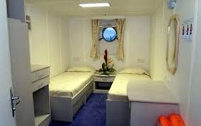
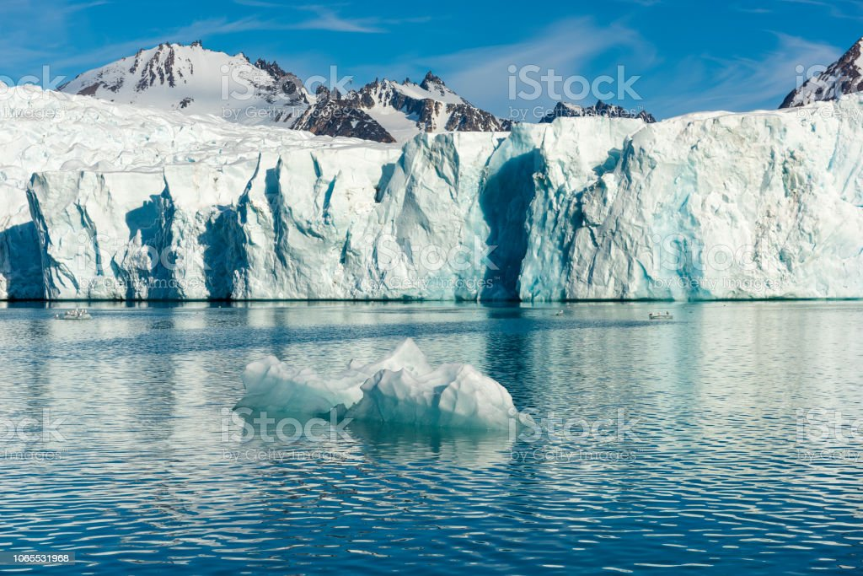
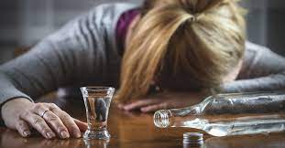
Hugo Lefevre
Notes:
I’m not sure if the drinking picture is inappropriate haha

Slide 10
Multiple Choice 1
During Nora’s speech in The Tree That Is Our Life, who inspired a lot of what she said?
Her mother
Mrs Elm
Her father
Joe

Slide 11
Discussion Question 1
Nora talks a lot about her relationship with Mrs Elm in the book. In the chapter The Tree That Is Our Life, she even uses the lessons/philosophies Mrs Elm has taught her in her speech. Why was this such a significant relationship for her?
Can you think of a mentor or someone you look up to in your life?

Slide 12
Multiple Choice 2
2. True or False: In the chapter The Tree That Is Our Life, Nora had made it to the Olympics two times and won a gold medal.

Slide 13
Discussion Question 2
2. Nora has experienced alternate lives where she achieves success in one area of her life (ex. making it to the Olympics) at the expense of all the rest.
Do you think it’s possible to reach fame/fortune and have balance with other areas of your life?

Slide 14
Multiple Choice 3
Who is Ingrid trying to escape from by taking the research position in Svalbard (page 120)?
The ghost of her husband
The ghost of her mother
The ghost of her best friend
The ghost of her ex-husband

Slide 15
Discussion Question 3
In the chapter “Svalbard,” Ingrid says, “Places are places and memories are memories and life is fucking life” (page 120).
What does she mean by this? Are there places in your life that remind you of people in your life?

Slide 16
Multiple Choice 4
True or false: In the chapter “Hugo Lefevre,” there’s more darkness than sunlight on the boat?

Slide 17
Discussion Question 4
In the chapter “Hugo Lefevre” what does Hugo say is depressing about being on the boat? Do you agree that this situation is depressing? Would you want to live like that? (page 122)

Slide 18
Crossword Puzzle!

Slide 19
1 Across:
The job Nora was assigned to on the boat, but she doesn’t know what it is.

Slide 20
S P O T T E R
1 Across:
The job Nora was assigned to on the boat, but she doesn’t know what it is.

Slide 21
S P O T T E R
2 Down:
The type of herbal tea Joe gave to Nora.

Slide 22
S P O T T E R
E
P
P
E
R
M
I
N
T
2 Down:
The type of herbal tea Joe gave to Nora.

Slide 23
S P O T T E R
E
P
P
E
R
M
I
N
T
3 Across:
Joe was Nora’s __________ in this reality.

Slide 24
S P O T T E R
E
P
P
E
R
M
I
N
T
3 Across:
Joe was Nora’s __________ in this reality.
M A N A G R

Slide 25
S P O T T E R
E
P
P
E
R
M
I
N
T
4 Down:
At the end of her speech, Nora told everyone to be _______.
M A N A G R

Slide 26
S P O T T E R
E
P
P
E
R
M
I
N
T
4 Down:
At the end of her speech, Nora told everyone to be _______.
M A N A G R
K
I
N
D

Slide 27
S P O T T E R
E
P
P
E
R
M
I
N
T
5 Down:
The man who was talking to Nora while she was eating breakfast.
M A N A G R
K
I
N
D

Slide 28
S P O T T E R
E
P
P
E
R
M
I
N
T
5 Down:
The man who was talking to Nora while she was eating breakfast.
M A N A G R
K
I
N
D
H
U
G
O

Slide 29
S P O T T E R
E
P
P
E
R
M
I
N
T
6 Down:
In her speech Nora compares her life to a ________.
M A N A G R
K
I
N
D
H
U
G
O

Slide 30
S P O T T E R
E
P
P
E
R
M
I
N
T
6 Down:
In her speech Nora compares her life to a ________.
M A N A G R
K
I
N
D
H
U
G
O
T
R
E
E

Slide 31
S P O T T E R
E
P
P
E
R
M
I
N
T
7 Across:
This person was on the boat with Nora and whose husband died.
M A N A G R
K
I
N
D
H
U
G
O
T
R
E
E

Slide 32
S P O T T E R
E
P
P
E
R
M
I
N
T
7 Across:
This person was on the boat with Nora and whose husband died.
M A N A G R
K
I
N
D
H
U
G
O
T
R
E
E
N G I

Slide 33
S P O T T E R
E
P
P
E
R
M
I
N
T
8 Across:
Someone who studies glaciers.
M A N A G R
K
I
N
D
H
U
G
O
T
R
E
E
N G I

Slide 34
S P O T T E R
E
P
P
E
R
M
I
N
T
8 Across:
Someone who studies glaciers.
M A N A G R
K
I
N
D
H
U
G
O
T
R
E
E
N G I
G L A C I L O G I S

Slide 35
S P O T T E R
E
P
P
E
R
M
I
N
T
9 Down:
Where the research center that Nora works at is located.
M A N A G R
K
I
N
D
H
U
G
O
T
R
E
E
N G I
G L A C I L O G I S

Slide 36
S P O T T E R
E
P
P
E
R
M
I
N
T
9 Down:
Where the research center that Nora works at is located.
M A N A G R
K
I
N
D
H
U
G
O
T
R
E
E
N G I
G L A C I L O G I S
V
A
L
B
A
R
D

Slide 37
S P O T T E R
E
P
P
E
R
M
I
N
T
10 Across:
Something happened to Nora in this country.
M A N A G R
K
I
N
D
H
U
G
O
T
R
E
E
N G I
G L A C I L O G I S
V
A
L
B
A
R
D

Slide 38
S P O T T E R
E
P
P
E
R
M
I
N
T
10 Across:
Something happened to Nora in this country.
M A N A G R
K
I
N
D
H
U
G
O
T
R
E
E
N G I
G L A C I L O G I S
V
A
L
B
A
R
D
P O T U G A L

Slide 39
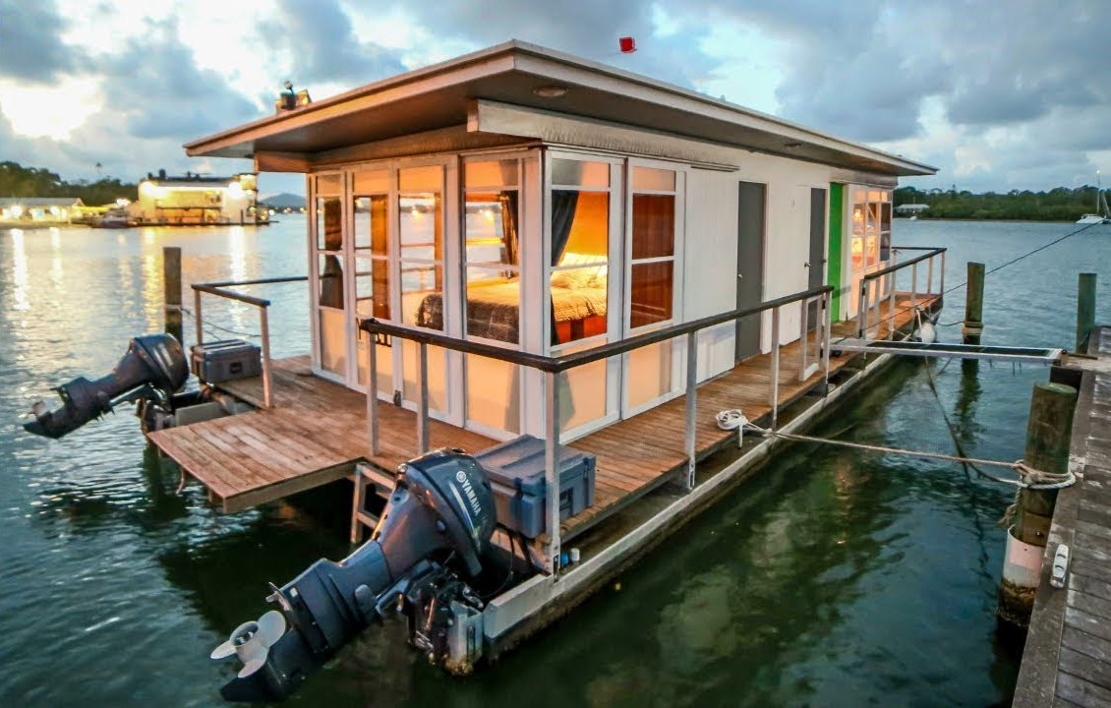
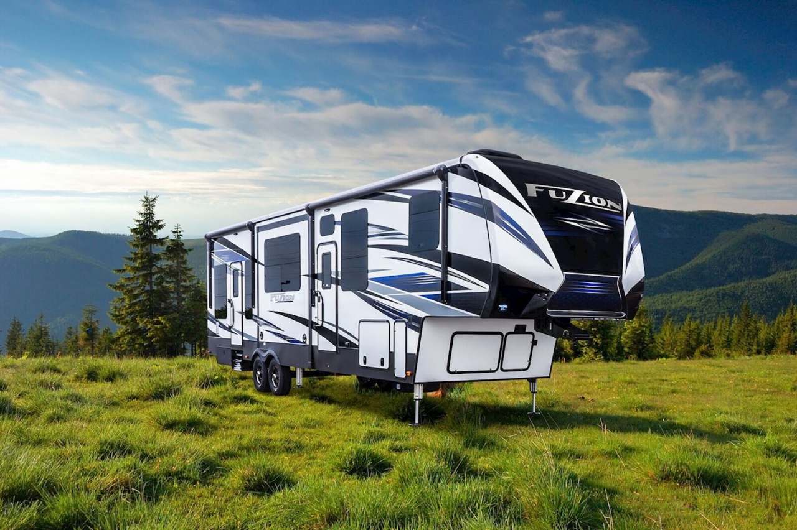
Would You Rather?
Live on a boat or an RV for the rest of your life?

Slide 40
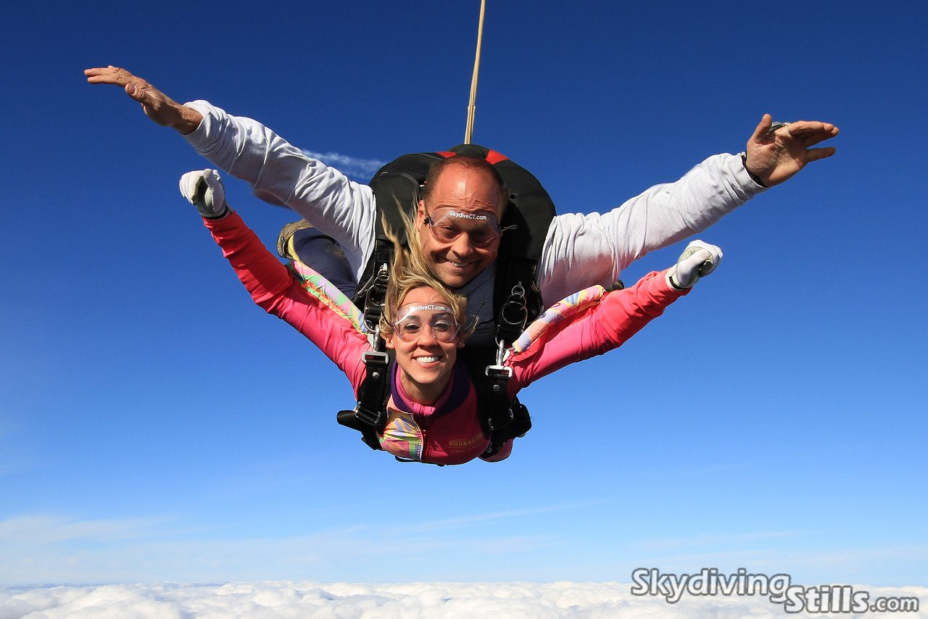
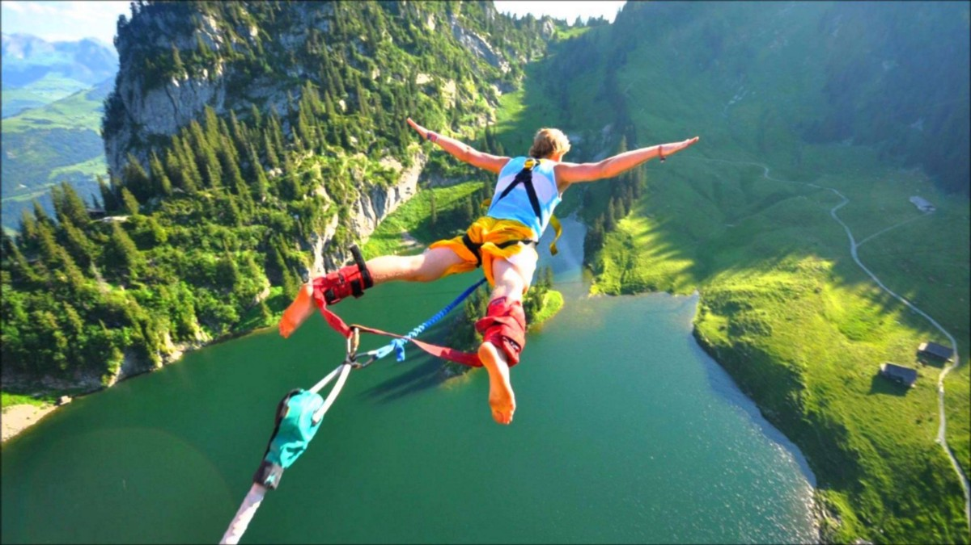
Would you Rather?
Go skydiving or bungee jumping?

Slide 41
Homework
Read Chapters Walking in Circles to Expectation
Pages 124-143
Complete worksheets A & B
Complete Crossword Puzzle
See you next week! Happy Reading!

