Slide 1
Aphasia Book Club
Week 10

Slide 2
Agenda
Weekly Check In
Character List
Chapter Summaries
Discussion Questions
Crossword Puzzle
Would You Rather
Homework

Slide 3
Weekly Check-In
Highs and lows of the week
What is your favorite spring activity?

Slide 4
Character List
Nora Seed
Mrs Elm
Ryan Bailey
Dan Lord
Brazil & Ravi
Joanna
Marcello
Joe

Slide 5
Ryan Bailey

Slide 6
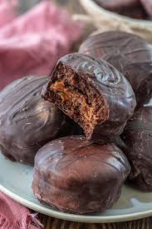
A Silver Tray of Honey Cakes

Slide 7
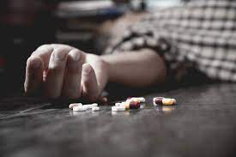
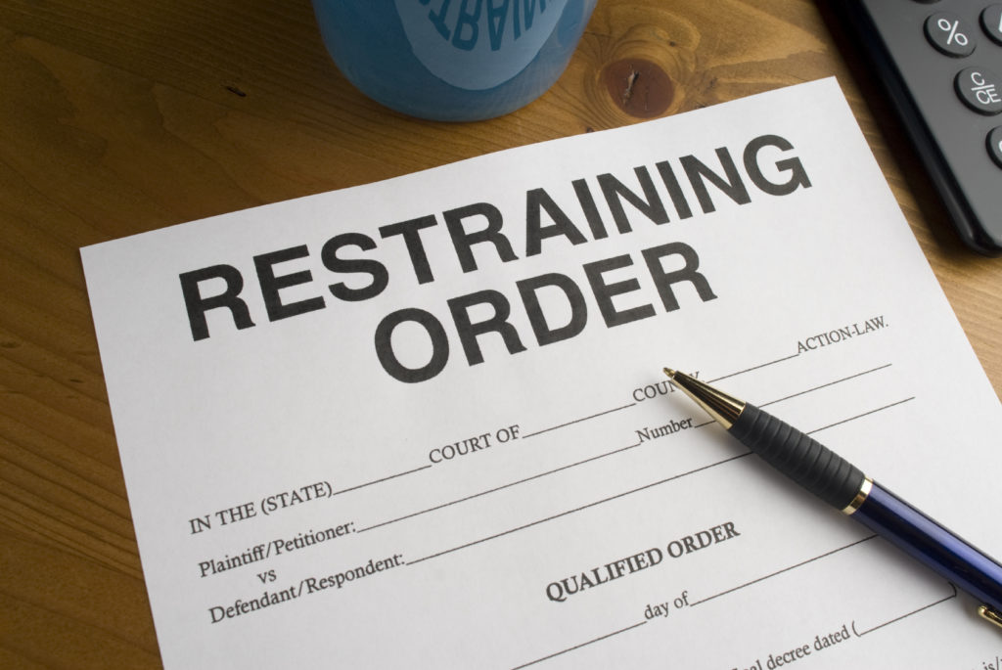
The Podcast of Revelations

Slide 8
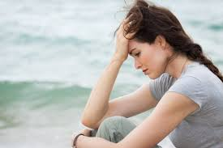
Love and Pain

Slide 9
Multiple Choice # 1
True or False: In the chapter, Love and Pain, Nora causes a mini earthquake in the library because she was having feelings of giving up.
Notes:
True

Slide 10
Discussion Question #1
In the Chapter, Love is Pain, Nora says“It seems impossible to live without hurting people. So why live it all?” (pg 186). What are your thoughts about this statement? What advice would you give to Nora about feeling this way?

Slide 11
Multiple Choice #2
In the chapter, The Podcast of Revelations, Nora walked out of the interview because she heard what news?
Her brother had overdosed in this reality
Voltaire ran away
Her mother was upset with her
Her father passed away in this reality

Slide 12
Discussion Question #2
What did you think about this storyline where Nora is famous? Do you think she would have stayed in this reality if it weren’t for the news of her brother’s overdose?

Slide 13
Multiple Choice #3
In the chapter, The Podcast of Revelations, who is interviewing Nora about her music?
A news anchor
A radio station
A music podcast
A talk show host

Slide 14
Discussion Question #3
In the chapter, The Podcast of Revelations, Nora says, “sadness is intrinsically part of the fabric of happiness. You can’t have one without the other.” (pg. 179)
What does Nora mean by this? Do you agree with this statement?

Slide 15
Multiple Choice #4
In the chapter, A Tray of Honeycakes, what body part does Nora sign an autograph on? (pg. 172)
Chest
Shoulder
Head
Leg

Slide 16
Discussion Question #4
In the chapter, A Silver Tray of Honey Cakes, one of her songs changed his life. (pg. 173)
What was the name of the song? Is there a song that makes you think of a certain memory or one that resonates with you?

Slide 17
Crossword Puzzle!

Slide 18
2 Across:
The nickname that Ryan calls Nora

Slide 19
N O N O
2 Across:
The nickname that Ryan calls Nora

Slide 20
N O N O
4 Across:
The name of the album Nora discusses on the podcast

Slide 21
N O N O
4 Across:
The name of the album Nora discusses on the podcast
P O T T E R S V I L L E

Slide 22
N O N O
5 Across:
Nora’s brother died from this
P O T T E R S V I L L E

Slide 23
N O N O
5 Across:
Nora’s brother died from this
P O T T E R S V I L L E
O V E R D O S E

Slide 24
N O N O
7 Across:
The name of the music podcast Nora was interviewed by
P O T T E R S V I L L E
O V E R D O S E

Slide 25
N O N O
7 Across:
The name of the music podcast Nora was interviewed by
P O T T E R S V I L L E
O V E R D O S E
O S O M

Slide 26
N O N O
8 Across:
Nora got a restraining order from this person
P O T T E R S V I L L E
O V E R D O S E
O S O M

Slide 27
N O N O
8 Across:
Nora got a restraining order from this person
P O T T E R S V I L L E
O V E R D O S E
O S O M
D A N

Slide 28
N O N O
9 Across:
The country Nora’s band performed in
P O T T E R S V I L L E
O V E R D O S E
O S O M
D A N

Slide 29
N O N O
9 Across:
The country Nora’s band performed in
P O T T E R S V I L L E
O V E R D O S E
O S O M
D A N
B R A Z I L

Slide 30
N O N O
10 Across:
Nora was ____ years old when she went swimming in the river
P O T T E R S V I L L E
O V E R D O S E
O S O M
D A N
B R A Z I L

Slide 31
N O N O
10 Across:
Nora was ____ years old when she went swimming in the river
P O T T E R S V I L L E
O V E R D O S E
O S O M
D A N
B R A Z I L
S E V E N T E E N

Slide 32
N O N O
1 Down:
One of Nora’s fans asked her to sign this body part
P O T T E R S V I L L E
O V E R D O S E
O S O M
D A N
B R A Z I L
S E V E N T E E N

Slide 33
S
H
U
L
D
R
N O N O
1 Down:
One of Nora’s fans asked her to sign this body part
P O T T E R S V I L L E
O V E R D O S E
O S O M
D A N
B R A Z I L
S E V E N T E E N

Slide 34
S
H
U
L
D
R
N O N O
3 Down:
Joanna told Nora she couldn’t eat these
P O T T E R S V I L L E
O V E R D O S E
O S O M
D A N
B R A Z I L
S E V E N T E E N

Slide 35
S
H
U
L
D
R
N O N O
3 Down:
Joanna told Nora she couldn’t eat these
H
N
Y
C
K
S
P O T T E R S V I L L E
O V E R D O S E
O S O M
D A N
B R A Z I L
S E V E N T E E N

Slide 36
S
H
U
L
D
R
N O N O
6 Down:
The first name of Nora’s ex-boyfriend who is an actor
H
N
Y
C
K
S
P O T T E R S V I L L E
O V E R D O S E
O S O M
D A N
B R A Z I L
S E V E N T E E N

Slide 37
S
H
U
L
D
R
N O N O
6 Down:
The first name of Nora’s ex-boyfriend who is an actor
H
N
Y
C
K
S
P O T T E R S V I L L E
O V E R D O S E
Y
A
N
O S O M
D A
B R A Z I L
S E V E N T E E N

Slide 38
Would You Rather….
Eat only pizza for a year or not eat any pizza for five years?

Slide 39
Would You Rather…
Would you rather move to a new city every week or never be able to leave the city you were born in?

Slide 40
Next Week
Read Equidistant to The Many Lives of Nora Seed
Pages 190-216
Complete Worksheet A
Complete Worksheet B
Complete Crossword Puzzle
Contact us with any questions :)

