Slide 1
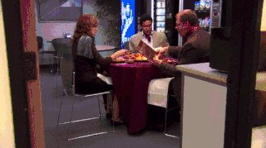
Welcome to Book Club!
Week 3

Slide 2
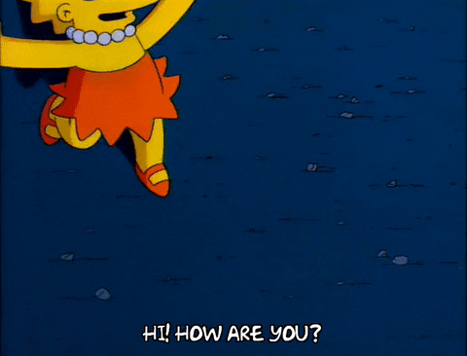
Weekly Check In!
What is one good thing that happened to you this week?
If you had to recommend one song to the group, what would it be?

Slide 3
Schedule
01
Character List
04
Crossword
02
Chapter Summaries
04
Would You Rather?
03
Discussion Questions
05
Homework

Slide 4
Characters
Nora: in this her successful life, she is a former Olympic swimmer, donates to charity, is very healthy and is about to speak at a conference.
Mrs. Elm: The Midnight Librarian
Nadia: Nora’s father’s new wife and former mistress. She is the mother of a Ukrainian Olympic swimmer. She is the love of her father’s life.
Dad: in this life he is alive. He is very healthy and happy. He cheated on Nora’s mother with Nadia in 2011.
Sally: Dad and Nadia’s family pet, who Nora assumes is a dog
Joe: clean-shaven and supportive older brother to Nora
Priya: works for Gulliver Research, who was organizing the conference
Rory: works for Celebrity Speakers. Supposedly, he and Nora know each other

Slide 5
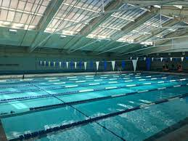
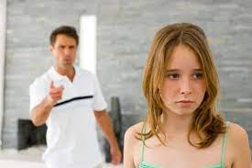
Fish Tank

Slide 6
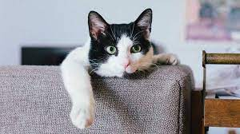
The Last Update That Nora Had Posted Before She Found Herself Between Life and Death

Slide 7
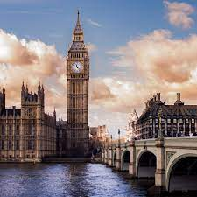
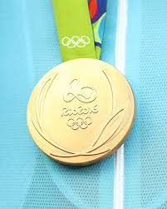
The Successful Life

Slide 8
Multiple Choice #1
Which of the following was NOT a reason Nora quit swimming?
She did not like being seen and having her body be talked about.
The father had financial issues and could not afford private swimming lessons.
The daily swims became too much as she got older. She was exhausted.
She was very shy growing up.

Slide 9
Discussion #1
While she was an amazing competitive swimmer, Nora quit swimming for many reasons: she was shy, it was an exhausting sport, and she didn’t like being seen. This was not an easy decision for her, but it needed to be done because swimming became too much. Can you think of a time when you gave up something you loved or were very good at? Why did you do that?

Slide 10
Multiple Choice #2
In her TED talk, Nora claims that “_____________ is essential to stay focused in a life filled with distraction.”
Confidence
Ignorance
Stamina
Courage

Slide 11
Discussion #2
In her TED talk, Nora says:
“People with stamina aren’t made any differently to anyone else. The only difference is they have a clear goal in mind, and a determination to get there. Stamina is essential to stay focused in a life filled with distraction.” (pg. 93)
Do you agree or disagree with Nora? When those clear goals seem hard to reach, how do you keep going when it gets really tough? What motivates you? What tools or coping methods did you use to keep you from quitting? Give examples.

Slide 12
Multiple Choice #3
Why does Mrs. Elm say that the rook is her favorite chess piece?
She likes the way it’s shaped
It’s one of the most valuable chess pieces
The other pieces are too hard to remember
It’s straightforward

Slide 13
Discussion #3
Mrs. Elm says, “You keep your eye on the queen, and the knights, and the bishop, because they are the sneaky ones. But it’s the rook that often gets you. The straightforward is never quite what it seems.” What does this mean? Has there ever been a time where you felt underestimated? Did that make you work harder or back down?

Slide 14
Multiple Choice #4
When Nora looked in her suitcase, what was her overwhelming feeling?
Loneliness
Disbelief
Confusion
Pride

Slide 15
Discussion #4
As Nora gets ready for her TED talk, she looks into her suitcase and felt profound loneliness emanating from it. Why? Can you think back to a time where you felt a profound loneliness like this? How did you handle it? Do you have advice for others who might feel lonely?

Slide 16
Crossword!

Slide 17
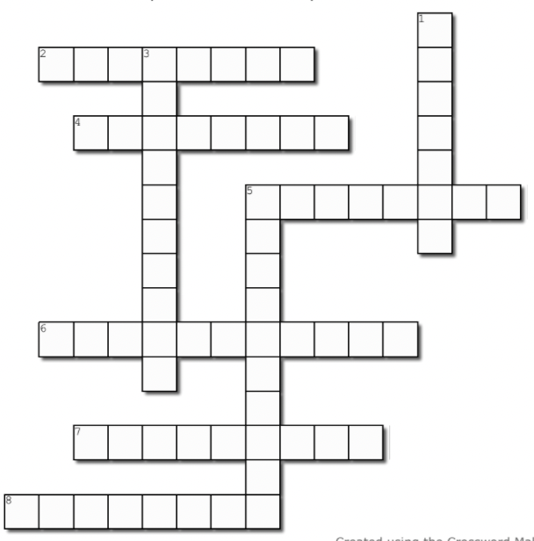
Word Bank
Speakers Swimmer
Twentyeight Olympics
Microphone Zebrafish
Facetime Successful
Swimmer Portugal
2 Across:
If Nora would’ve kept training, her dad believed she would’ve ended up in the _____. (p. 86)

Slide 18
Word Bank
Speakers Swimmer
Twentyeight Olympics
Microphone Zebrafish
Facetime Successful
Swimmer Portugal
2 Across:
If Nora would’ve kept training, her dad believed she would’ve ended up in the _____. (p. 86)

Slide 19
Word Bank
Speakers Swimmer
Twentyeight Olympics
Microphone Zebrafish
Facetime Successful
Swimmer Portugal
4 Across:
Nora was emotional when her dad wanted to ____. He died before it was invented. (p. 95)

Slide 20
Word Bank
Speakers Swimmer
Twentyeight Olympics
Microphone Zebrafish
Facetime Successful
Swimmer Portugal
4 Across:
Nora was emotional when her dad wanted to ____. He died before it was invented. (p. 95)

Slide 21
Word Bank
Speakers Swimmer
Twentyeight Olympics
Microphone Zebrafish
Facetime Successful
Swimmer Portugal
5 Across:
Rory works for Celebrity _____. (p. 99)

Slide 22
Word Bank
Speakers Swimmer
Twentyeight Olympics
Microphone Zebrafish
Facetime Successful
Swimmer Portugal
5 Across:
Rory works for Celebrity _____. (p. 99)

Slide 23
Word Bank
Speakers Swimmer
Twentyeight Olympics
Microphone Zebrafish
Facetime Successful
Swimmer Portugal
6 Across:
After going to the Olympics twice, Nora retired at age _____. (p. 92)

Slide 24
Word Bank
Speakers Swimmer
Twentyeight Olympics
Microphone Zebrafish
Facetime Successful
Swimmer Portugal
6 Across:
After going to the Olympics twice, Nora retired at age _____. (p. 92)

Slide 25
Word Bank
Speakers Swimmer
Twentyeight Olympics
Microphone Zebrafish
Facetime Successful
Swimmer Portugal
7 Across:
Testing was done on _____. It was discovered that fish also get depression. (p. 83)

Slide 26
Word Bank
Speakers Swimmer
Twentyeight Olympics
Microphone Zebrafish
Facetime Successful
Swimmer Portugal
7 Across:
Testing was done on _____. It was discovered that fish also get depression. (p. 83)

Slide 27
Word Bank
Speakers Swimmer
Twentyeight Olympics
Microphone Zebrafish
Facetime Successful
Swimmer Portugal
8 Across:
Nora’s dad was relieved she is finally getting back on her feet again mentally after _____. (p. 97)

Slide 28
Word Bank
Speakers Swimmer
Twentyeight Olympics
Microphone Zebrafish
Facetime Successful
Swimmer Portugal
8 Across:
Nora’s dad was relieved she is finally getting back on her feet again mentally after _____. (p. 97)

Slide 29
Word Bank
Speakers Swimmer
Twentyeight Olympics
Microphone Zebrafish
Facetime Successful
Swimmer Portugal
1 Down:
Nadia was the mother of a Ukrainian male _____. (p 97.)

Slide 30
Word Bank
Speakers Swimmer
Twentyeight Olympics
Microphone Zebrafish
Facetime Successful
Swimmer Portugal
1 Down:
Nadia was the mother of a Ukrainian male _____. (p 97.)

Slide 31
Word Bank
Speakers Swimmer
Twentyeight Olympics
Microphone Zebrafish
Facetime Successful
Swimmer Portugal
3 Down:
Joe reminds Nora of the nightmare in Cardiff with her _____. (p. 100)

Slide 32
Word Bank
Speakers Swimmer
Twentyeight Olympics
Microphone Zebrafish
Facetime Successful
Swimmer Portugal
3 Down:
Joe reminds Nora of the nightmare in Cardiff with her _____. (p. 100)

Slide 33
Word Bank
Speakers Swimmer
Twentyeight Olympics
Microphone Zebrafish
Facetime Successful
Swimmer Portugal
5 Down:
Nora wants to experience a life where she is not stuck and is _____. (p. 84)

Slide 34
Word Bank
Speakers Swimmer
Twentyeight Olympics
Microphone Zebrafish
Facetime Successful
Swimmer Portugal
5 Down:
Nora wants to experience a life where she is not stuck and is _____. (p. 84)

Slide 35
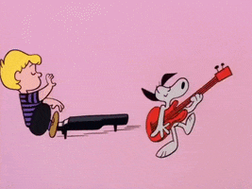
Would you Rather…
Master every type of sport?
or
Be able to play every musical instrument

Slide 36
Homework!
Worksheet A, Worksheet B, and Crossword!
Read pages 102-123
Peppermint Tea
The Tree That Is Our Life
System Error
Svalbard
Hugo Lefevre
Happy reading :)

