Slide 1
Aphasia Book Club!
Week 5

Slide 2
Weekly Check in:
How was your week?
Anything you you would like to share with group?
Highs/Lows?

Slide 3
Schedule
Character List
Chapter Summaries
Discussion Questions
Crossword
Would you rather
Homework

Slide 4
Characters
Nora Seed: Main Character
Mrs. Elm: Librarian
Voltaire: Nora’s cat
Izzy: Nora’s best friend
Dan: Nora’s ex-fiance
Charlotte: Nora’s old work friend from String Theory
Jojo: Nora’s roommate
Jared: Jojo’s friend

Slide 5
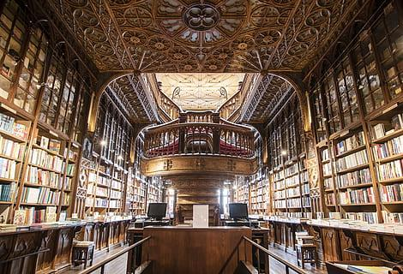
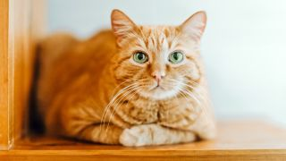
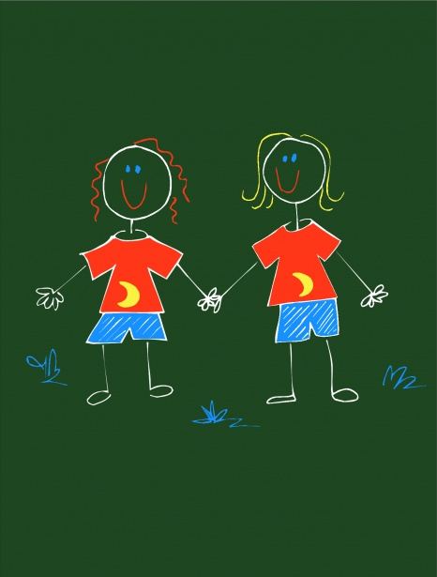
The Only Way to Learn is to Live

Slide 6
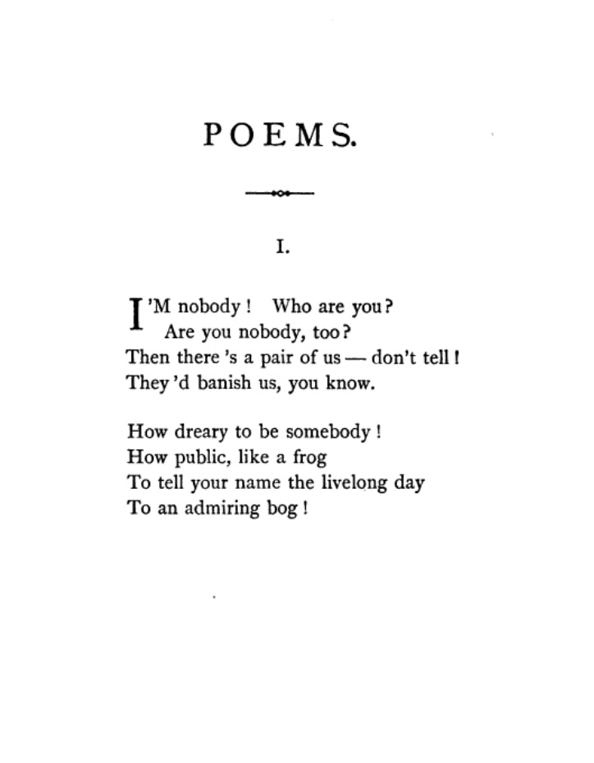
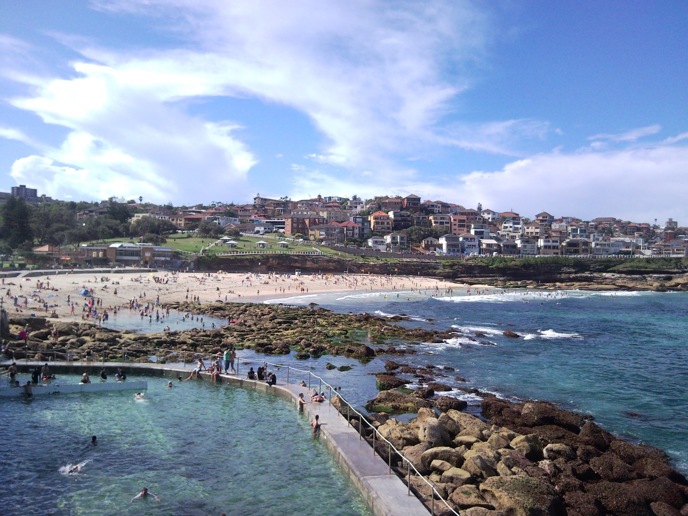
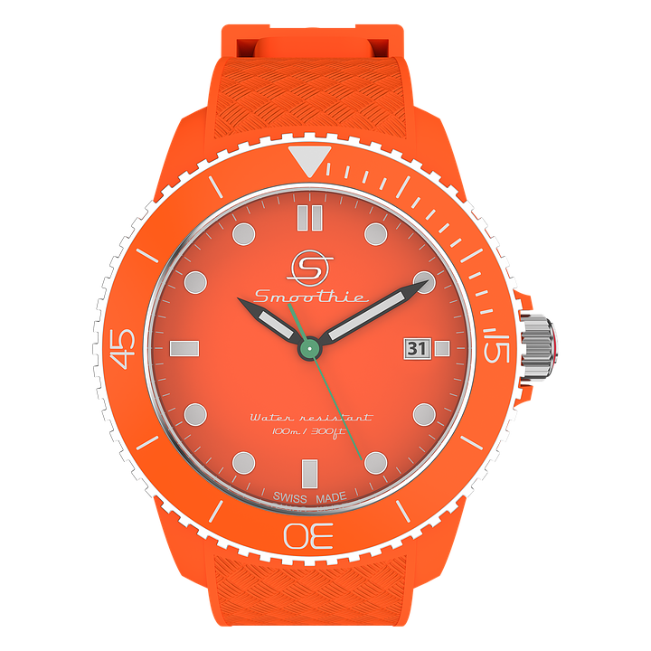
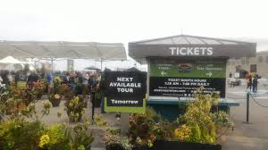
Fire

Slide 7
Nora worries that she is going to choose a life to experience where she is already___________
Famous
Dead
Miserable
In love
Multiple Choice Q #1

Slide 8
Discussion Q #1
Nora worries about choosing a reality where she is already dead. Mrs. Elm assures her that the library is one of possibility, which is the opposite of death. Do you think it is worthwhile to evaluate “what could have been”? Do you ever do that yourself?

Slide 9
Why didn’t Mrs. Elm tell Nora she wasn’t a bad cat owner instead of sending her to experience his death all over again?
She believed the only way to learn was to live
She wanted Nora to figure it out herself
She wanted Nora to get rid of her regret of being a bad cat owner
All of the above
Multiple Choice Q #2

Slide 10
Discussion Q #2
Why do you think Mrs. Elm wanted Nora to experience the death of her cat again? Do you think it was right of her to send her into that life knowing the cat had died anyway? Would you want someone to tell you your future before you experienced it yourself? Explain your answer.

Slide 11
What did Nora do to escape reality?
Sleep
Run
Knit
swim
Multiple Choice Q #3

Slide 12
Discussion Q #3
Nora talks about how she uses swimming as an escape from reality. Is there something that you do to take a break, or “escape” from reality?

Slide 13
What did Nora want to be when she was younger?
Teacher
Scientists in the National Geographic magazines
Chief Executive Officer
Attorney
Multiple Choice Q #4

Slide 14
Discussion Q #4
Nora talks about how she studied hard in science and geography when in school because she wanted to be like the scientists in the National Geographic magazines. What did you want to be when you were younger?

Slide 15
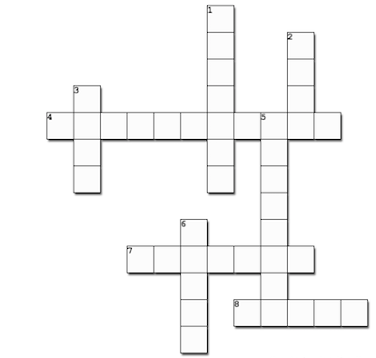
Crossword
1 Down:
Title of book of her life with Izzy (2 Words)

Slide 16
Crossword
M
Y
1 Down:
Title of book of her life with Izzy (2 Words)
L
I
F
E

Slide 17
Crossword
M
Y
2 Down:
Type of Water in the swimming pool she was in, in Australia
L
I
F
E

Slide 18
Crossword
M
Y
S
A
2 Down:
Type of Water in the swimming pool she was in, in Australia
L
L
I
T
F
E

Slide 19
Crossword
M
Y
S
A
3 Down:
Name of Nora’s roommate in Australia
L
L
I
T
F
E

Slide 20
Crossword
M
Y
S
A
3 Down:
Name of Nora’s roommate in Australia
J
L
L
O
I
T
J
F
O
E

Slide 21
Crossword
M
Y
S
A
4 Across
The midnight library is not a library of corpses, but a library of….
J
L
L
O
I
T
J
F
O
E

Slide 22
Crossword
M
Y
S
A
4 Across
The midnight library is not a library of corpses, but a library of….
J
L
L
P
O
S
S
I
B
I
L
I
T
Y
J
F
O
E

Slide 23
Crossword
M
Y
S
A
5 Down
The amount of possible universes in which Nora lives
J
L
L
P
O
S
S
I
B
I
L
I
T
Y
J
F
O
E

Slide 24
Crossword
M
Y
S
A
5 Down
The amount of possible universes in which Nora lives
J
L
L
P
O
S
S
I
B
I
L
I
T
Y
J
F
N
O
E
F
I
N
I
I
T
E

Slide 25
Crossword
M
Y
S
A
6 Down
In the library, Nora couldn’t get hungry, thirsty, or tired, but she could get______
J
L
L
P
O
S
S
I
B
I
L
I
T
Y
J
F
N
O
E
F
I
N
I
I
T
E

Slide 26
Crossword
M
Y
S
A
6 Down
In the library, Nora couldn’t get hungry, thirsty, or tired, but she could get______
J
L
L
P
O
S
S
I
B
I
L
I
T
Y
J
F
N
O
E
F
I
B
N
I
O
I
R
T
E
E
D

Slide 27
Crossword
M
Y
S
A
J
L
L
7 Across
What is the tattoo she has in Australia just below her shoulder of?
P
O
S
S
I
B
I
L
I
T
Y
J
F
N
O
E
F
I
B
N
I
O
I
R
T
E
E
D

Slide 28
Crossword
M
Y
S
A
7 Across
What is the tattoo she has in Australia just below her shoulder of?
J
L
L
P
O
S
S
I
B
I
L
I
T
Y
J
F
N
O
E
F
I
B
N
I
P
h
O
E
N
I
X
R
T
E
E
D

Slide 29
Crossword
M
Y
S
A
8 Across
Where Nora works selling tickets
J
L
L
P
O
S
S
I
B
I
L
I
T
Y
J
F
N
O
E
F
I
B
N
I
P
h
O
E
N
I
X
R
T
E
E
D

Slide 30
Crossword
M
Y
S
A
8 Across
Where Nora works selling tickets
J
L
L
P
O
S
S
I
B
I
L
I
T
Y
J
F
N
O
E
F
I
B
N
I
P
h
O
E
N
I
X
R
T
E
F
E
R
R
Y
D

Slide 31
Would you rather?
Read a book about your past
Read a book about your future

Slide 32
Would you rather?
Live in Australia
Live in the UK

Slide 33
Homework
Read :
Fishtank
The last update that Nora posted before she found herself between life and death
The Successful Life
Worksheet A, Worksheet B, Crossword
See you next week! :)

