Slide 1
Aphasia Book Club
Week 4

Slide 2
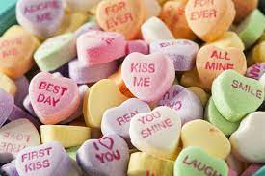
What holiday is coming up next week?
Are you celebrating? If so what are you doing?
How do you show your loved ones you care about them?

Slide 3
Weekly Check-In
How was your week? Anything you would like to share with the group?
Highs/Lows?

Slide 4
Schedule
Character List
Chapter Summaries
Discussion Questions
Crossword
Would You Rather?
Homework

Slide 5
Character List
Nora Seed: Main character
Mrs Elm: Librarian
Dan: Nora’s husband
Voltaire: Nora’s cat
Erin: Who Dan cheated on Nora with in Nora’s alternate reality.
Izzy: Nora’s friend
Notes:
https://www.bookcompanion.com/the_midnight_library_character_list.html ← character list I found online (may be helpful later on)

Slide 6
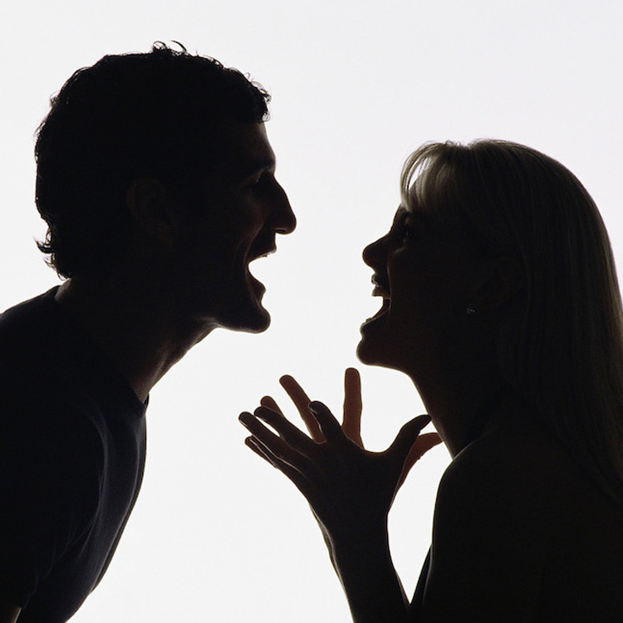
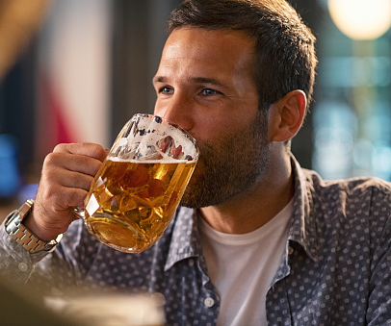
The Three Horseshoes
Notes:
Dan drinks a lot (more than Nora remembered) → Dan was unfaithful
Start arguing before bed and that’s when Nora realizes she doesn’t regret not marrying Dan

Slide 7
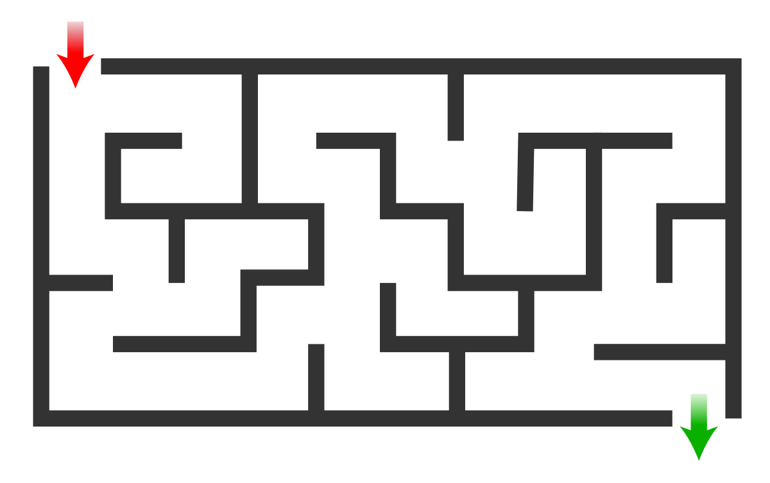
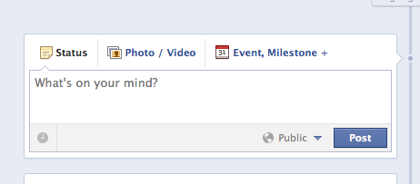
The Penultimate Update Nora Had Posted Before She Found Herself Between Life and Death

Slide 8
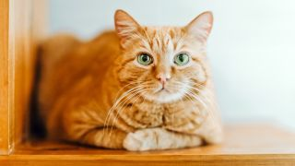
The Chessboard
Notes:
Wishes she could’ve taken better care of voltaire
Goes back to a reality where voltaire isnt dead

Slide 9
Multiple Choice 1
What was the first “alternate life” Nora decided to explore?
She never quit her band.
She married Dan.
She never quit swimming.
Her mother never passed away.

Slide 10
Discussion Question 1
When Nora looks at what her life would have been if she had married Dan, she realizes that this version of her life is not what she expected. What do you think about this realization? Can you think of a specific thing you wish you had done in your life that you didn’t do?
Notes:
Points to Lead Discussion:
-The grass may not be greener on the other side
-Maybe some things we regret not doing doesn’t turn out the way we expected. What do you think about this realization?
-Does this change the perspective about your own regrets?

Slide 11
Multiple Choice 2
True or False: Nora’s cat has a different name in the alternate reality where she marries Dan.

Slide 12
Discussion Question 2
We meet a different version of Voltaire in “The Three Horseshoes” chapter. Considering there is a cat on the front cover of this book and Nora clearly loves cats, what role do you think cats might play in the rest of the book? Will there be more Voltaires?
Notes:
Points to Lead Discussion:
-Volts pops up in almost every chapter
-Make some predictions on this observation
-What might Volts symbolize?
-Small detail that may mean a lot later in the story

Slide 13
Multiple Choice 3
In the chapter “The Penultimate Update Nora Had Posted Before She Found Herself Between Life and Death,” what does Nora compare her life to?
A rollercoaster
A horror film
A ferris wheel
A maze

Slide 14
Discussion Question 3
In the chapter “The Penultimate Update Nora Had Posted Before She Found Herself Between Life and Death,” why does Nora resent herself?
Was there ever a time in your life where you felt dissatisfaction towards a situation, person or life? How did you handle it?

Slide 15
Multiple Choice 4
In the chapter “The Chessboard” what did Nora say about Dan?
“Dan wasn’t like that”
“Dan was a drunk”
“Dan was a good husband ”
“Dan wasn’t faithful to her”

Slide 16
Discussion Question 4
In the chapter “The Chessboard” what did Nora say about Dan’s personality?
Was there someone in your life that you were close with, but their personality changed? How did that make you feel?

Slide 17
Crossword Puzzle!

Slide 18
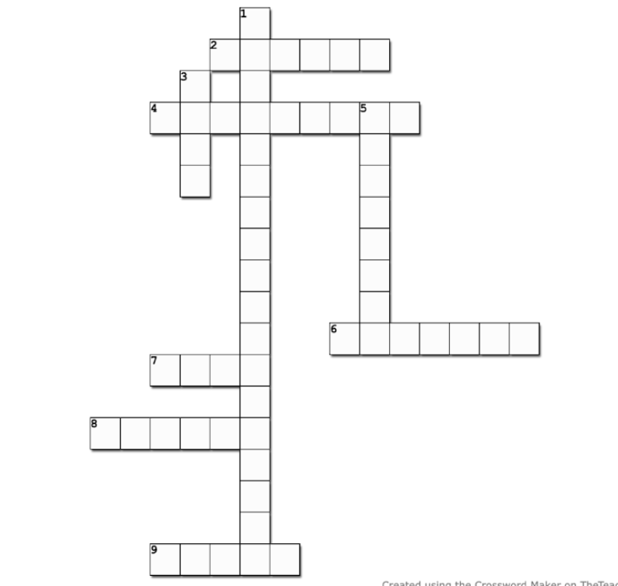
2 Across:
The amount of time (in minutes) Nora was in the alternate reality (pg. 62)

Slide 19
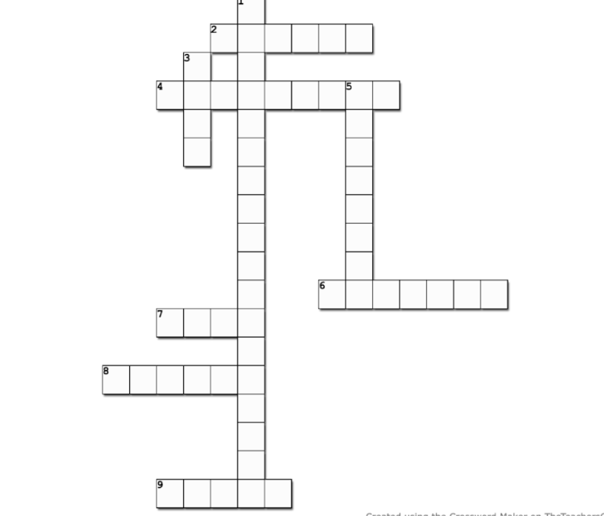
T H I R T Y
2 Across:
The amount of time (in minutes) Nora was in the alternate reality (pg. 62)

Slide 20
4 Across:
Nora’s friend Izzy is living here (pg. 51)
T H I R T Y

Slide 21
4 Across:
Nora’s friend Izzy is living here (pg. 51)
T H I R T Y
A U S T R A L I A

Slide 22
6 Across:
The Three Horseshoes pub was located in this country (pg. 44)
T H I R T Y
A U S T R A L I A

Slide 23
6 Across:
The Three Horseshoes pub was located in this country (pg. 44)
T H I R T Y
A U S T R A L I A
E N G L A N D

Slide 24
7 Across:
The t-shirt Dan was wearing that triggered bad memories for Nora (pg. 55)
T H I R T Y
A U S T R A L I A
E N G L A N D

Slide 25
7 Across:
The t-shirt Dan was wearing that triggered bad memories for Nora (pg. 55)
T H I R T Y
A U S T R A L I A
E N G L A N D
J A W S

Slide 26
8 Across:
Izzy sent Nora a picture of these via text message (pg. 51)
T H I R T Y
A U S T R A L I A
E N G L A N D
J A W S

Slide 27
8 Across:
Izzy sent Nora a picture of these via text message (pg. 51)
T H I R T Y
A U S T R A L I A
E N G L A N D
J A W S
W H A L E S

Slide 28
9 Across:
The game Mrs. Elm was playing by herself (pg. 61)
T H I R T Y
A U S T R A L I A
E N G L A N D
J A W S
W H A L E S

Slide 29
9 Across:
The game Mrs. Elm was playing by herself (pg. 61)
T H I R T Y
A U S T R A L I A
E N G L A N D
J A W S
W H A L E S
C H E S S

Slide 30
1 Down:
The name of Dan and Nora’s pub (pg. 42)
T H I R T Y
A U S T R A L I A
E N G L A N D
J A W S
W H A L E S
C H E S S

Slide 31
1 Down:
The name of Dan and Nora’s pub (pg. 42)
T
E
T
H
R
E E H
O
R
E
H
O
E
T H I R T Y
A U S R A L I A
E N G L A N D
J A W S
W H A L E S
C H E S S
Notes:
**I cant for the life of me figure out how to do the formatting for the down ones

Slide 32
3 Down:
The pub was hosting a _____ night when Nora arrived (pg. 42)
T
E
T
H
R
E E H
O
R
E
H
O
E
T H I R T Y
A U S R A L I A
E N G L A N D
J A W S
W H A L E S
C H E S S
Notes:
**I cant for the life of me figure out how to do the formatting for the down ones

Slide 33
3 Down:
The pub was hosting a _____ night when Nora arrived (pg. 42)
T
E
T
H
R
E E H
O
R
E
H
O
E
T H I R T Y
Q
I
Z
A U S R A L I A
E N G L A N D
J A W S
W H A L E S
C H E S S
Notes:
**I cant for the life of me figure out how to do the formatting for the down ones

Slide 34
5 Down:
A twenty sided polygon is called this (pg. 58)
T
E
T
H
R
E E H
O
R
E
H
O
E
T H I R T Y
Q
I
Z
A U S R A L I A
E N G L A N D
J A W S
W H A L E S
C H E S S
Notes:
**I cant for the life of me figure out how to do the formatting for the down ones

Slide 35
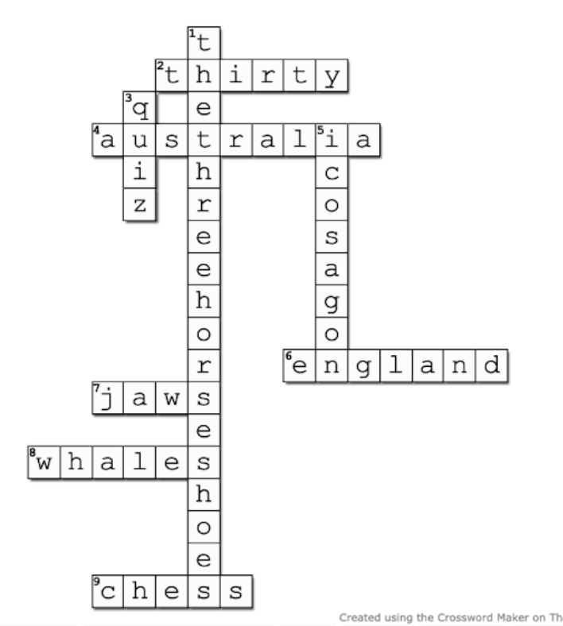
5 Down:
A twenty sided polygon is called this (pg. 58)

Slide 36
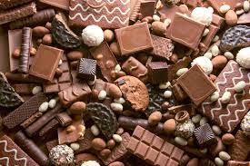
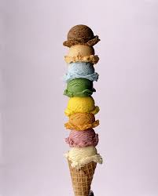
Would You Rather……
Eat Chocolate or Ice Cream
Notes:
-Ask them what their favorite kind of chocolate/ice cream is

Slide 37
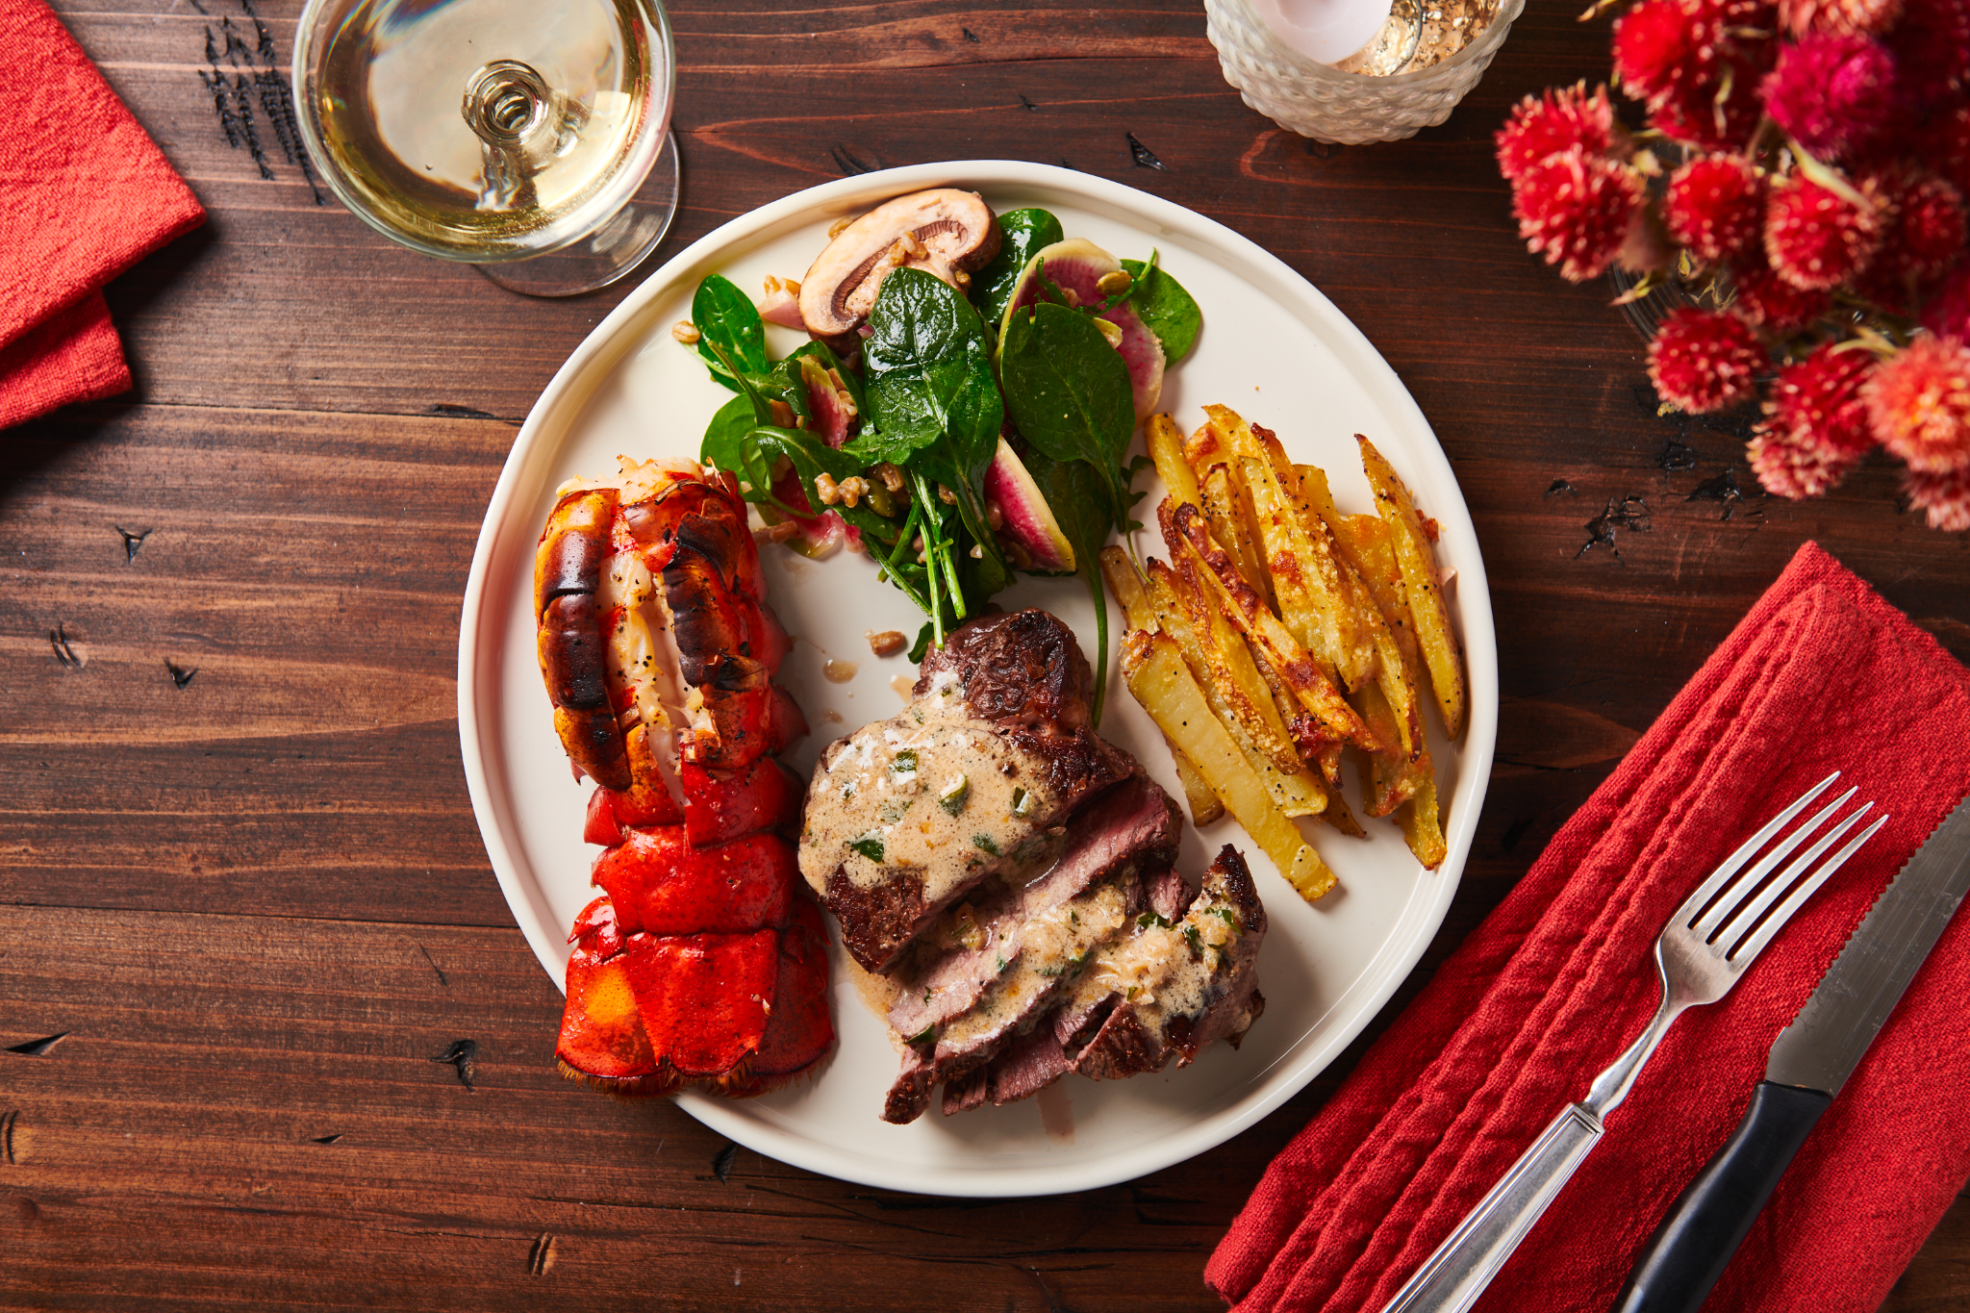
Would You Rather……
Stay in for Valentines Day or Go Out?
Notes:
-Go our for

Slide 38
For Next Week
Read “The Only Way to Learn is to Live” to “Fire”
Pages 64-82
Complete Worksheets A & B
Complete Crossword Puzzle
See you next week :)

