Slide 1
Aphasia Book Club
Week 3

Slide 2
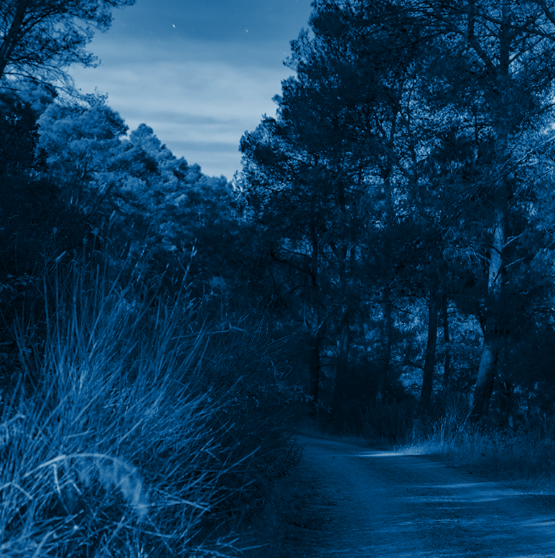
Introductions/Weekly Check-In
Your name
Where you’re from
How long you have been attending Book Club
Any highs/lows of this week?

Slide 3
Goals for ABC 1
James: pick one paragraph, read it 10 times out loud focusing on prosody
Liz: have patience with yourself when reading
Sean: reread chapter three times
Andy: reread chapter two times (focus on characters)
Joe: takes notes on summaries
Judy: working on the crossword puzzle, worksheets,
John: figure out the best way to read so you can successful for homework
Bill: reread chapter three times and practice reading aloud as you’re going through
Phil: continue to get better and live my life!

Slide 4
Goals for ABC 2
Liz: have patience with yourself when reading
Ted: do the crossword puzzle without the wordbank; read 2-3 pages out loud
John N: try reading one paragraph out loud

Slide 5
Goals Check-In
How did you work on your goal this week?

Slide 6
Plan for Today
Character List
Chapter Summaries
Discussion Questions
Crossword
Would You Rather?
Homework

Slide 7
Character List
Nora Seed: 35 year old woman who feels like her life is hopeless. She recently decided to die
Mrs. Elm: the librarian of the Midnight Library, who Nora admired growing up
Dan: Nora’s ex-fiancé, who she has regrets with for leaving him right before their wedding

Slide 8
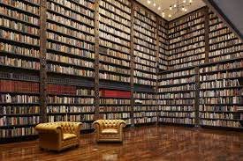
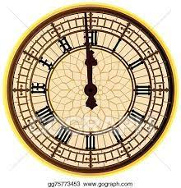
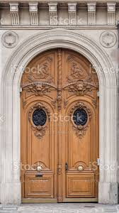
Chapter Summary: “00:00:00”

Slide 9
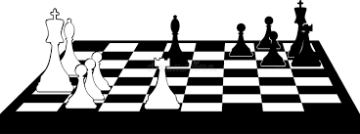
Chapter Summary: “The Librarian”

Slide 10
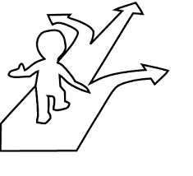
Chapter Summary: “The Midnight Library”

Slide 11
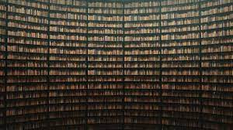
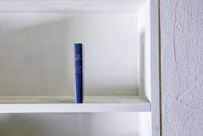
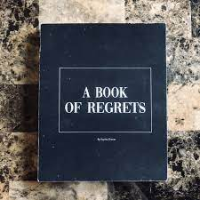
Chapter Summary: “The Moving Shelves”

Slide 12
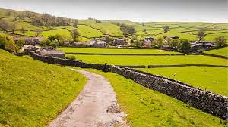
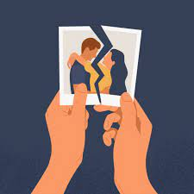
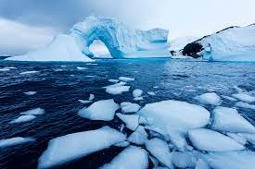
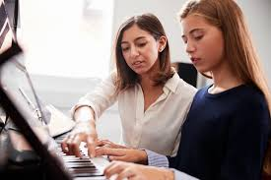
Chapter Summary: “The Book of Regrets”

Slide 13
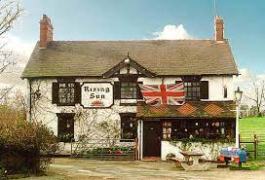
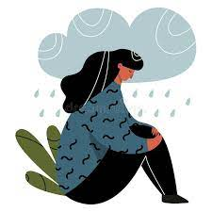
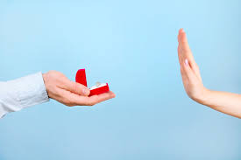
Chapter Summary: “Regret Overload”

Slide 14
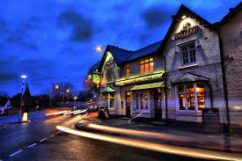
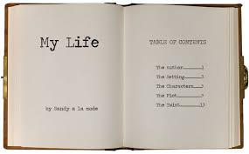
Chapter Summary: “Every Life Begins Now”

Slide 15
Discussion and Multiple Choice Questions

Slide 16
Discussion #1
Mrs. Elms was a teacher who was always there for Nora growing up. She reminded Nora of her potential and was always so supportive. Did you have a person (a coach, a neighbor, a friend) like that in your life? Are you that kind of person to someone else?

Slide 17
Multiple Choice #1
Nora reconnected with Mrs. Elm at The Midnight Library. How did Nora feel when she saw her?
Nora did not recognize Mrs. Elm and needed to be reminded of who she was.
Nora felt scared because Mrs. Elm used to try to get her in trouble with the school.
Nora was jealous that Mrs. Elm was chosen head of the library and Nora was not.
Nora felt comforted because Mrs. Elm was always there for her as a beloved librarian.

Slide 18
Discussion #2
As Mrs. Elm tells Nora how The Midnight Library works, she asks her, what would you have done differently, if you had the chance to redo your regrets? Have you ever thought about if you made a different choice, what your life would be like now? What would you have done differently, if anything? Can you think of something that you thought was a poor decision at the time you made it, but now see as a positive?

Slide 19
Multiple Choice #2
Which of the following was NOT one of the major regrets that Nora had?
She did not marry Dan.
She decided to quit swimming even though she was the best.
She has never owned a dog.
She never had any children.

Slide 20
Discussion #3
If you somehow ended up in a place like The Midnight Library, how do you think you would handle it? If given the choice, would you want to see all the different outcomes that your life could have taken? Why or why not?

Slide 21
Multiple Choice #3
Mrs. Elm explains that The Midnight Library is a place between life and death, and that Nora is getting a chance to change her life. How did she initially react to that news?
Grateful
Keeps an open mind
Devastated
Angry

Slide 22
Discussion #4
Do you believe that different variations of your life could all be taking place at the same time? Who do you imagine you would be in another variation?

Slide 23
Multiple Choice #4
True or False?
Nora embraces this chance of exploring different variations of her life and begins to think deeply about her regrets.

Slide 24
Crossword Puzzle

Slide 25
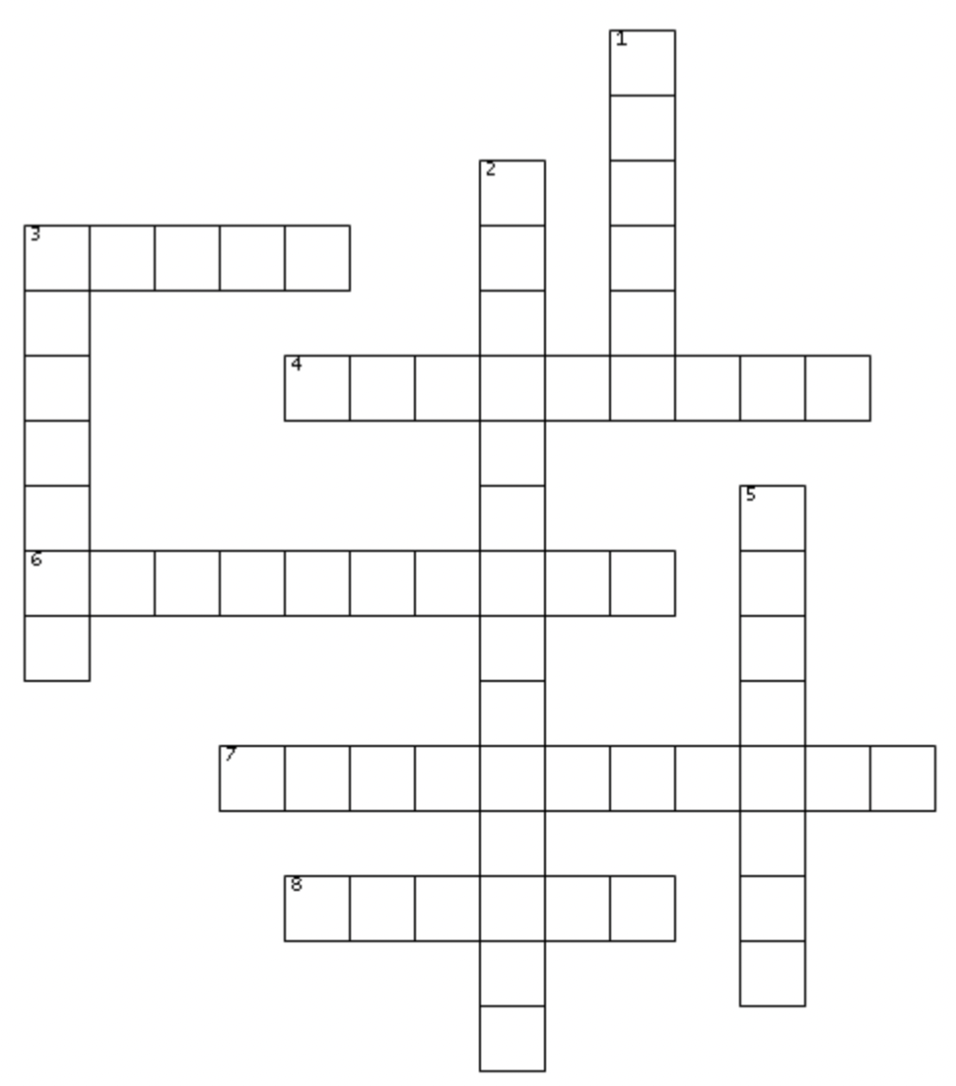
Word Bank
thirtyfour mylife
disappointment regrets
rugby mrselm
becareful midnight
countryside
3 Across:
Nora’s father was playing _____ when he died of a heart attack

Slide 26
Word Bank
thirtyfour mylife
disappointment regrets
rugby mrselm
becareful midnight
countryside
r u g b y
3 Across:
Nora’s father was playing _____ when he died of a heart attack

Slide 27
Word Bank
thirtyfour mylife
disappointment regrets
rugby mrselm
becareful midnight
countryside
r u g b y
4 Across:
When she grabbed a book, Nora heard a voice say: ______.

Slide 28
Word Bank
thirtyfour mylife
disappointment regrets
rugby mrselm
becareful midnight
countryside
r u g b y
b e c a r e f u l
4 Across:
When she grabbed a book, Nora heard a voice say: ______.

Slide 29
Word Bank
thirtyfour mylife
disappointment regrets
rugby mrselm
becareful midnight
countryside
r u g b y
b e c a r e f u l
6 Across:
The age where Nora had the longest chapter was _______.

Slide 30
Word Bank
thirtyfour mylife
disappointment regrets
rugby mrselm
becareful midnight
countryside
r u g b y
b e c a r e f u l
t h i r t y f o u r
6 Across:
The age where Nora had the longest chapter was _______.

Slide 31
Word Bank
thirtyfour mylife
disappointment regrets
rugby mrselm
becareful midnight
countryside
r u g b y
b e c a r e f u l
t h i r t y f o u r
7 Across:
Dan dreamed of owning a pub in the _______.

Slide 32
Word Bank
thirtyfour mylife
disappointment regrets
rugby mrselm
becareful midnight
countryside
r u g b y
b e c a r e f u l
t h i r t y f o u r
7 Across:
Dan dreamed of owning a pub in the _______.
c o u n t r y s i d e

Slide 33
Word Bank
thirtyfour mylife
disappointment regrets
rugby mrselm
becareful midnight
countryside
r u g b y
b e c a r e f u l
t h i r t y f o u r
8 Across:
The name of the librarian is _______.
c o u n t r y s i d e

Slide 34
Word Bank
thirtyfour mylife
disappointment regrets
rugby mrselm
becareful midnight
countryside
r u g b y
b e c a r e f u l
t h i r t y f o u r
8 Across:
The name of the librarian is _______.
c o u n t r y s i d e
m r s e l m

Slide 35
Word Bank
thirtyfour mylife
disappointment regrets
rugby mrselm
becareful midnight
countryside
r u g b y
b e c a r e f u l
t h i r t y f o u r
1 Down:
The name of the book that is green and smaller than the Book of Regrets.
c o u n t r y s i d e
m r s e l m

Slide 36
m
Word Bank
thirtyfour mylife
disappointment regrets
rugby mrselm
becareful midnight
countryside
y
l
r u g b y
i
f
b e c a r e f u l
t h i r t y f o u r
1 Down:
The name of the book that is green and smaller than the Book of Regrets.
c o u n t r y s i d e
m r s e l m

Slide 37
m
Word Bank
thirtyfour mylife
disappointment regrets
rugby mrselm
becareful midnight
countryside
y
l
r u g b y
i
f
b e c a r e f u l
t h i r t y f o u r
2 Down:
Mrs. Elm says Nora will come back to the Midnight Library when __________ is felt in full.
c o u n t r y s i d e
m r s e l m

Slide 38
m
Word Bank
thirtyfour mylife
disappointment regrets
rugby mrselm
becareful midnight
countryside
y
d
l
r u g b y
i
i
s
f
b e c a r e f u l
p
p
t h i r t y f o u r
i
2 Down:
Mrs. Elm says Nora will come back to the Midnight Library when __________ is felt in full.
n
c o u n t r y s i d e
m
m r s e l m
n
t

Slide 39
m
Word Bank
thirtyfour mylife
disappointment regrets
rugby mrselm
becareful midnight
countryside
y
d
l
r u g b y
i
i
s
f
b e c a r e f u l
p
p
t h i r t y f o u r
i
3 Down:
The stone-grey book is full of Nora’s ______.
n
c o u n t r y s i d e
m
m r s e l m
n
t

Slide 40
m
Word Bank
thirtyfour mylife
disappointment regrets
rugby mrselm
becareful midnight
countryside
y
d
l
r u g b y
i
i
e
s
f
g
b e c a r e f u l
r
p
e
p
t h i r t y f o u r
s
i
3 Down:
The stone-grey book is full of Nora’s ______.
n
c o u n t r y s i d e
m
m r s e l m
n
t

Slide 41
m
Word Bank
thirtyfour mylife
disappointment regrets
rugby mrselm
becareful midnight
countryside
y
d
l
r u g b y
i
i
e
s
f
g
b e c a r e f u l
r
p
e
p
t h i r t y f o u r
s
i
n
5 Down:
The time on Nora’s watch.
c o u n t r y s i d e
m
m r s e l m
n
t

Slide 42
m
Word Bank
thirtyfour mylife
disappointment regrets
rugby mrselm
becareful midnight
countryside
y
d
l
r u g b y
i
i
e
s
f
g
b e c a r e f u l
r
p
e
p
m
t h i r t y f o u r
i
s
i
d
n
n
5 Down:
The time on Nora’s watch.
c o u n t r y s i d e
m
g
m r s e l m
h
n
t
t

Slide 43
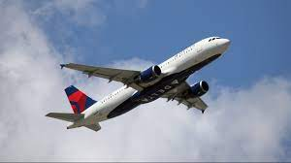
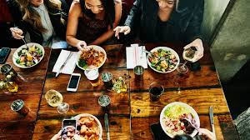
Would you rather…
or
Travel everywhere for free Eat everywhere for free

Slide 44
See you next week!!
Homework: Read pages 42 - 41 (The Three Horseshoes - The Chessboard)
Please email us with any questions :)

