Slide 1
Aphasia
Book
Club
Welcome to Week 2!

Slide 2
Welcome Back!
Highs? Lows?

Slide 3
Goals:
What is everyone’s goal for this semester? Make sure it is different from last semester’s!

Slide 4
Character List
Nora Seed
Mrs. Elms
Nora’s Mother
Ash
Neil
Dan
Ravi
Joe
Kerry-Anne
Izzy
Doreen
Leo
Mr. Banerjee

Slide 5
A Conversation About Rain

Slide 6
The Man at the Door

Slide 7
String Theory

Slide 8
To Live Is To Suffer

Slide 9
Doors

Slide 10
How To Be A Black Hole

Slide 11
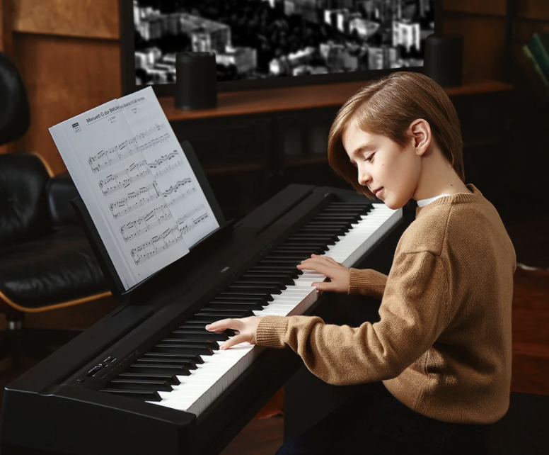
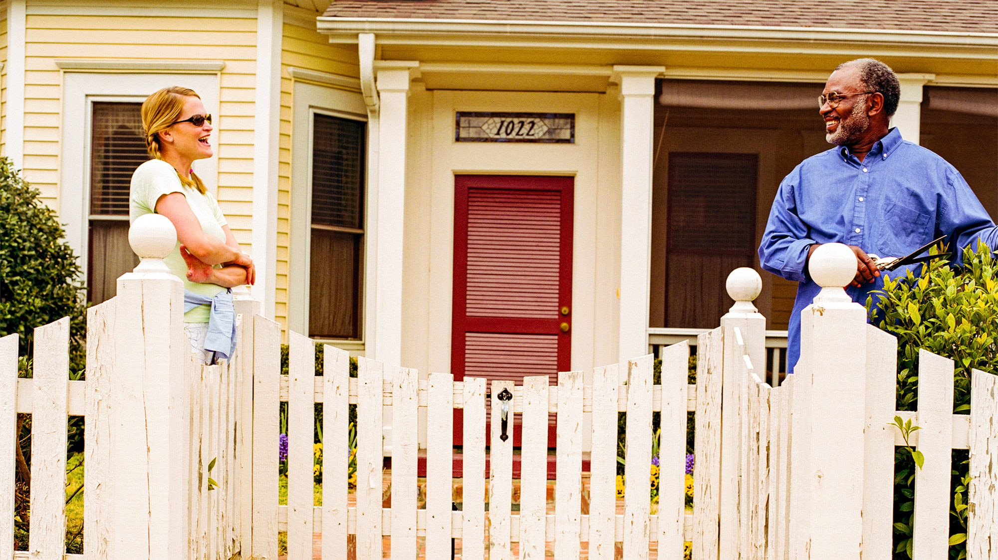
Antimatter

Slide 12
Discussion Question 1
When Nora was younger, where did she escape to? Is there any place you go to as an escape from the real world, or go to relax

Slide 13
Discussion Question 2
What type of instrument does Nora teach? Have you played any instruments in your life? If so, what types? What type of music did you like to play, or do you enjoy listening to?

Slide 14
Discussion Question 3
Where does Nora’s brother move to? Why didn’t Nora move away from Bedford? If there was one place in the world you could move to, where would it be?

Slide 15
Discussion Question 4
Why does Neil, Nora’s boss at String Theory, let Nora go? Do you think he is trying to be kind by letting her go? Have you ever been fired from a job or had to fire someone?

Slide 16
Multiple Choice 1
1. When Nora was younger, she would go to the library to escape from the real world. Why does she like being there so much?
Because her house is boring and she doesn’t own any books
Because she has estranged relationships with her family
Because she has a crush on a boy who is always there
Because she is able to swim there

Slide 17
Multiple Choice 2
2. Why did Doreen tell Nora she no longer needs to be Leo’s piano instructor?
Because Leo is too busy to play piano with school work
Because Leo did not like Nora
Because Doreen felt Leo needed a different instructor
Because Nora was not good at teaching piano

Slide 18
Multiple Choice 3
3. What type of job did Nora’s brother take when he moved away?
Engineer
Teacher
IT
Electrician

Slide 19
Multiple Choice 4
4. Why did Neil let Nora go from String Theory?
Because he did not like her work ethic
Because she was always on her phone at work
Because he felt like she has more potential in life
Because she was rude to the customers

Slide 20
ACROSS
2. The type of sport Nora used to play

Slide 21
S W I M M I N G
ACROSS
2. The type of sport Nora used to play

Slide 22
S W I M M I N G
ACROSS
3. The type of animal that Nora owned

Slide 23
S W I M M I N G
C A T
ACROSS
3. The type of animal that Nora owned

Slide 24
S W I M M I N G
C A T
ACROSS
4. One of the careers that Mrs. Elms tells Nora she can pursue

Slide 25
S W I M M I N G
C A T
ACROSS
4. One of the careers that Mrs. Elms tells Nora she can pursue
G L A C I O L O G I S T

Slide 26
S W I M M I N G
C A T
G L A C I O L O G I S T
ACROSS
5. The name of Nora and Ravi's old band (2 Words)

Slide 27
S W I M M I N G
C A T
G L A C I O L O G I S T
ACROSS
5. The name of Nora and Ravi's old band (2 Words)
T H E . L A B Y R I N T H S

Slide 28
S W I M M I N G
C A T
G L A C I O L O G I S T
T H E . L A B Y R I N T H S
DOWN
1. What Nora used to bring Mr. Banerjee

Slide 29
P
L
L
S
S W I M M I N G
C A T
G L A C I O L O G I S T
T H E . L A B Y R I N T H S
DOWN
1. What Nora used to bring Mr. Banerjee

Slide 30
P
L
L
S
S W I M M I N G
C A T
G L A C I O L O G I S T
T H E . L A B Y R I N T H S
DOWN
2. The name of the place where Nora works (2 Words)

Slide 31
P
L
L
S
T
R
I
N
S W I M M I N G
C A T
G L A C I O L O G I S T
T
T H E . L A B Y R I N T H S
DOWN
2. The name of the place where Nora works (2 Words)
E
O
R
Y

Slide 32
P
L
L
S
T
R
I
N
S W I M M I N G
C A T
G L A C I O L O G I S T
T
T H E . L A B Y R I N T H S
DOWN
3. The board game Nora and Mrs. Elms were playing
E
O
R
Y

Slide 33
P
L
L
S
T
R
I
N
S W I M M I N G
H
E
S
C A T
G L A C I O L O G I S T
T
T H E . L A B Y R I N T H S
DOWN
3. The board game Nora and Mrs. Elms were playing
E
O
R
Y

Slide 34
P
L
L
S
T
R
I
N
S W I M M I N G
H
E
S
C A T
G L A C I O L O G I S T
T
T H E . L A B Y R I N T H S
DOWN
6. The name of the town where Nora lives
E
O
R
Y

Slide 35
P
L
L
S
T
R
I
N
S W I M M I N G
H
E
S
C A T
G L A C I O L O G I S T
T
E
D
T H E . L A B Y R I N T H S
DOWN
6. The name of the town where Nora lives
E
O
R
Y
F
O
R
D

Slide 36
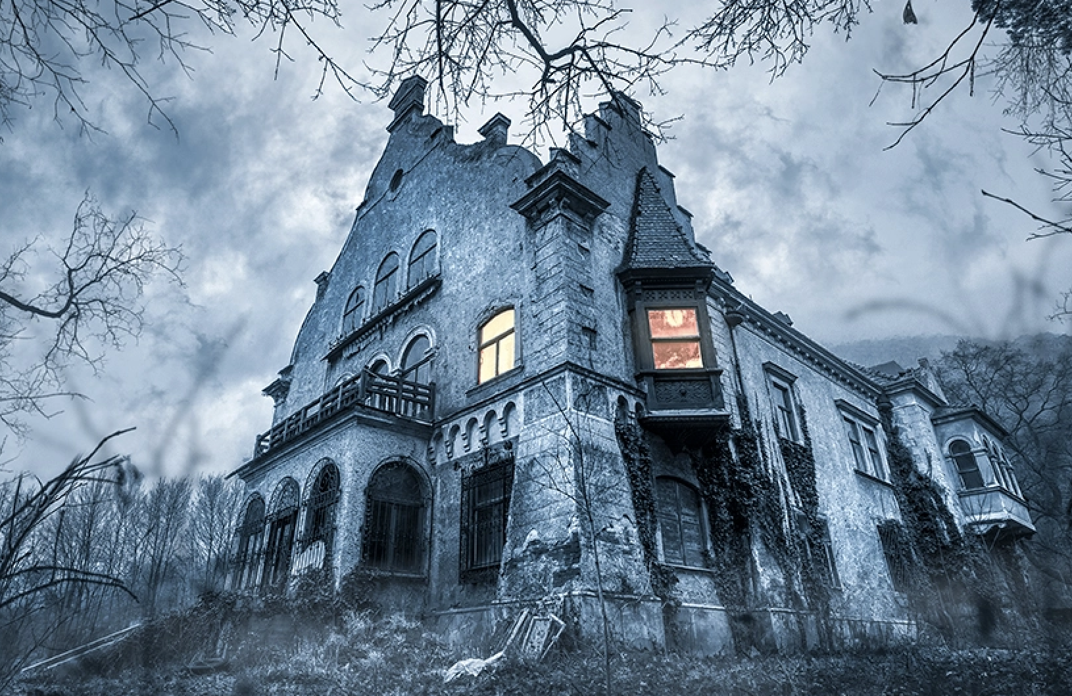
WOULD YOU RATHER
Spend one week in the forest
One night in a real haunted house?

Slide 37
See You Next Week!
Homework: Read pages 24 - 41 (00:00:00 to Every Life Begins Now)

