Slide 1
The Five Wishes of Mr. Murray McBride
Book Club
2-19-21

Slide 2
Summary
Key points of the chapters
Anything that stuck out?
Predictions?

Slide 3
Question 1
In chapter 9, Murray brings Jason’s to Chance’s house to see if Chance will join them in completing Jason’s bucket list.
How does Chance respond?
What important concept does Murray try to convey to Chance at the end of the chapter?

Slide 4
Question 2
In Chapter 10, Murray and Jason head to a football game to create a game plan so that Jason can kiss Mindy Applegate.
What advice does Murray give Jason regarding how to approach the situation?
What is a possible dilemma with Jason’s plan to kiss Mindy?

Slide 5
Question 3
In Chapter 11, Murray goes up into the attic and reflects on his baseball career when he comes across personal items from his time in the league.
What was Murray’s professional career in baseball like?
What effect did his career have on his family dynamic?
When you reflect on your career, how did it go for you?
What was your dream job growing up?

Slide 6
Question 4
In chapter 12, Murray gives his second piece of advice on how to kiss Mindy Applegate.
What was this advice?
When Jason feels scared, what story did Murray share with him to give him courage?

Slide 7
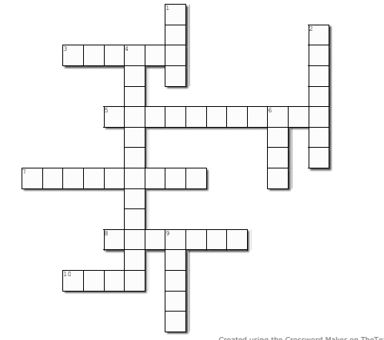
3 Across
3. Page 57, Murray punches the inside of his _______________ in order to fix the damage Jason caused when he did a somersault (fedora)

Slide 8
3 Across
F e d o r a
3. Page 57, Murray punches the inside of his _______________ in order to fix the damage Jason caused when he did a somersault (fedora)

Slide 9
1 Down
F e d o r a
1. Page 55, Murray tells Jason to ask if Mindy has a boyfriend but he uses this word instead _____

Slide 10
1 Down
B e
F e d o r a
1. Page 55, Murray tells Jason to ask if Mindy has a boyfriend but he uses this word instead _____
u

Slide 11
2 Down
B e
F e d o r a
Page 58, In 1934, Murray's last year in the big leagues, the day before picture day he fell ill with a
_______________ ache
u

Slide 12
2 Down
B e
S tomach
F e d o r a
Page 58, In 1934, Murray's last year in the big leagues, the day before picture day he fell ill with a
_______________ ache
u

Slide 13
5 Across
B e
S tomach
F e d o r a
Page 59, The baseball card where Murray looked very athletic is the one piece of _________ that he will never part with
u

Slide 14
5 Across
B e
S tomach
F e d o r a
Page 59, The baseball card where Murray looked very athletic is the one piece of _________ that he will never part with
u
M e m o r i b i l i

Slide 15
7 Across
B e
S tomach
F e d o r a
Page 62, Jason wears a pinstripe suit and shoes that look like ___________ skin
u
M e m o r i b i l i

Slide 16
7 Across
B e
S tomach
F e d o r a
Page 62, Jason wears a pinstripe suit and shoes that look like ___________ skin
u
M e m o r i b i l i
A l l i g a t o r

Slide 17
8 Across
B e
S tomach
F e d o r a
Page 52, Chance looks at Murray's 1967 Chevy as though he were seeing the Loch-ness ___________
u
M e m o r i b i l i
A l l i g a t o r

Slide 18
8 Across
B e
S tomach
F e d o r a
Page 52, Chance looks at Murray's 1967 Chevy as though he were seeing the Loch-ness ___________
u
M e m o r i b i l i
A l l i g a t o r
M o n s t e r

Slide 19
10 Across
B e
S tomach
F e d o r a
Chapter 9, Murray says that it does not take a genius to know that Chance does not like ______
u
M e m o r i b i l i
A l l i g a t o r
M o n s t e r

Slide 20
10 Across
B e
S tomach
F e d o r a
Chapter 9, Murray says that it does not take a genius to know that Chance does not like ______
u
M e m o r i b i l i
A l l i g a t o r
M o n s t e r
K i d s

Slide 21
4 Down
B e
S tomach
F e d o r a
Page 50, Murray describes Chance's drive way as fancy and ________________________
u
M e m o r i b i l i
A l l i g a t o r
M o n s t e r
K i d s

Slide 22
4 Down
B e
S tomach
F e d o r a
Page 50, Murray describes Chance's drive way as fancy and ________________________
s t
u
M e m o r i b i l i
n t
A l l i g a t o r
t i
M o n s t e r
u
K i d s

Slide 23
6 Down
B e
S tomach
F e d o r a
Page 56, Jason is willing to die for this four letter word
s t
u
M e m o r i b i l i
n t
A l l i g a t o r
t i
M o n s t e r
u
K i d s

Slide 24
6 Down
B e
S tomach
F e d o r a
Page 56, Jason is willing to die for this four letter word
s t
u
M e m o r i b i l i
n t
o v e
A l l i g a t o r
t i
M o n s t e r
u
K i d s

Slide 25
9 Down
B e
S tomach
F e d o r a
Page 55, Jason and Murray duck behind the cars like a couple of real __________
s t
u
M e m o r i b i l i
n t
o v e
A l l i g a t o r
t i
M o n s t e r
u
K i d s

Slide 26
9 Down
B e
S tomach
F e d o r a
Page 55, Jason and Murray duck behind the cars like a couple of real __________
s t
u
M e m o r i b i l i
n t
o v e
A l l i g a t o r
t i
M o n s t e r
u
pies
K i d s

Slide 27
Highs & Lows

Slide 28
Weekend Plans?

