Slide 1
The Five Wishes of Mr. Murray Mcbride
Chapter 6-8 Discussion

Slide 2
Happy Birthday Larry!

Slide 3
Goal Reminders
Ted: sustain reading for 15 minutes
Elizabeth: take notes and/or read chapter twice
Bob: reading without audio, reading in the morning
Larry: finding your own reading errors before cued
John: Greater understanding of passage without needing to read it multiple times. Read key parts for a second time

Slide 4
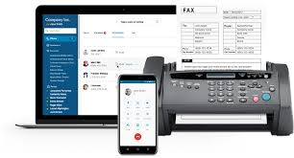
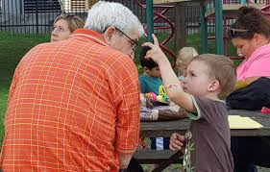
Chapter 6 Summary

Slide 5
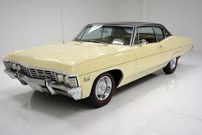
Chapter 7 summary

Slide 6
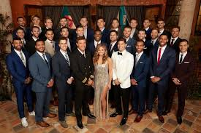
Chapter 8 Summary

Slide 7
Discussion Question #1
In Chapter 6, Father James brings Murray McBride to the hospital to meet Jason’s advocate. What does Murray and Jason’s advocate discuss? Why does Father James think it is important for Murray and Jason to have a connection?
In Chapter 6, Father James brings Murray McBride to the hospital to meet Jason’s advocate. What does Murray and Jason’s advocate discuss? (choose all that apply)
a) Jason’s medical condition
b) Jason’s family situation
c) the opportunity for Mr. Murray McBride to be a “big brother” to Jason
d) Jason’s family would like Mr. Murray McBride to stay away from Jason
e) Jason would like Mr. Murray McBride to leave him alone

Slide 8
Discussion Question #2
“The man meets my eyes for the first time. He puts his hands on his hips and looks straight at me. “What do you want?” (pg. 43). Why might this interaction have been confusing for Murray? How did Murray react to Mr. Cashman’s disrespect? How would you react to somebody being so disrespectful to you?
Briefly describe how you would react if you were greeted at a guests house the way Mr. Murray McBride was treated by Mr. Cashman

Slide 9
Discussion Question #3
“The crack of a bat hitting a baseball is the most beautiful sound in the world. Second to Jenny saying “I love you”, that is (pg. 46). Mr. Murray McBride brings Jason to the ballpark because he describes it as both alive and peaceful. Where is somewhere that you feel is alive and peaceful, and somewhere that you go to “get away”. What do you feel the most beautiful sound in the world is?
What was the first bucket list item that Jason asked Mr. Murray McBride to start with?
Kiss a girl (on the lips)
Hit a homerun in a major league baseball stadium
Be a superhero
Find a nice boyfriend for Mom
Do real magic

Slide 10
Discussion Question #4
When Jason tells Mr. McBride that kissing Mindy Applegate is “the most impossible thing in the world” (pg. 51), Mr. McBride tells him “It might not be as impossible as you think” (pg. 51). What are your predictions for how Murray might be able to help him? Do you think it is possible for a 10 year old boy and 100 year old man to carry out this plan?
Make a prediction! Will Jason and Murray find a plan for Jason to eventually kiss Mindy Applegate on the lips? If yes, how do you think they will be successful? If no, what might stop them?

Slide 11
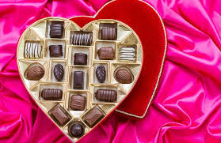
Valentine’s Day
What are your thoughts?
Valentine’s day is this weekend. What are your thoughts? Have you always seen the holiday in this light? Do you do anything for Valentine’s day?

Slide 12
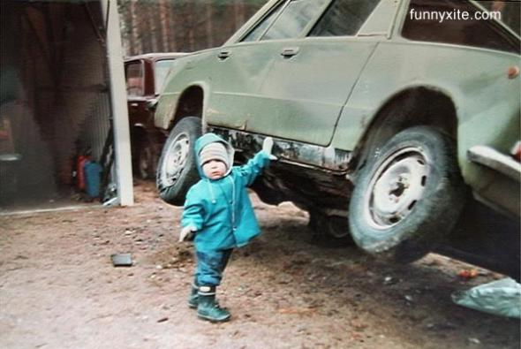
Would you rather
Have universal respect or unlimited power?

Slide 13
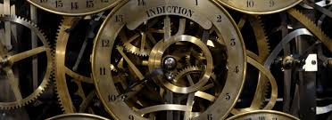
Would you rather
Be able to travel to any time in the future or any time in the past?

Slide 14
1 Down
A
D
V
O
C
A
T
E

Slide 15
5 Across
C H E V Y

Slide 16
2 Across
L I N C O L N

Slide 17
3 Down
C
H
E
E
R
L
E
A
D
E
R

Slide 18
4 Across
C H A N D E L I E R

Slide 19
5 Down
C
U
B
S

Slide 20
6 Across
D A D G O M M I T

Slide 21
7 Down
T
E
C
H
N
O

Slide 22
8 Across
A P P L E S A U C E

Slide 23
9 Down
P
O
C
K
E
T

