Slide 1
The Five Wishes of Mr. Murray McBride
Chapters 44-49

Slide 2
End of the book!
Reactions?

Slide 3
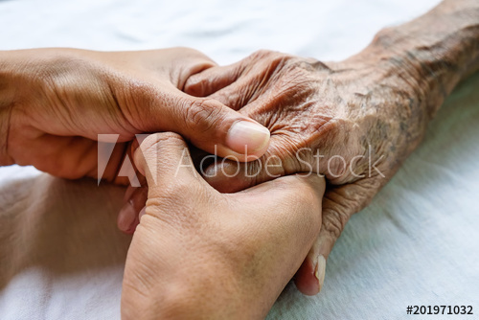
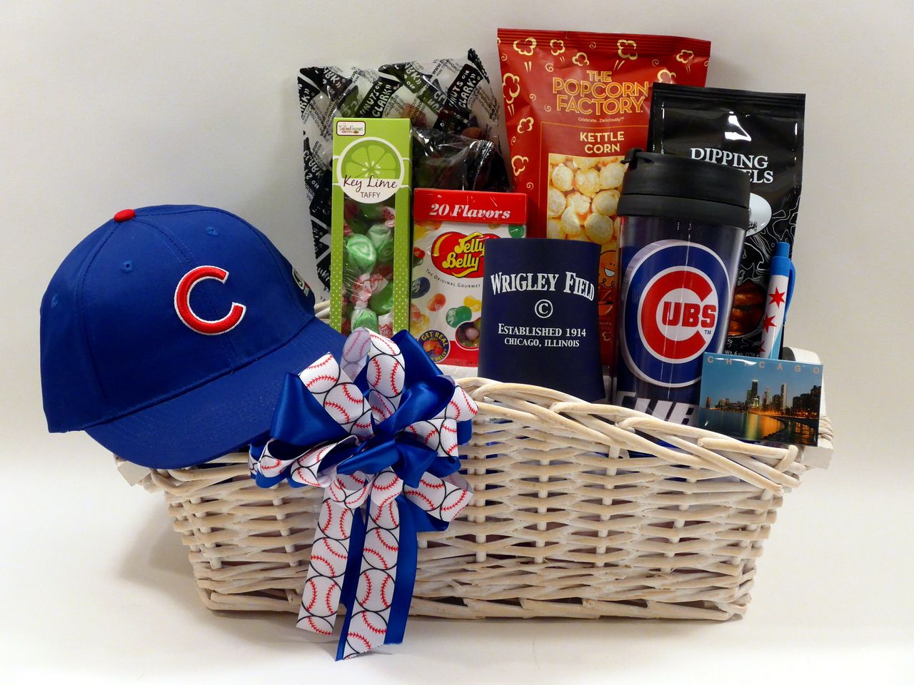
Chapters 44 and 45
Chapter 44: Chance visits Murray Chapter 45: Javier Gonzalez visits

Slide 4
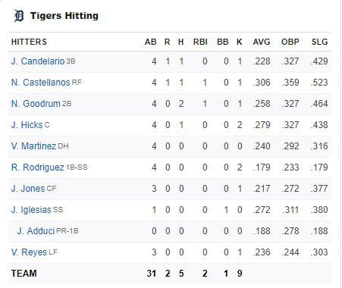
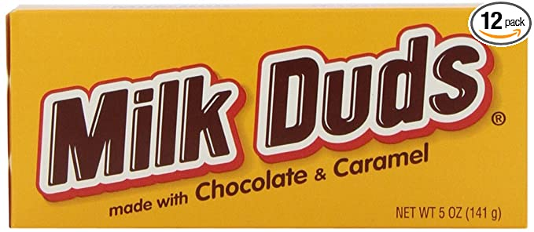
Chapters 46 and 47
Chapter 46: Murray and Tiegan talk about baseball, Tiegan goes to get Milk Duds
Chapter 47: Jason and Murray have a heart to heart

Slide 5
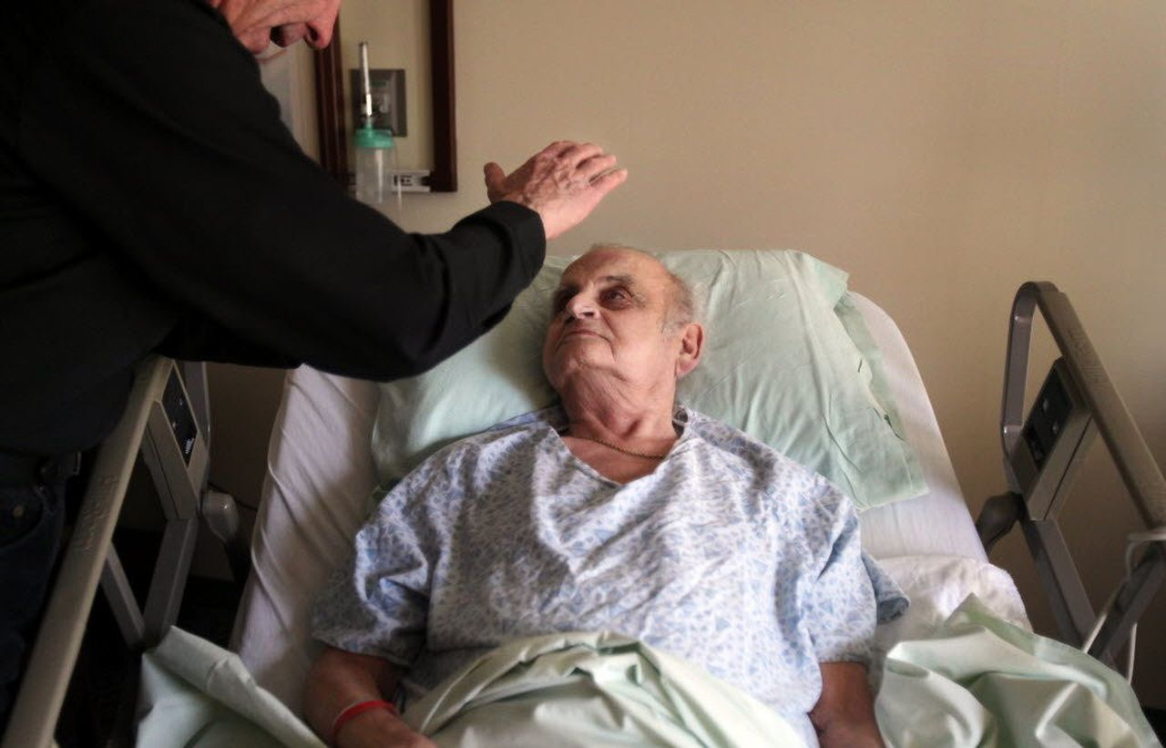
Chapters 48 and 49
Chapter 49: Jason gets a new heart. He performs as an adult. We learn Tiegan’s fate
Chapter 48: Father James gives Murray his last rites

Slide 6
1A
In Chapter 44, Murray tells Chance he should be more like:
Jason’s Father “ Be like Benedict Cashman”
“Be Like me” Murray Mcbride
“Be like you” Chance Mcbride
“Be like Jason”

Slide 7
1B
What is something important you want to tell a loved one?
Who is someone you looked up to growing up?

Slide 8
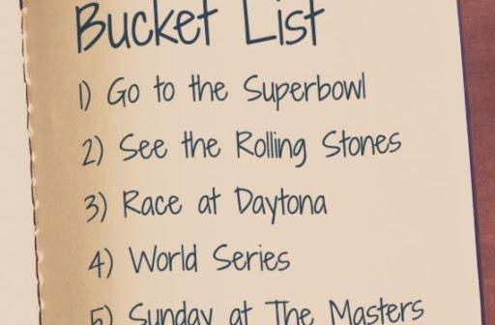
2A
In chapter 46, Tiegan believes she does not deserve to have a wish list or bucket list because she is not sick. What does Murray think about Bucket lists?
Everyone deserves to have a list
Only sick people can have a list
Lists are overrated no one should have them
It is okay for young children to have a list

Slide 9
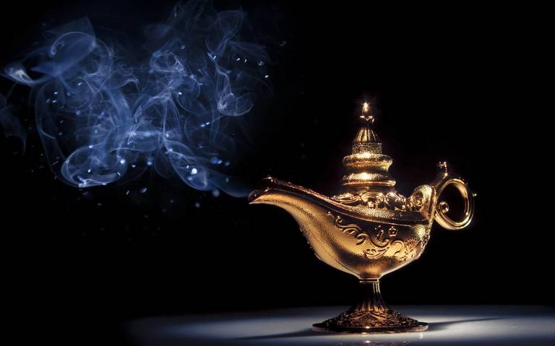
2B
What are some wishes you have accomplished?
What are some you hope to accomplish in the future?

Slide 10
3A
In chapter 47, Murray tells Jason that before he met him, he wasn’t really alive for about a year and a half. Murray describes Jason’s impact on his life as:
A replacement of his children
The best magic trick of all
An answered prayer
A good alternative to traditional medicine

Slide 11
3B
What goal did Jason achieve through helping out Murray?
What is something meaningful someone has done for you?

Slide 12
4A
In the final chapter, 49, Anna tells Murray that Jason: (select all that apply)
Has sadly passed away
Requested to see him
Has received a new heart and will live
Is alive because of meeting Murray

Slide 13
4B
What does Anna say about what Murray has done for Jason?
Do you believe in miracles?

Slide 14
4 Across
Murray states that something about being a ________ is unlike anything else in the world

Slide 15
4 Across
Murray states that something about being a granddad is unlike anything else in the world
G R A N D D A D

Slide 16
5 Across
According to Jason, Murray woke up because of his loud ____.
G R A N D D A D

Slide 17
5 Across
According to Jason, Murray woke up because of his loud fart.
G R A N D D A D
F A R T

Slide 18
7 Across
Murray has an entire cupboard filled with this chocolate candy for Tiegan
G R A N D D A D
F A R T

Slide 19
7 Across
Murray has an entire cupboard filled with this chocolate candy for Tiegan
Milkduds
G R A N D D A D
F A R T
M I L K D U D S

Slide 20
9 Across
Javier Gonzalez brings Jason a gift basket that has a baseball signed by every member of what baseball team?
G R A N D D A D
F A R T
M I L K D U D S

Slide 21
9 Across
Javier Gonzalez brings Jason a gift basket that has a baseball signed by every member of what baseball team?
Cubs
G R A N D D A D
F A R T
M I L K D U D S
C U B S

Slide 22
1 Down
Murray states that it does not matter if you are ten years or one _______ years old when you learn you’re dying
G R A N D D A D
F A R T
M I L K D U D S
C U B S

Slide 23
1 Down
H
U
N
R
E
D
Murray states that it does not matter if you are ten years or one hundred years old when you learn you’re dying
G R A N D D A D
F A R T
M I L K D U D S
C U B S

Slide 24
2 Down
H
U
N
R
E
D
Tiegan draws near to Murray’s cheek and tells him that he is _________
G R A N D D A D
F A R T
M I L K D U D S
C U B S

Slide 25
2 Down
H
U
N
R
E
D
B E
U
I
F
L
Tiegan draws near to Murray’s cheek and tells him that he is beautiful
G R A N D D A D
F A R T
M I L K D U D S
C U B S

Slide 26
3 Down
H
U
N
R
E
D
B E
U
I
F
L
In Chapter 46, what does Murray ask Tiegan to get for him at the store?
Baseball _____
G R A N D D A D
F A R T
M I L K D U D S
C U B S

Slide 27
3 Down
H
U
N
R
E
D
B E
U
I
F
L
C
R
D
S
In Chapter 46, what does Murray ask Tiegan to get for him at the store?
Baseball cards
G R A N D D A D
F A R T
M I L K D U D S
C U B S

Slide 28
6 Down
H
U
N
R
E
D
B E
U
I
F
L
C
R
D
S
In Chapter 48, Father James gives Murray his Last _____
G R A N D D A D
F A R T
M I L K D U D S
C U B S

Slide 29
6 Down
H
U
N
R
E
D
B E
U
I
F
L
C
R
D
S
In Chapter 48, Father James gives Murray his Last Rites
G R A N D D A D
F A R T
R
T
E
M I L K D U D S
C U B S

Slide 30
8 Down
H
U
N
R
E
D
B E
U
I
F
L
C
R
D
S
Murray tells Jason to call him by his first name “Murray”, or this word ____ if that’s what Jason prefers
G R A N D D A D
F A R T
R
T
E
M I L K D U D S
C U B S

Slide 31
8 Down
H
U
N
R
E
D
B E
U
I
F
L
C
R
D
S
Murray tells Jason to call him by his first name “Murray”, or this word dude if that’s what Jason prefers
G R A N D D A D
F A R T
R
T
E
M I L K D U D S
D
D
E
C U B S

Slide 32
Last meeting next week!
Meeting preferences?
Separate book clubs
Joint book clubs
All aphasia groups combined

