Slide 1
The Five Wishes of Mr. Murray Mcbride Chapters 37-43
April 9th 2021

Slide 2
Goals
Ted: Read two pages in 15 minutes, read faster
Elizabeth: Take notes and/or read chapter twice
Bob: Read without audio, read in the morning
Larry: Find reading errors before cued, to work towards reading out loud towards someone else
John: Greater understanding of passage without needing to read it multiple times, read key parts two times

Slide 3
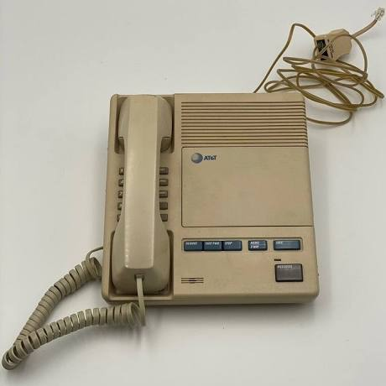
Chapter 37 Summary

Slide 4
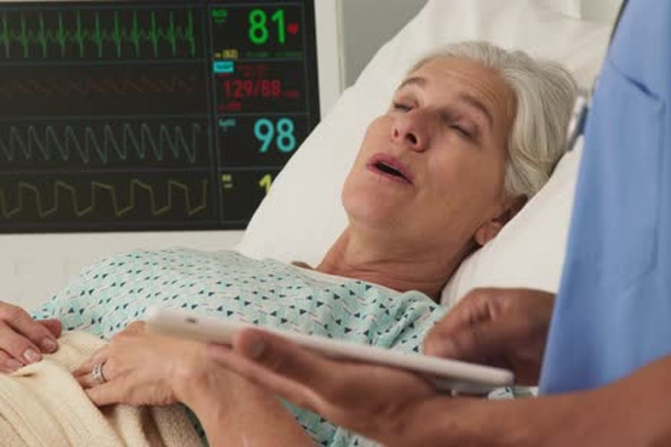
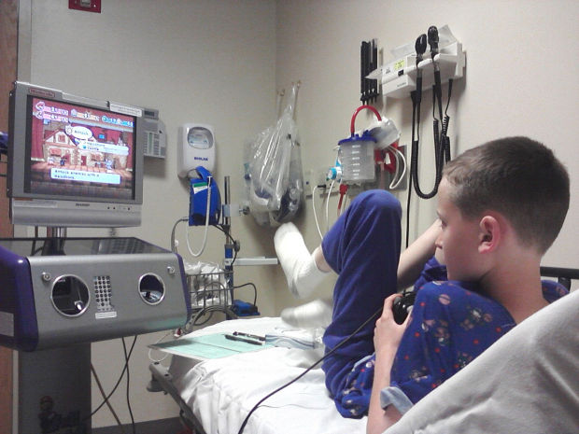
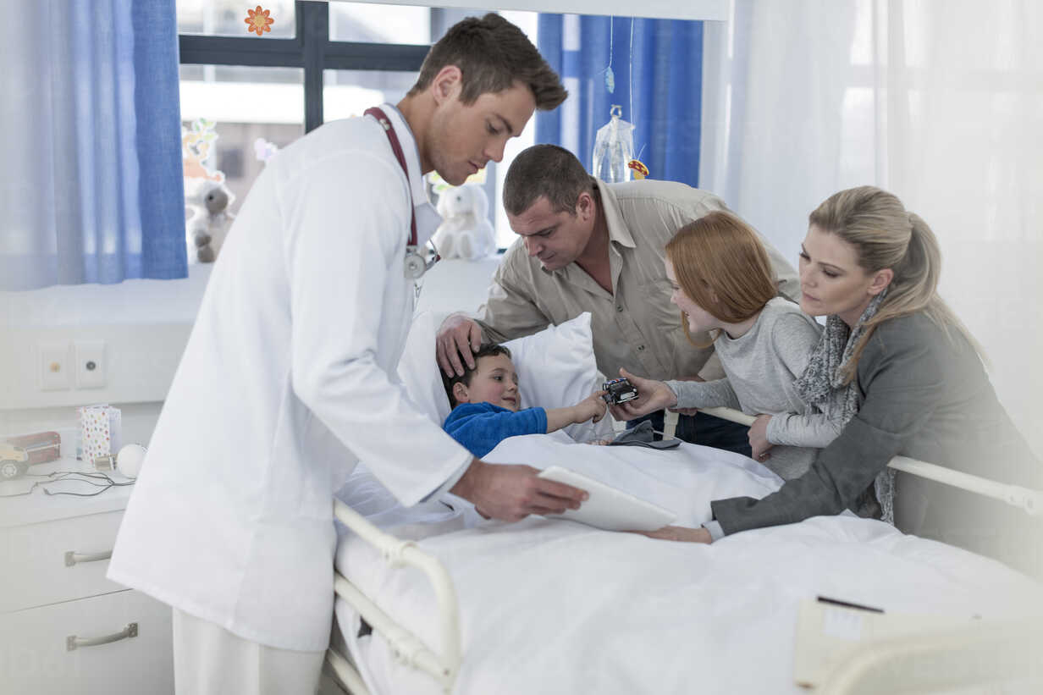
Chapter 38 Summary

Slide 5
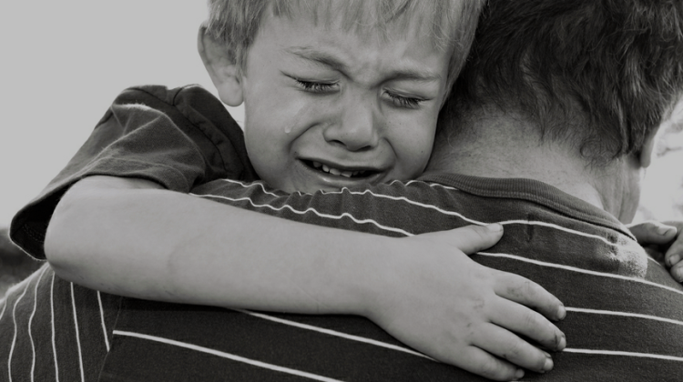
Chapter 39 Summary

Slide 6
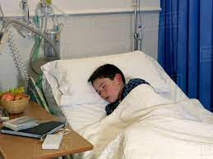
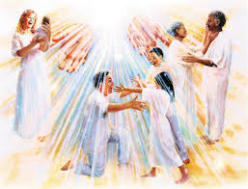
Chapter 40 summary

Slide 7
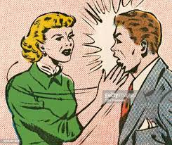
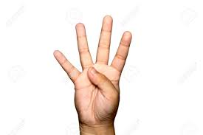
Chapter 41 summary

Slide 8
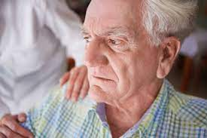
Chapter 42 Summary

Slide 9
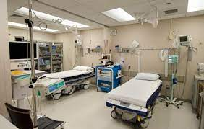
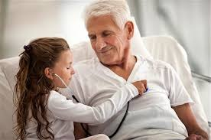
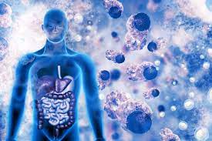
Chapter 43 Summary

Slide 10
Question 1A
In chapter 37 (page 186), Murray says, “There was a time when news like that would take days to make the rounds.” How do we get our news now? How has this changed in your lifetime?

Slide 11
Question 1B
In chapter 38 (page 191), Murray cannot believe how even though Jason has heart problems, he always seemed okay to Murray. What made Murray believe this?
He has kissed a girl
He has punched a boy much bigger than him
Hit a ball over the Wrigley Field fence
All of the above

Slide 12
Question 2A
In chapter 38 (page 191), Murray cannot believe how even though Jason has heart problems, he always seemed okay to Murray. Murray says, “But now I see it. It’s because there are two hearts in each of us.” What does Murray mean by this? Do you believe that there are two hearts in each of us the way Murray does?

Slide 13
Question 2B
At the end of chapter 40, Murray attempts to sacrifice his life so that Jason could have his heart. How does Anna react?
She thanks Murray for trying to sacrifice his life
She smacks him in the face
She begs the doctor to let Murray give his heart
She tells Jason Murray is donating his heart

Slide 14
Question 3A
At the end of chapter 40, Murray attempts to sacrifice his life so that Jason could have his heart. Does this work? How does Anna react? Has there ever been a time in your life where you had to sacrifice something?

Slide 15
Question 3B
In chapter 37 (page 186), Murray says, “There was a time when news like that would take days to make the rounds.” How do you get your news today? (Select all that apply)
Cell phones
Internet
Talking with family and friends
Newspaper
Television

Slide 16
Question 4A
In Chapter 43, Murray is in a bed next to Jason in the hospital room. What news did Murray get from the doctor? How did Murray handle this news? Do you have any predictions for Murray and Jason being in the same hospital room together?

Slide 17
Question 4B
In Chapter 43, Murray is in a bed next to Jason in the hospital room. What news did Murray get from the doctor?
He will be able to donate his heart to Jason
Murray’s lungs are not holding up
Murray has late-stage bone cancer
Murray is still a very healthy 100 year old man

Slide 18
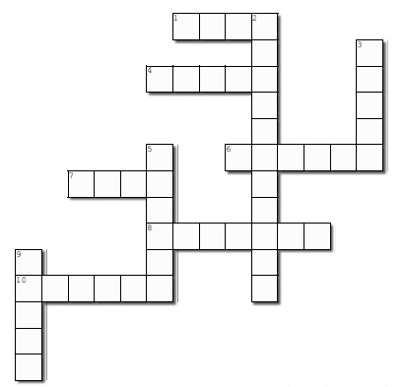
Crossword Answers
F O U R
E
GONE
T O P P S
How was the Crossword?
T R
H
C A N C E R
D U D E
IN
A
V I L L I A N
A
E
NG
G I B S O N
AIN

