Slide 1
Chapter 37-43
April 9, 2021

Slide 2
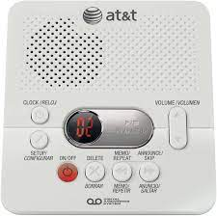
Summary
Chapter 39: Jason crying to Murray in his hospital room.
Chapter 37: Murray received message on answering machine.
Chapter 38: Murray arrives to hospital and enters Jason’s room.

Slide 3
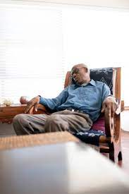
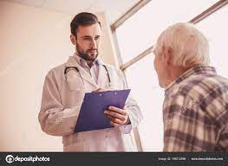
Summary
Chapter 41: Murray wakes up from sleeping in chair and thinks he is in Heaven.
Chapter 40: Murray tells the doctor that he wants to donate his heart to Jason.

Slide 4
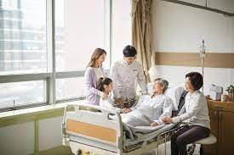
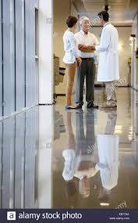
Summary
Chapter 43: Murray wakes up from passing out and gets bad medical news.
Chapter 42: Doctor talks to the adults in a separate room about how Jason does not have much time left.

Slide 5
Question 1
In chapter 37 (page 186), Murray says, “There was a time when news like that would take days to make the rounds.”
How do we get our news now?
How has this changed in your lifetime?

Slide 6
Question 2
In chapter 38 (page 191), Murray cannot believe how even though Jason has heart problems, he always seemed okay to Murray. Murray says, “But now I see it. It’s because there are two hearts in each of us.”
What does Murray mean by this?
Do you believe that there are two hearts in each of us the way Murray does?

Slide 7
Question 3
At the end of chapter 40, Murray attempts to sacrifice his life so that Jason could have his heart. How does Anna react?
She thanks Murray for trying to sacrifice his life
She smacks him in the face
She begs the doctor to let Murray give his heart
She tells Jason Murray is donating his heart

Slide 8
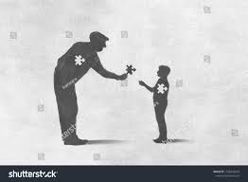
Question 4
At the end of chapter 40, Murray attempts to sacrifice his life so that Jason could have his heart.
Does this work?
Has there ever been a time in your life where you had to sacrifice something?

Slide 9
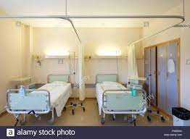
Question 5
In Chapter 43, Murray is in a bed next to Jason in the hospital room.
What news did Murray get from the doctor?
How did Murray handle this news?
Do you have any predictions for Murray and Jason being in the same hospital room together?

Slide 10
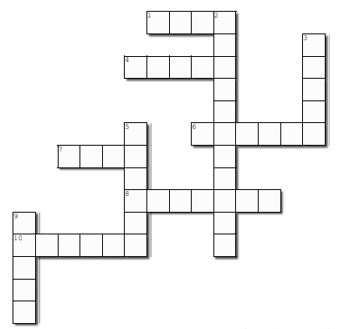
1 Across
1. The amount of wishes Jason has completed so far. (Page 199)

Slide 11
1 Across
F O U R
1. The amount of wishes Jason has completed so far. (Page 199)

Slide 12
4 Across
F O U R
When Murray first enters the room, Jason has Murray's 1934 _______ card in his hand. (page 189)

Slide 13
4 Across
F O U R
T O P P S
When Murray first enters the room, Jason has Murray's 1934 _______ card in his hand. (page 189)

Slide 14
6 Across
F O U R
T O P P S
The doctor tells Murray that he has late-stage bone
__________. (Page 204)

Slide 15
6 Across
F O U R
T O P P S
The doctor tells Murray that he has late-stage bone
__________. (Page 204)
C A N C E R

Slide 16
8 Across
F O U R
T O P P S
8. Murray describes Jason as looking like the __________ from one of his superhero movies. (Page 190)
C A N C E R
V I L L I A N

Slide 17
7 Across
F O U R
T O P P S
On page 190, Jason says, 'Finally. The old _______ arrives
C A N C E R
V I L L I A N

Slide 18
7 Across
F O U R
T O P P S
On page 190, Jason says, 'Finally. The old _______ arrives
C A N C E R
D U D E
V I L L I A N

Slide 19
10 Across
F O U R
T O P P S
Jason says that his _________ fist pump while rounding the bases was schweet. (page 199)
C A N C E R
D U D E
V I L L I A N

Slide 20
10 Across
F O U R
T O P P S
Jason says that his _________ fist pump while rounding the bases was schweet. (page 199)
C A N C E R
D U D E
V I L L I A N
G I B S O N

Slide 21
2 Down
F O U R
T O P P S
2. On page 186, in Anna's message she tells Murray that she heard that his __________ order has been lifted.
C A N C E R
D U D E
V I L L I A N
G I B S O N

Slide 22
2 Down
F O U R
E
T O P P S
2. On page 186, in Anna's message she tells Murray that she heard that his __________ order has been lifted.
T R
C A N C E R
D U D E
IN
V I L L I A N
NG
G I B S O N

Slide 23
3 Down
F O U R
E
T O P P S
3. Dr. Keaton tells Murray that without his medications, he will be a _________. (page 195)
T R
C A N C E R
D U D E
IN
V I L L I A N
NG
G I B S O N

Slide 24
3 Down
F O U R
E
GONE
T O P P S
3. Dr. Keaton tells Murray that without his medications, he will be a _________. (page 195)
T R
C A N C E R
D U D E
IN
V I L L I A N
NG
G I B S O N

Slide 25
5 Down
F O U R
E
GONE
T O P P S
5. In the beginning of chapter 41, Murray thinks he wakes up in ________. (Page 197)
T R
C A N C E R
D U D E
IN
V I L L I A N
NG
G I B S O N

Slide 26
5 Down
F O U R
E
GONE
T O P P S
5. In the beginning of chapter 41, Murray thinks he wakes up in ________. (Page 197)
T R
H
C A N C E R
D U D E
IN
A
V I L L I A N
E
NG
G I B S O N

Slide 27
9 Down
F O U R
E
GONE
T O P P S
9. Jenny's favorite tune: ______ (page 185)
T R
H
C A N C E R
D U D E
IN
A
V I L L I A N
E
NG
G I B S O N

Slide 28
9 Down
F O U R
E
GONE
T O P P S
9. Jenny's favorite tune: ______ (page 185)
T R
H
C A N C E R
D U D E
IN
A
V I L L I A N
A
E
NG
G I B S O N
AIN

Slide 29
HAVE A GREAT WEEKEND
Next week: Finish the book!

