Slide 1
The Five Wishes of Mr. Murray McBride
Chapters 34-36
Friday April 2, 2021

Slide 2
Ted: Read two pages in 15 minutes, read faster
Elizabeth: Take notes and/or read chapter twice
Bob: Read without audio, read in the morning
Larry: Find reading errors before cued, to work towards reading out loud towards someone else
John: Greater understanding of passage without needing to read it multiple times, read key parts two times

Slide 3
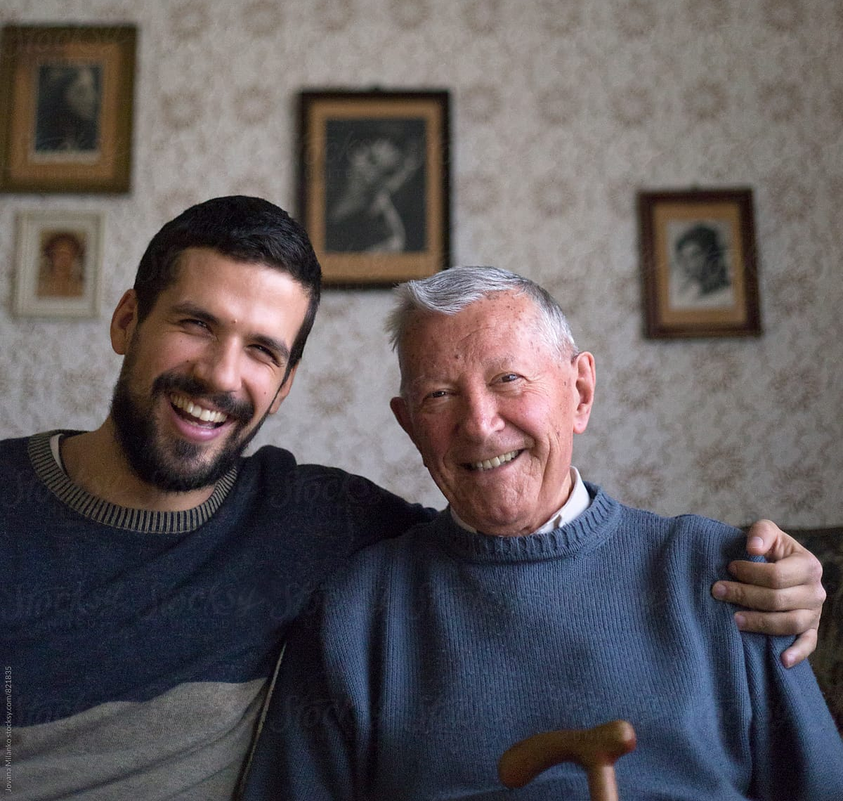
Chapter 34

Slide 4
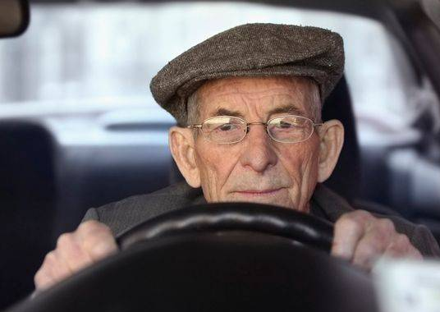
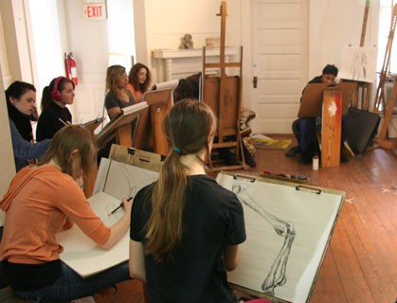
Chapter 35

Slide 5
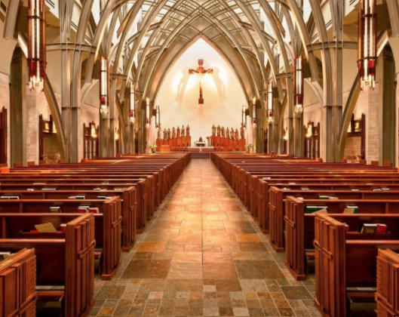
Chapter 36

Slide 6
Worksheet A, Question 1
Murray and Chance heal their previously fractured relationship in Chapter 34. How does this happen? What do they say to each other? On a scale of 1-10, how surprised were you by their conversation? Is Chance’s relationship with Murray similar to or different from Jason’s relationship with his father? Explain.

Slide 7
Worksheet B, Question 1
On a scale of 1-10, how surprised were you that Chance and Murray healed their previously fractured relationship?
1 2 3 4 5 6 7 8 9 10
On a scale of 1-10, how similar do you think Chance’s relationship with Murray is to Jason’s relationship with his father?
1 2 3 4 5 6 7 8 9 10

Slide 8
Worksheet A, Question 2
In Chapter 34, Murray says “Funny thing is, the closer I get to my own house, the farther I feel from home” (p. 172). How has Murray’s sense of home changed throughout this story? What is home to you? Is it a place, person, feeling or something else? Has your sense of home shifted throughout life? In what way?

Slide 9
Worksheet B, Question 2
How does Murray describe “home” at the end of Chapter 34? (p. 172)
Murray is excited to return to his cozy and inviting home after the long trip to Chicago
Murray decides to stay with Chance so he doesn’t have to be in an empty house while waiting for news about Jason
Murray’s house doesn’t feel like home anymore
One of the conditions of Murray’s bail is that he must stay in his home
Murray got into so much trouble in Chicago that he never wants to leave his home again

Slide 10
Worksheet A, Question 3
In Chapter 36, Murray feels lost (p. 179). Father James tells him that if he finds himself, he will find his path. How does Murray find his path? How would you have advised Murray in this situation? Describe a time when you felt lost. Did you receive any advice? Did it help you find your path?

Slide 11
Worksheet B, Question 3
What does Father James tell Murray he must find in order to understand his path? (p. 181)
Peace
A friend
A heart for Jason
Meaning
Himself

Slide 12
Worksheet A, Question 4
On page 166 Murray thinks, “sometimes trying to do the right thing is the surest way to get yourself in a heap of trouble.” Who does Murray confront in Chapter 36? Do Murray’s words have an impact? Would you have acted similarly? Make a prediction: Will Benedict change his behavior because of Murray’s scolding?

Slide 13
Worksheet B, Question 4
Who does Murray confront in Chapter 36? Select all that apply. (p. 182)
Jason’s doctor
Father James
A 30-year old version of himself
Benedict Cashman
Chance
Make a prediction: Will Jason’s father change his behavior because of Murray’s scolding?

Slide 14
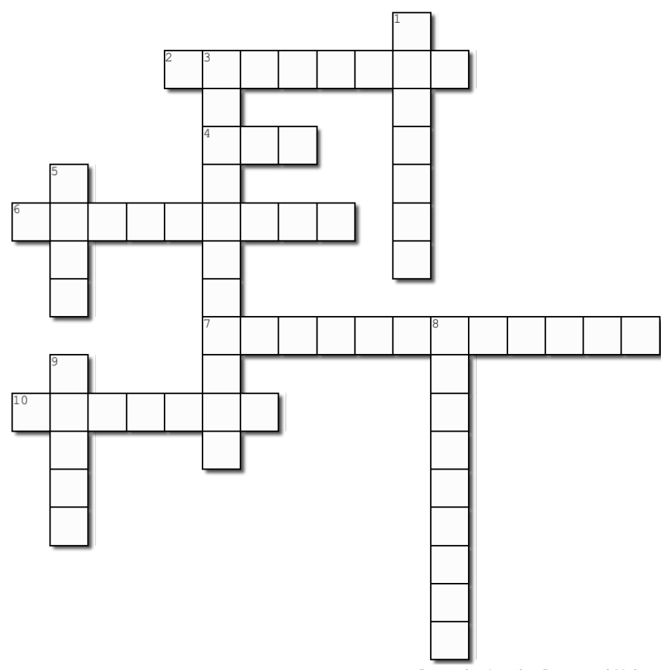
1 Down
Collins' first name (p. 177)

Slide 15
1 Down
JACKSON
Jackson

Slide 16
2 Across
While in jail, Murray calls himself a ______ (p. 166)

Slide 17
2 Across
C R I M I N A L
Criminal

Slide 18
3 Down
The policeman tells Murray that he has a _________ order against him (p. 170)

Slide 19
3 Down
RESTRAINING
Restraining

Slide 20
4 Across
What does Murray call Jason in his email? (p. 174)

Slide 21
4 Across
S O N
Son

Slide 22
5 Down
Father James says: '...this is the only time you have to live. Don't throw that _____ away' (p. 180)

Slide 23
5 Down
Gift
G
I
F
T

Slide 24
6 Across
At first Murray thinks Father James' advice sounds like _______ (p. 181)

Slide 25
6 Across
Gibberish
G I B B E R I S H

Slide 26
7 Across
Jason is Murray's _______ beacon and compass
(p. 182)

Slide 27
7 Across
Navigational
N A V I G A T I O N A L

Slide 28
8 Down
After Benedict pushes him, the pain spreads through Murray's entire body like it has ______ (p. 183)

Slide 29
8 Down
Tentacles
T
E
N
T
A
CLES

Slide 30
9 Down
Murray describes his drive home, car, plans and soul as ______ (p. 173)

Slide 31
9 Down
Empty
EMPTY

Slide 32
10 Across
Collins thinks Murray's '34 Topps card is _______ (p. 178)

Slide 33
10 Across
Amazing
A M A Z I N G

