Slide 1
The Five Wishes of Mr. Murray McBride
Aphasia Book Club
April 2, 2021

Slide 2
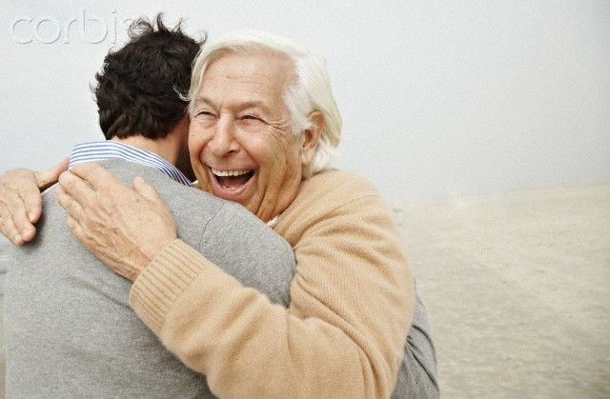
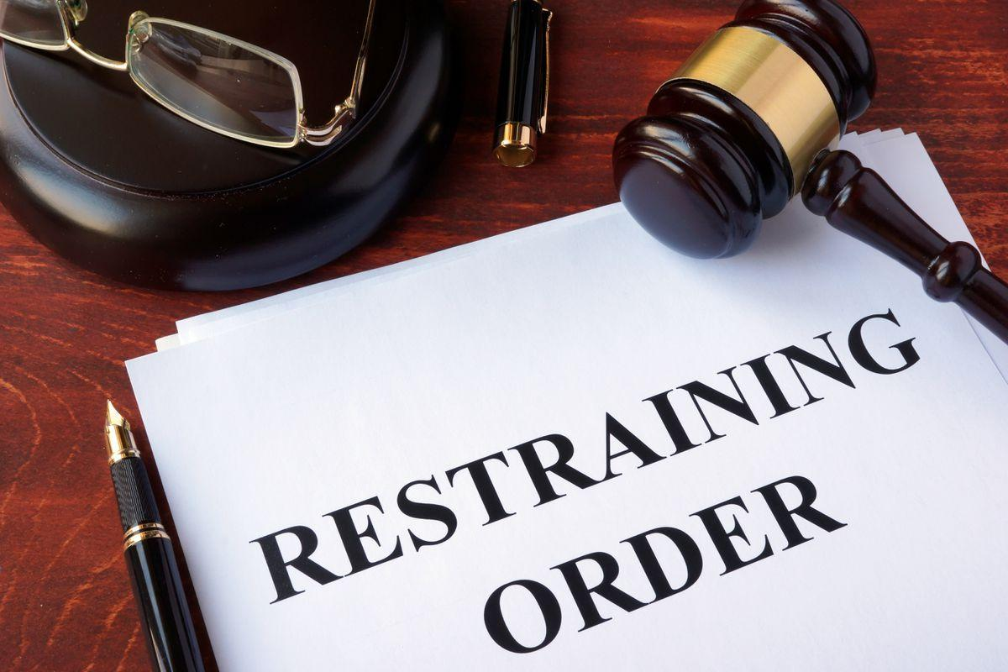
Chapter 34
Murray and Chance clear up their relationship. Murray gets a restraining order that forbids him from going near Jason.

Slide 3
Chapter 35
Murray drives home alone. At art class, he learns more about Collins. Collins offers to help Murray.

Slide 4
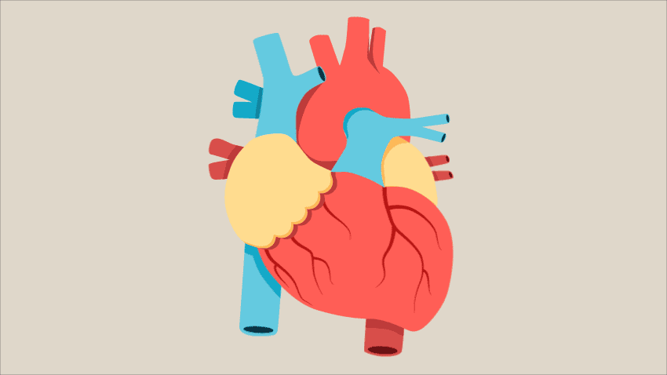
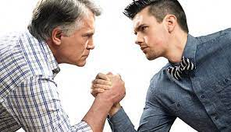
Chapter 36
Jason is in line for a heart transplant. Murray realizes he wants to be Jason’s friend. Murray has a confrontation with Benedict.

Slide 5
Question 1A
Murray and Chance heal their previously fractured relationship in Chapter 34.
How surprised were you by their conversation?

Slide 6
Question 1B
How does this healing happen? What do they say to each other?
Is Chance’s relationship with Murray similar to or different from Jason’s relationship with his father?

Slide 7
Question 2A
How does Murray describe “home” at the end of Chapter 34?
Murray is excited to return to his cozy and inviting home after the long trip to Chicago
Murray decides to stay with Chance so he doesn’t have to be in an empty house while waiting for news about Jason
Murray’s house doesn’t feel like home anymore
One of the conditions of Murray’s bail is that he must stay in his home
Murray got into so much trouble in Chicago that he never wants to leave his home again

Slide 8
Question 2B
How has Murray’s sense of home changed throughout this story?
What is home to you? Is it a place, person, feeling or something else?
Has your sense of home shifted throughout life? In what way?

Slide 9
Question 3A
In Chapter 36, Murray feels lost.
What does Father James tell Murray he must find in order to understand his path? (p. 181)
Peace
A friend
A heart for Jason
Meaning
Himself

Slide 10
Chapter 3B
How does Murray find this path?
How would you have advised Murray in this situation?
Describe a time when you felt lost. Did you receive any advice? Did it help you find your path?

Slide 11
Question 4A
Who does Murray confront in Chapter 36?
Jason’s doctor
Father James
A 30-year old version of himself
Benedict Cashman
Chance

Slide 12
Question 4B
Do Murray’s words have an impact?
Would you have acted similarly?
Make a prediction: Will Benedict change his behavior because of Murray’s scolding?

Slide 13
2 Across
While in jail, Murray calls himself a ________

Slide 14
2 Across
While in jail, Murray calls himself a
criminal.
C R I M I N A L

Slide 15
4 Across
What does Murray call Jason in his email?
___
C R I M I N A L

Slide 16
4 Across
What does Murray call Jason in his email?
son
C R I M I N A L
S O N

Slide 17
6 Across
At first Murray thinks Father James’ advice sounds like _________
C R I M I N A L
S O N

Slide 18
6 Across
At first Murray thinks Father James’ advice sounds like gibberish
C R I M I N A L
S O N
G I B B E R I S H

Slide 19
7 Across
Jason is Murray’s ___________
beacon and compass
C R I M I N A L
S O N
G I B B E R I S H

Slide 20
7 Across
Jason is Murray’s navigational
beacon and compass
C R I M I N A L
S O N
G I B B E R I S H
N A V I G A T I O N A L

Slide 21
10 Across
Collins thinks Murray’s 34 Topps card is _______
C R I M I N A L
S O N
G I B B E R I S H
N A V I G A T I O N A L

Slide 22
10 Across
Collins thinks Murray’s 34 Topps card is amazing
C R I M I N A L
S O N
G I B B E R I S H
N A V I G A T I O N A L
A M A Z I N G

Slide 23
1 Down
Collins’ first name is _______
C R I M I N A L
S O N
G I B B E R I S H
N A V I G A T I O N A L
A M A Z I N G

Slide 24
1 Down
Collins’ first name is Jackson
J
C
K S O N
C R I M I N A L
S O N
G I B B E R I S H
N A V I G A T I O N A L
A M A Z I N G

Slide 25
3 Down
The policeman tells Murray that he has a _________ order against him
J
C
K S O N
C R I M I N A L
S O N
G I B B E R I S H
N A V I G A T I O N A L
A M A Z I N G

Slide 26
3 Down
The policeman tells Murray that he has a restraining order against him
J
C
K S O N
C R I M I N A L
E T
A
I
I
G
S O N
G I B B E R I S H
N A V I G A T I O N A L
A M A Z I N G

Slide 27
5 Down
Father James says “...this is the only time you have to live. Don’t throw that ____ away.”
J
C
K S O N
C R I M I N A L
E T
A
I
I
G
S O N
G I B B E R I S H
N A V I G A T I O N A L
A M A Z I N G

Slide 28
5 Down
Father James says “...this is the only time you have to live. Don’t throw that gift away.”
J
C
K S O N
C R I M I N A L
E T
A
I
I
G
S O N
G
F
T
G I B B E R I S H
N A V I G A T I O N A L
A M A Z I N G

Slide 29
8 Down
After Benedict pushes him, the pain spreads through Murray’s entire body like it has ________
J
C
K S O N
C R I M I N A L
E T
A
I
I
G
S O N
G
F
T
G I B B E R I S H
N A V I G A T I O N A L
A M A Z I N G

Slide 30
8 Down
After Benedict pushes him, the pain spreads through Murray’s entire body like it has tentacles.
J
C
K S O N
C R I M I N A L
E T
A
I
I
G
S O N
G
F
T
G I B B E R I S H
N A V I G A T I O N A L
E
N T A C L
E
S
A M A Z I N G

Slide 31
9 Down
Murray describes his drive home, car, plans, and soul as _____.
J
C
K S O N
C R I M I N A L
E T
A
I
I
G
S O N
G
F
T
G I B B E R I S H
N A V I G A T I O N A L
E
N T A C L
E
S
A M A Z I N G

Slide 32
9 Down
Murray describes his drive home, car, plans, and soul as empty.
J
C
K S O N
C R I M I N A L
E T
A
I
I
G
S O N
G
F
T
G I B B E R I S H
N A V I G A T I O N A L
E
N T A C L
E
S
E
P
T
Y
A M A Z I N G

Slide 33
Highs and lows?
Weekend plans?
Any April Fools’ pranks?

