Slide 1
The Five Wishes of Mr. Murray Mcbride
Chapter 3-5 Discussion

Slide 2
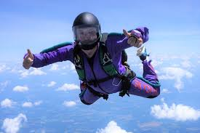
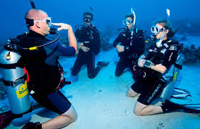
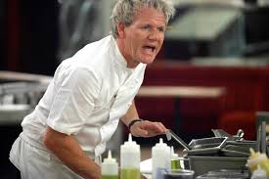
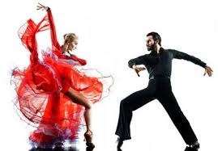
Homework: Five things on your bucket list!

Slide 3
Goal Reminders
Ted: sustain reading for 15 minutes
Elizabeth: take notes and/or read chapter twice
Bob: reading without audio, reading in the morning
Larry: finding your own reading errors before cued
John: Greater understanding of passage without needing to read it multiple times. Read key parts for a second time

Slide 4
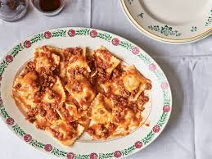
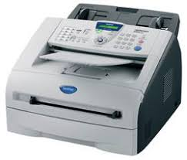
Chapter 3 Summary

Slide 5
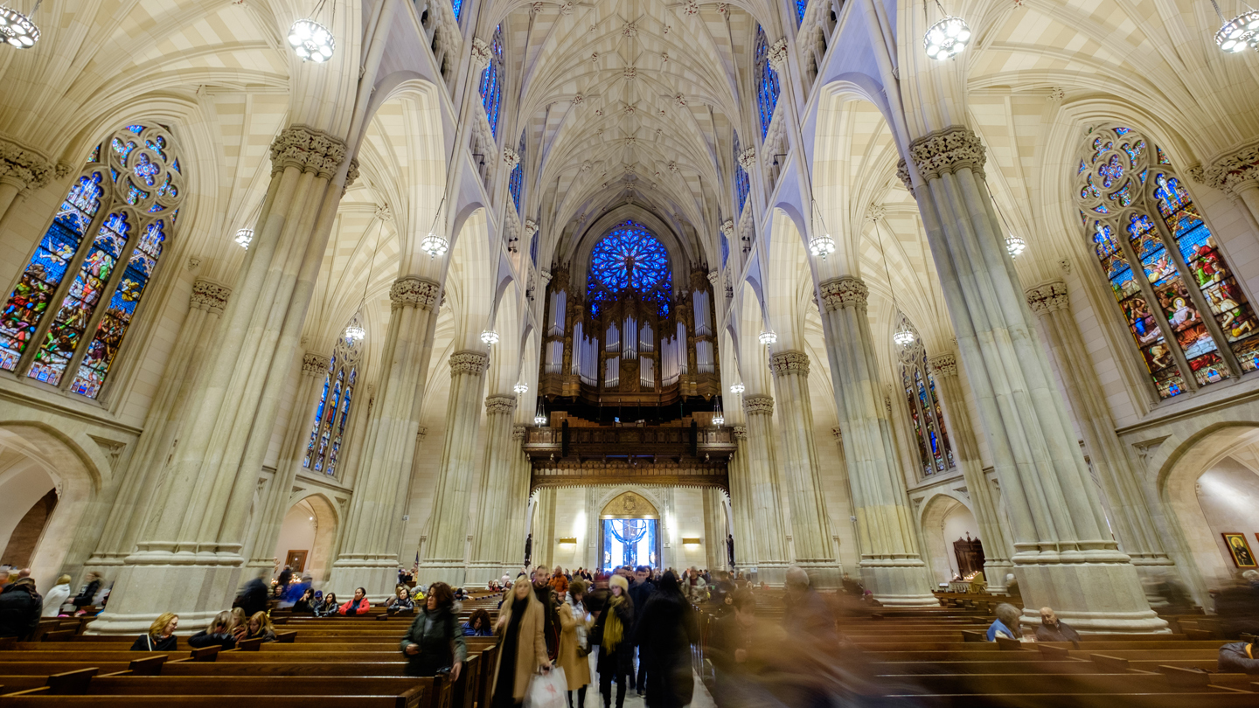
Chapter 4 summary

Slide 6
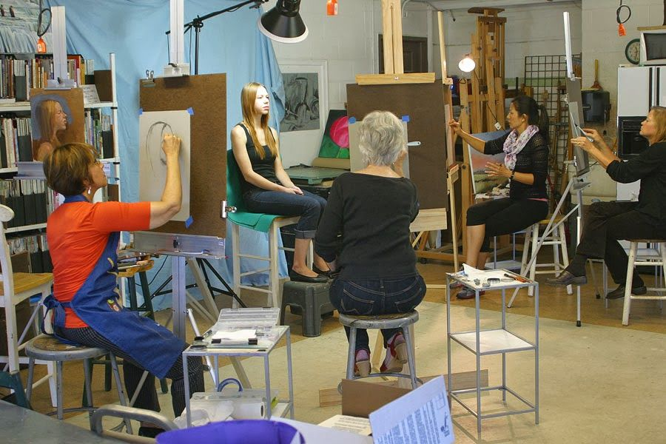
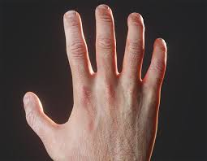
Chapter 5 Summary

Slide 7
Discussion Question #1
In Chapter 3, what do we learn about Murray’s relationship with his grandson Chance? What do you think about their relationship? What do we learn about Murray’s personality and past from their conversation?
Chapter 3, what do we learn about Murray’s relationship with his grandson Chance? Choose all that apply.
Murray doesn’t think Chance cares about him
Chance likes to eat Chef Boyardee with his grandfather
Chance brings his grandfather secondhand gifts
Chance wants Murray to move into an assisted living home
Murray wishes he told Chance that he loves him

Slide 8
Discussion Question #2
Murray listens to Father James speak on the phone with Martha. He thinks: “These days, some folks are all business. No time to even ask how someone’s day has been before they get down to it. But not the good Father” (p. 23). Do you agree with Murray’s observation? If yes, what role might technology play in this societal shift? How is this reflected in the email exchange between Murray and Jason?
On a scale from 1-10, how much do you agree with Murray that: “These days, some folks are all business. No time to even ask how someone’s day has been before they get down to it” (p. 23).

Slide 9
Discussion Question #3
On his way to community college, Murray thinks about how his “world has shrunk in the last couple decades” (p. 28). What does Murray mean when he talks about his world shrinking? Have you ever felt like Murray? If so, how did you make yourself feel better?
What does Murray think about on his way to the community college? Choose all that apply.
Anticipation
His shrinking world
Chance
Racism in baseball
His favorite artist
Demographics

Slide 10
Discussion Question #4
Jason appears to have a difficult relationship with his father and Murray describes his strained relationship with his son and grandson. After reading Chapters 3-5, do you think Murray and Jason will get along? Why or why not? Do you have any predictions about how they will impact each other’s lives?
Make a prediction! Do you think Jason and Murray will get along? Why or why not?

Slide 11
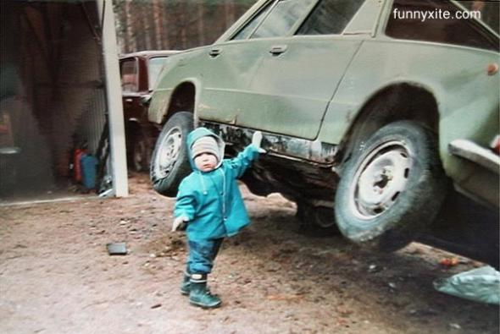
Would you rather
Have universal respect or unlimited power?

Slide 12
Would you rather
Be able to travel to any time in the future or any time in the past?

Slide 13
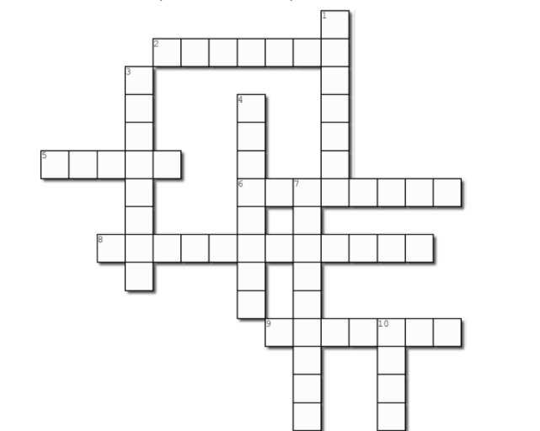
1 down
I
N
C
E
N
S
E

Slide 14
2 across
B U F F O O N

Slide 15
3 down
M
O
D
E
L
I
N
G

Slide 16
4 down
K
E
Y
B
O
A
R
D

Slide 17
5 across
M o n e y

Slide 18
6 across
B a s e b a l l

Slide 19
7 down
S
P
A
G
H
E
T
T
I

Slide 20
8 across
U n s p e a k a b l e s

Slide 21
9 across
D e c a d e s

Slide 22
10 down
D
U
D
E

