Slide 1
The Five Wishes of Mr. Murray McBride
(Chapters 3-5)
Olivia Zaino and Trevor Whalen

Slide 2
In Chapter 3, what do we learn about Murray’s relationship with his grandson Chance?
What do you think about their relationship?
What do we learn about Murray’s personality and past from their conversation?

Slide 3
Murray listens to Father James speak on the phone with Martha. He thinks: “These days, some folks are all business. No time to even ask how someone’s day has been before they get down to it. But not the good Father” (p. 23).
Do you agree with Murray’s observation?
If yes, what role might technology play in this societal shift?
How is this reflected in the email exchange between Murray and Jason?

Slide 4
On his way to community college, Murray thinks about how his “world has shrunk in the last couple decades” (p. 28).
What does Murray mean when he talks about his world shrinking?
Have you ever felt like Murray?
If so, how did you make yourself feel better?

Slide 5
Jason appears to have a difficult relationship with his father and Murray describes his strained relationship with his son and grandson.
After reading Chapters 3-5, do you think Murray and Jason will get along?
Why or why not?
Do you have any predictions about how they will impact each other’s lives?

Slide 6
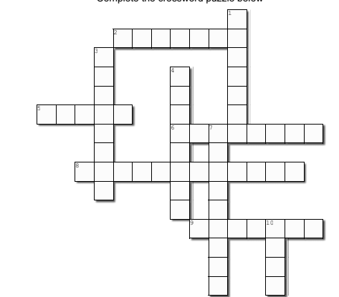
6 Across
6. Mr. McBride used to play _______ for a living (p. 15)

Slide 7
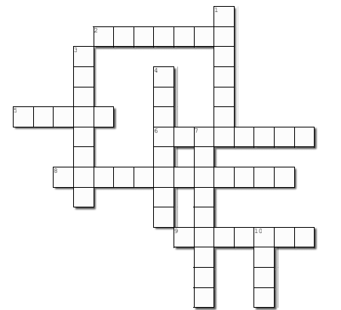
6 Across
6. Mr. McBride used to play _______ for a living (p. 15)
B a s e b a l l

Slide 8
1 Down
1. What smell makes Mr. McBride dizzy in the art classroom? (p. 29)

Slide 9
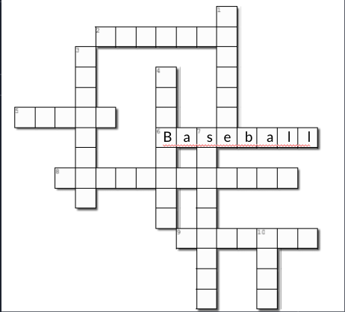
1 Down
incens
1. What smell makes Mr. McBride dizzy in the art classroom? (p. 29)

Slide 10
4 Down
4. Mr. McBride only knows three parts of a computer: mouse, keys & _______ (p. 23)

Slide 11
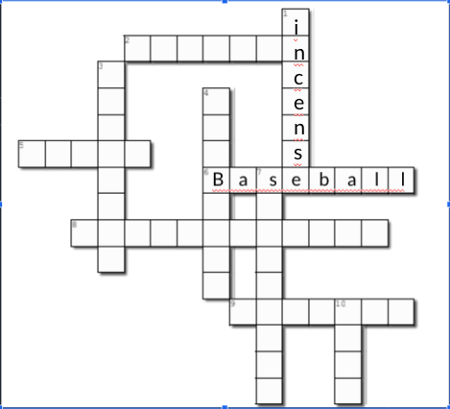
4 Down
key
4. Mr. McBride only knows three parts of a computer: mouse, keys & _______ (p. 23)
oard

Slide 12
3 Down
What is the name of Mr. McBride’s current job? (pg. 28)

Slide 13
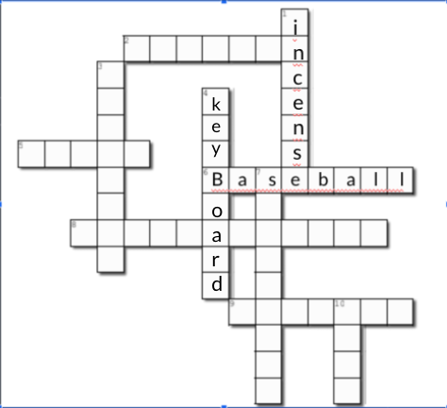
3 Down
Model ing
What is the name of Mr. McBride’s current job? (pg. 28)

Slide 14
2 Across
2. Mr. McBride tells the art professor that he is not a _____ (p. 31)

Slide 15
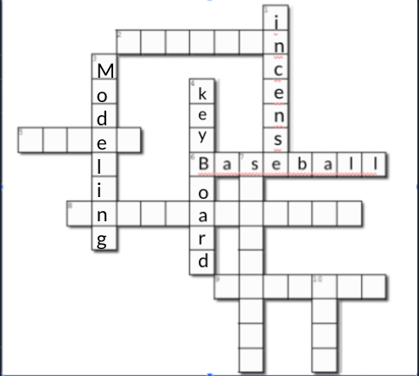
2 Across
B u f f o o
2. Mr. McBride tells the art professor that he is not a _____ (p. 31)

Slide 16
8 Across
8. What does the art professor suggest Mr. McBride keep on during the class? His “_________” (p. 30)

Slide 17
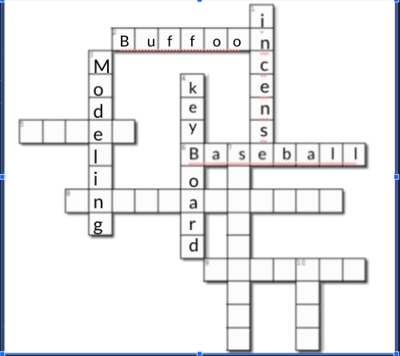
8 Across
8. What does the art professor suggest Mr. McBride keep on during the class? His “_________” (p. 30)
u
s p e
k a b l e s

Slide 18
9 Across
9. 'I feel so happy I very nearly skip for the first time in a good nine _______.” (p. 26)

Slide 19
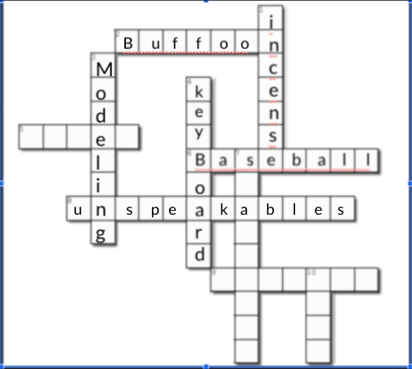
9 Across
9. 'I feel so happy I very nearly skip for the first time in a good nine _______.” (p. 26)
D e c a d e s

Slide 20
10 Down
10. What does Jason call Mr. McBride in his email to him? (p. 25)

Slide 21
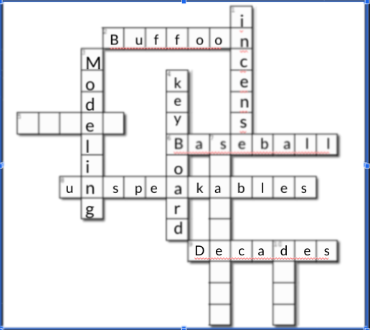
10 Down
10. What does Jason call Mr. McBride in his email to him? (p. 25)
ude

Slide 22
5 Across
5. Mr. McBride thinks Chance is obsessed with ______ (p. 17)

Slide 23
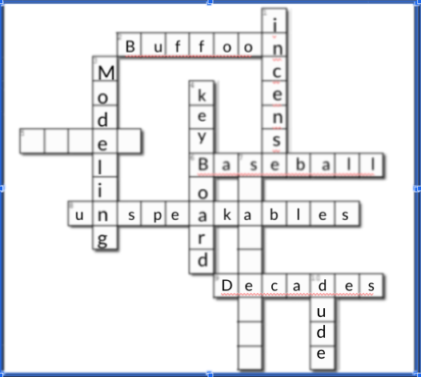
5 Across
5. Mr. McBride thinks Chance is obsessed with ______ (p. 17)
M o n e y

Slide 24
7 Down
7. Mr. McBride eats two types of Chef Boyardee: ravioli and _______ (p. 15)

Slide 25
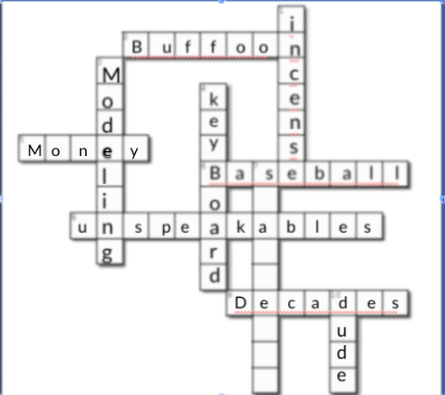
7 Down
7. Mr. McBride eats two types of Chef Boyardee: ravioli and _______ (p. 15)
p
g
h
tti

Slide 26
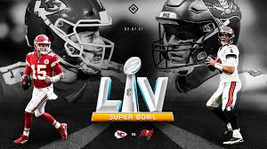
Who are you rooting for?
Opinions on Tom Brady? (love? hate? respect??)
Super Bowl Traditions (food, family)
Super Bowl Plans this year?
Predictions?

