Slide 1
The Five Wishes of Mr. Murray McBride
Chapters 26-29

Slide 2
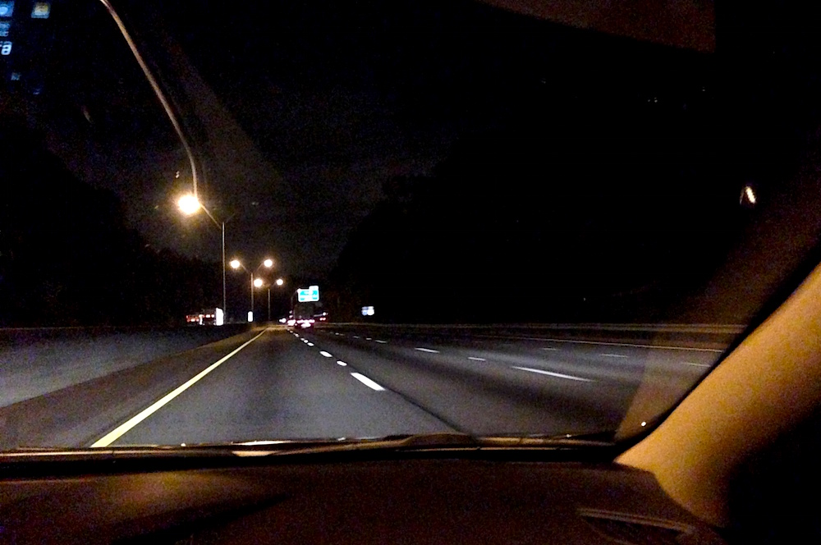
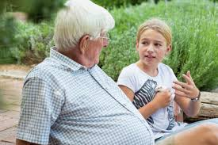
Chapter 26
Chapter 27
The group drives to Chicago at night,
Tiegan and Murray talk on the road
The group has breakfast at the apartment.
Jason wants to talk to Murray alone

Slide 3
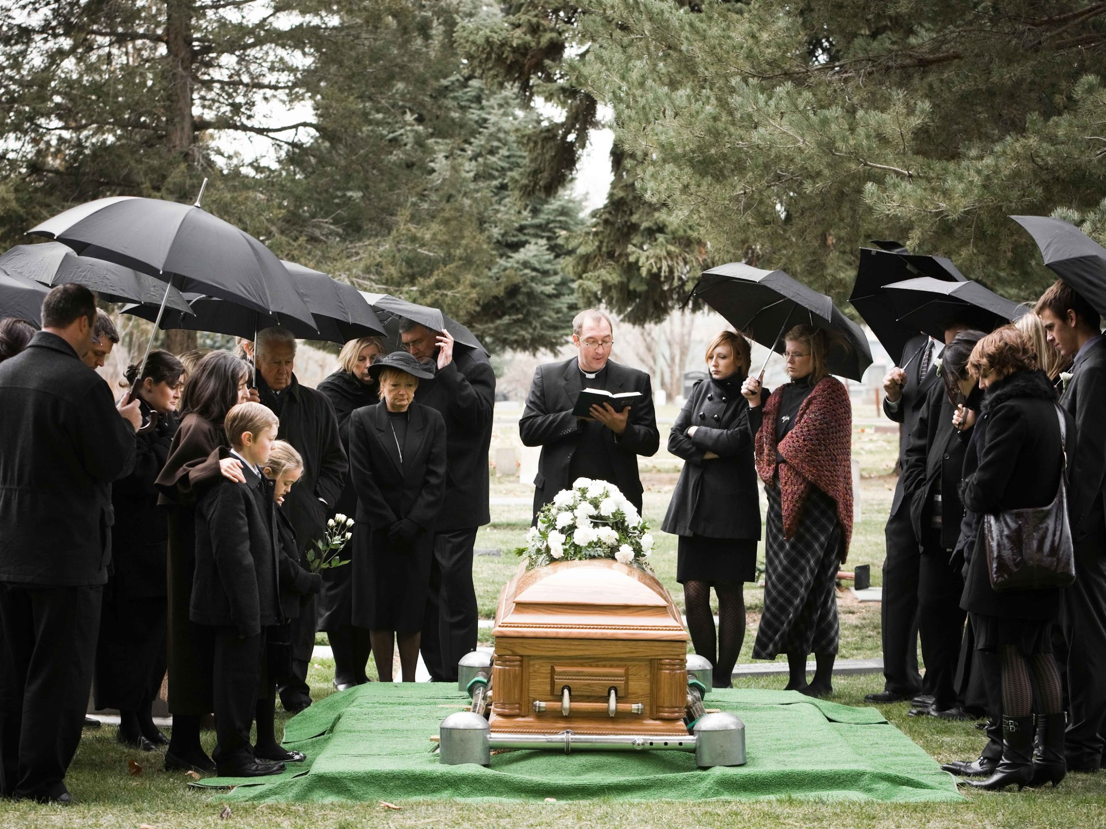
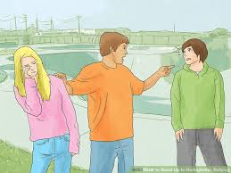
Chapter 28
Chapter 29
Jason asks Murray about death, and talks about planning his funeral
The group sees that Jason and Tiegan have been reported missing.
Jason stands up for Tiegan against bullies

Slide 4
1A
In Chapter 26, Tiegan helps keep Murray awake on the road.
What are some of the things they talk about?
What is Murray’s opinion of Tiegan?
Have you taken a long trip with someone?
Do you have profound conversations on long
car rides or do you keep it light?

Slide 5
1B
After eating breakfast, Jason takes deep breaths from his oxygen tank, then runs to the car to grab his video game. After that he tells Tiegan she should go shower. Why?
He does not want to play video games with her
Tiegan smells bad
He wants to be alone with Murray
He knows Tiegan wanted to shower first.

Slide 6
2
In Chapter 28, Murray reveals to Jason that he has seen loved ones in his life pass away. Who were they?
His sons
His brother
His wife
His sister

Slide 7
2
How have you ever lost a loved one?
How did you cope with the loss of a loved one?
What would be your advice to Jason in this scene?

Slide 8
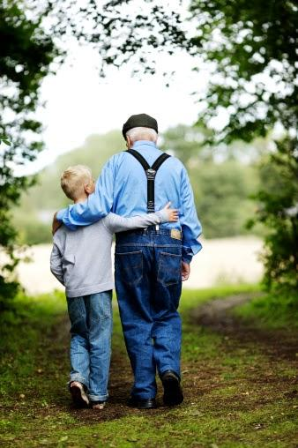
3
In Chapter 29, Murray decides to play a more fatherly role since Jason is left in his care for the weekend in Chicago. The first thing he attempts to do is
Give Jason medical advice
Clean orange juice Jason’s shirt
Call Anna for advice
Get a handkerchief to wipe Jason’s face

Slide 9
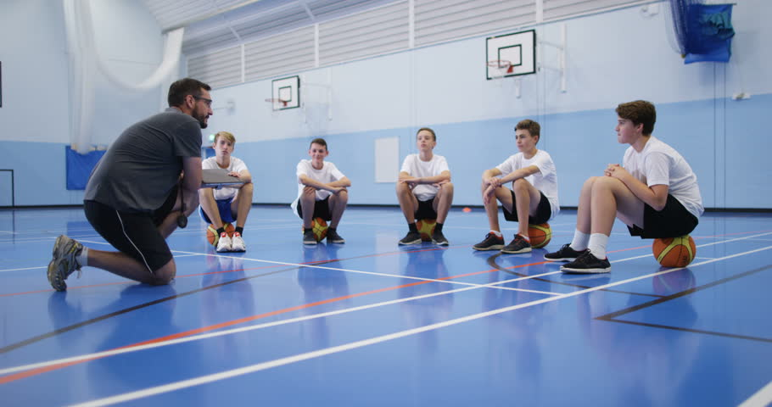
3
Have you played a parenting role or mentoring role to someone who was not your child? If so, in what way?

Slide 10
4
During their excursion in Chicago, Jason, Tiegan, and Murray find a Mexican restaurant to eat at for dinner. Who do they see on the news, and why?
Celia Cruz and Patti Labelle are in town
Amber alert for random boy and girl
Jason and Tiegan are reported as Missing
Benedict Cashman is offering a cash reward for Jason

Slide 11
4
Do you think Murray’s response to what they saw on TV was appropriate?
What could Murray have done to prevent this from occurring?

Slide 12
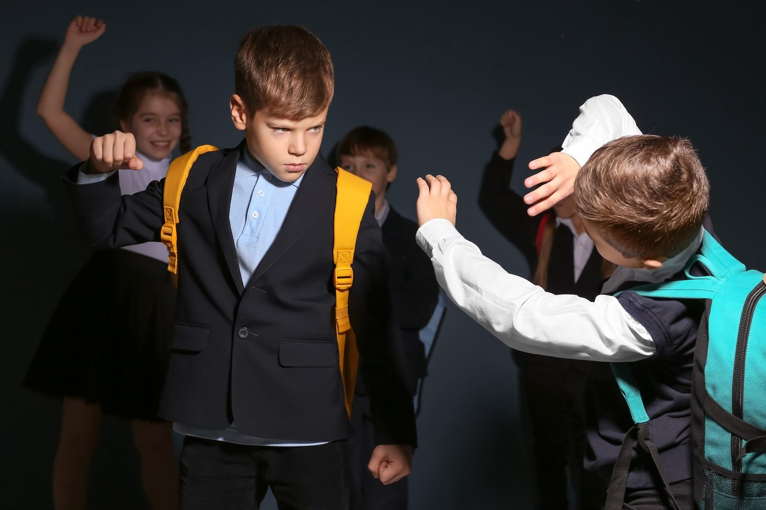
5
In Chapter 29, a group of 4 boys tease Tiegan, stating that she can not play baseball and that she can only play with a larger softball. In response Jason walks up to one of the boys and does this:
Punches the boy right in the crotch
Punches the boy in the face
Grabs Tiegan’s hand and runs away
Asks Murray to say something to them

Slide 13
1 Down
After Jason defends Tiegan, he grins in the same way that he smiled after he kissed Mindy _________.

Slide 14
1 Down
A
P
P
L
E
G
A
T
E
After Jason defends Tiegan, he grins in the same way that he smiled after he kissed Mindy Applegate.

Slide 15
2 Down
A
P
P
L
E
G
A
T
E
After Jason destroys Murray in video games, Murray tells Jason he needs to be more of a ________ winner.

Slide 16
2 Down
A
P
P
L
E
G
A
T
E
G
R
A
C
I
O
U
S
After Jason destroys Murray in video games, Murray tells Jason he needs to be more of a gracious winner.

Slide 17
3 Down
A
P
P
L
E
G
A
T
E
G
R
A
C
I
O
U
S
In Anna’s absence, Murray feels he should try to be as ________ as possible.

Slide 18
3 Down
A
P
P
L
E
G
A
T
E
G
R
A
C
I
O
U
S
F
A
T
H
E
R
L
Y
In Anna’s absence, Murray feels he should try to be as fatherly as possible.

Slide 19
6 Down
A
P
P
L
E
G
A
T
E
G
R
A
C
I
O
U
S
F
A
T
H
E
R
L
Y
A mean group of boys tell Tiegan that girls can only play ________.

Slide 20
6 Down
A
P
P
L
E
G
A
T
E
G
R
A
C
I
O
U
S
F
A
T
H
E
R
L
Y
A mean group of boys tell Tiegan that girls can only play softball.
S
O
F
T
B
AL
L

Slide 21
7 Down
A
P
P
L
E
G
A
T
E
G
R
A
C
I
O
U
S
F
A
T
H
E
R
L
Y
Jason wants Murray to buy him a t-shirt that says kiss me I’m _____.
S
O
F
T
B
AL
L

Slide 22
7 Down
A
P
P
L
E
G
A
T
E
G
R
A
C
I
O
U
S
F
A
T
H
E
R
L
Y
Jason wants Murray to buy him a t-shirt that says kiss me I’m Irish.
S
O
F
T
B
AL
L
I
R
I
SH

Slide 23
4 Across
A
P
P
L
E
G
A
T
E
G
R
A
C
I
O
U
S
F
A
T
H
E
R
L
Y
Jason, Tiegan, and Murray can see this field tower from their apartment balcony.
_______
S
O
F
T
B
AL
L
I
R
I
SH

Slide 24
4 Across
A
P
P
L
E
G
A
T
E
G
R
A
C
I
O
U
S
F
A
T
H
E
R
L
Y
Jason, Tiegan, and Murray can see this field tower from their apartment balcony.
Wrigley
W R G L E Y
S
O
F
T
B
AL
L
I
R
I
SH

Slide 25
5 Across
A
P
P
L
E
G
A
T
E
G
R
A
C
I
O
U
S
F
A
T
H
E
R
L
Y
Tiegan discovers that 1923 was Murray’s best baseball year by using this internet browser.
_____
W R G L E Y
S
O
F
T
B
AL
L
I
R
I
SH

Slide 26
5 Across
A
P
P
L
E
G
A
T
E
G
R
A
C
I
O
U
S
F
A
T
H
E
R
L
Y
Tiegan discovers that 1923 was Murray’s best baseball year by using this internet browser.
Yahoo
W R G L E Y
Y A O O
S
O
F
T
B
AL
L
I
R
I
SH

Slide 27
6 Across
A
P
P
L
E
G
A
T
E
G
R
A
C
I
O
U
S
F
A
T
H
E
R
L
Y
When Tiegan steps out of the bathroom, the room smells like ____________.
W R G L E Y
Y A O O
S
O
F
T
B
AL
L
I
R
I
SH

Slide 28
6 Across
A
P
P
L
E
G
A
T
E
G
R
A
C
I
O
U
S
F
A
T
H
E
R
L
Y
When Tiegan steps out of the bathroom, the room smells like strawberries.
W R G L E Y
Y A O O
S
O
F
T
B
AL
L
T A W B R R E
I
R
I
SH

Slide 29
8 Across
A
P
P
L
E
G
A
T
E
G
R
A
C
I
O
U
S
F
A
T
H
E
R
L
Y
Who gave Jason the impression that he is supposed to die soon?
_______
W R G L E Y
Y A O O
S
O
F
T
B
AL
L
T A W B R R E
I
R
I
SH

Slide 30
8 Across
A
P
P
L
E
G
A
T
E
G
R
A
C
I
O
U
S
F
A
T
H
E
R
L
Y
Who gave Jason the impression that he is supposed to die soon?
Doctors
W R G L E Y
Y A O O
S
O
F
T
B
AL
L
T A W B R R E
I
R
I
SH
D O C T O R

Slide 31
Happy Spring!
Highs and lows?
Anything you are looking forward to this weekend?

