Slide 1
ABC 1 Chapters 20-25
March 12, 2021

Slide 2
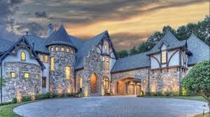
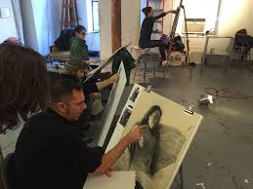
Summary chapter 20-22 Summary
Chapter 20 at Benedict’s mansion
Chapter 22 Murray playing video games with Jason
Chapter 21 modeling at community college

Slide 3
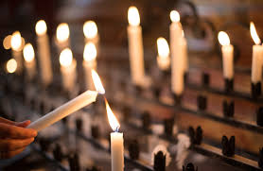
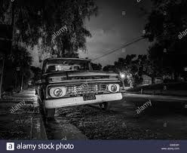
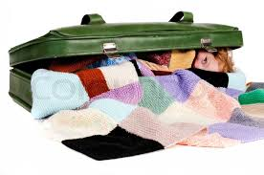
Chapters 23-25 summary
Chapter 25 hiding in suitcase
Chapter 23 at the church
Chapter 24 waiting for Jason

Slide 4
Question 1
On page 110, Murray asks Mr. Cashman if Jason can go to Chicago to take batting practice at Wrigley Field on Saturday. Mr. Cashman’s final answer is, “When he’s here, he’s mine. Understood?”
Does this answer surprise you?
Why or why not?
What does Murray think about this response?
Would you let your 10 year old go off on a trip with an old man that you don’t know well?

Slide 5
Question 2
On page 115, When Anna shows Collins the picture she painted of her hands, he says “It’s beautiful.” Murray says, “anyone with half a brain could tell he’s not talking about the painting.”
What is Murray referring to?
Do you have any predictions as to whether this plays into the rest of the book?

Slide 6
Question 3
On pages 123 and 124, When Murray and Father James are talking about the plan to go to Chicago, Father James tries warning Murray of the risks. Murray replies, “What’s life without a little risk?” and “Besides, when was the last time I took a risk?”
What do you think the reason Murray is taking extra risks now?
Do you think the adrenaline of the risk is good for Murray at his old age?
Can you give an example of something you’ve done in your life that might be considered risky?

Slide 7
Question 4
On page 128, Murray can’t believe Tiegan came with them.
Are you surprised Tiegan would sneak out on her mother?
Did you ever tell lies to sneak out of the house or go places you were not supposed to?

Slide 8
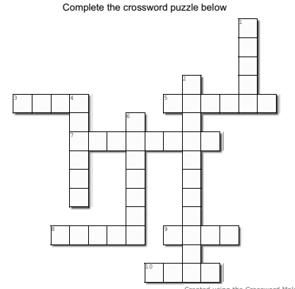
3 across
3. Murray jokes with Jason that he didn't have to pack the kitchen ____. (Page 127)

Slide 9
3 across
3. Murray jokes with Jason that he didn't have to pack the kitchen ____. (Page 127)
S i n k

Slide 10
1 down
1. Murray refers to Chicago as the ______. (page 110)
S i n k

Slide 11
1 down
apple
1. Murray refers to Chicago as the ______. (page 110)
S i n k

Slide 12
5 across
apple
5. Where Jason was hiding when Murray arrived to
pick him up. (page 126)
S i n k

Slide 13
5 across
apple
5. Where Jason was hiding when Murray arrived to
pick him up. (page 126)
S i n k
B u s h
s

Slide 14
2 down
apple
2. What does Murray feel in his stomach before
driving to pick Jason up the night that they leave?
(Page 125)
S i n k
B u s h
s

Slide 15
2 down
apple
2. What does Murray feel in his stomach before
driving to pick Jason up the night that they leave?
(Page 125)
b
S i n k
B u s h
s
tterflies

Slide 16
4 down
apple
4. what is the word Father James uses to describe
Murray's plan B (page 123)
b
S i n k
B u s h
s
tterflies

Slide 17
4 down
apple
4. what is the word Father James uses to describe
Murray's plan B (page 123)
b
S i n k
B u s h
s
idnap
tterflies

Slide 18
6 down
apple
6. What are the lights that Murray sees in the corner
of the church? (Page 122)
b
S i n k
B u s h
s
idnap
tterflies

Slide 19
6 down
apple
6. What are the lights that Murray sees in the corner
of the church? (Page 122)
b
S i n k
B u s h
s
idnap
candles
tterflies

Slide 20
7 across
apple
7. The team Tiegan was supposed to play against in
her baseball game. (Page 128)
b
S i n k
B u s h
s
idnap
candles
tterflies

Slide 21
7 across
apple
7. The team Tiegan was supposed to play against in
her baseball game. (Page 128)
b
S i n k
B u s h
s
idnap
candles
tterflies
y n
m i
e

Slide 22
8 across
apple
8. Collins Jackson models while people draw his
b
S i n k
B u s h
s
idnap
candles
tterflies
y n
m i
e

Slide 23
8 across
apple
8. Collins Jackson models while people draw his
b
S i n k
B u s h
s
idnap
candles
tterflies
y n
m i
e
H a n d

Slide 24
9 across
apple
9. What is the picture that Jason painted at the
community center? (Page 115)
b
S i n k
B u s h
s
idnap
candles
tterflies
y n
m i
e
H a n d

Slide 25
9 across
apple
9. What is the picture that Jason painted at the
community center? (Page 115)
b
S i n k
B u s h
s
idnap
candles
tterflies
y n
m i
e
H a n d
d
r t

Slide 26
10 across
apple
10. On page 123, Murray says, 'What's life without a
little ________.
b
S i n k
B u s h
s
idnap
candles
tterflies
y n
m i
e
H a n d
d
r t

Slide 27
10 across
apple
10. On page 123, Murray says, 'What's life without a
little ________.
b
S i n k
B u s h
s
idnap
candles
tterflies
y n
m i
e
H a n d
d
r t
R i
k

Slide 28
March madness
Will anybody be watching March Madness?
Predictions?

