Slide 1
Aphasia Book Club
Chapters 18-19

Slide 2
Weekly Check-In
Discussion: Any upcoming travel plans?
Notes:
If not, where is one place you would want to travel to?

Slide 3
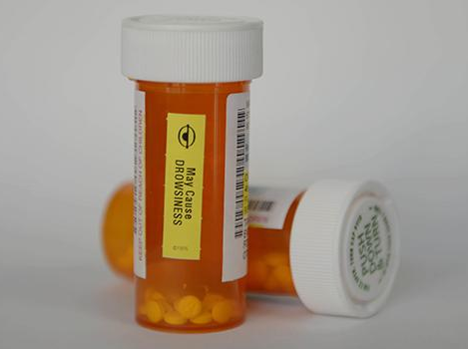
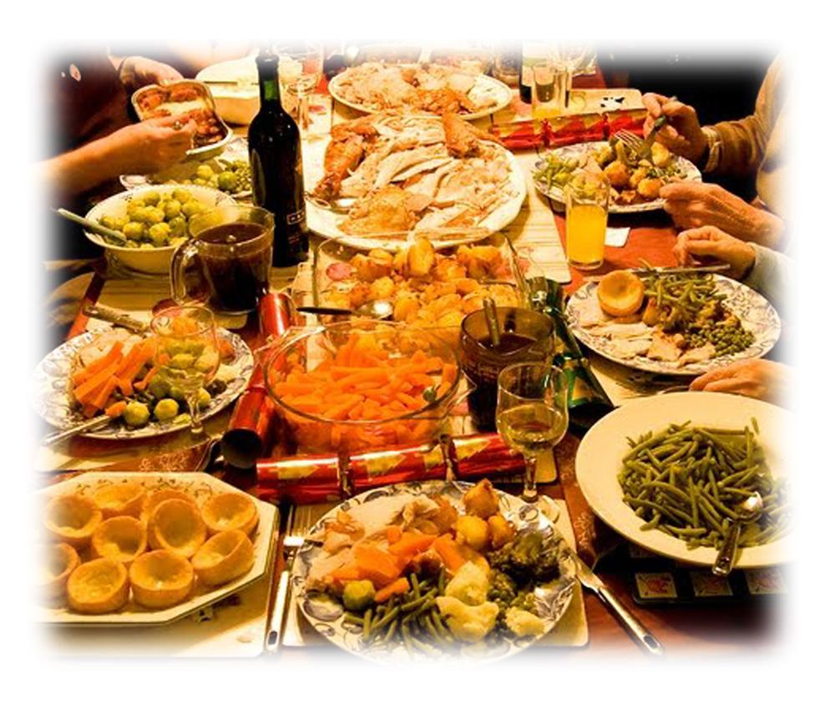
Chapter 18

Slide 4
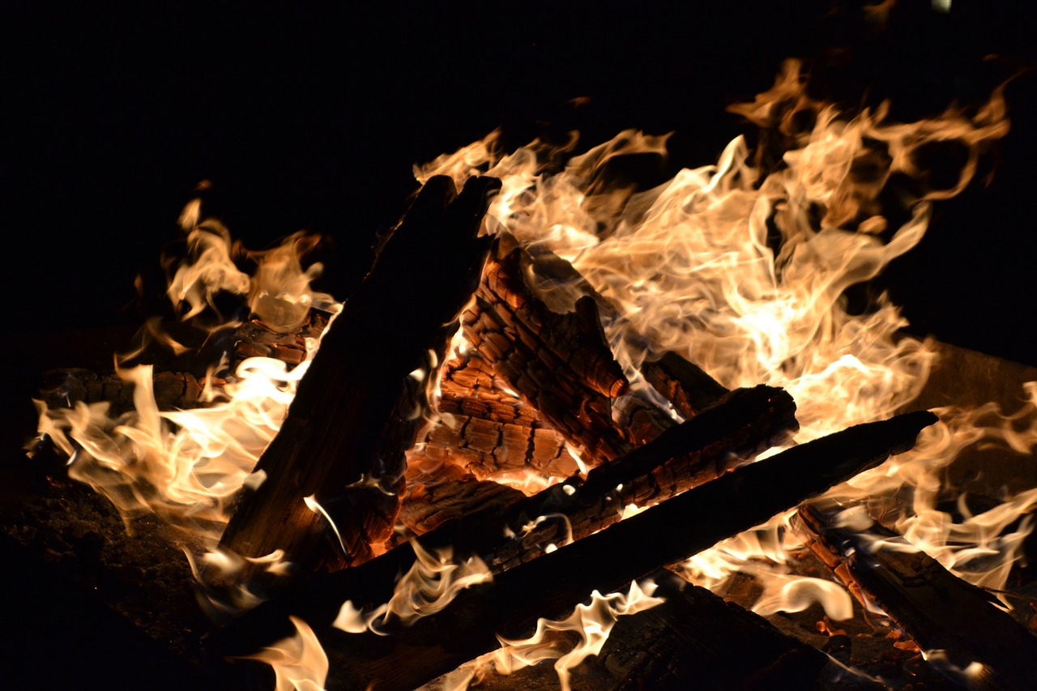
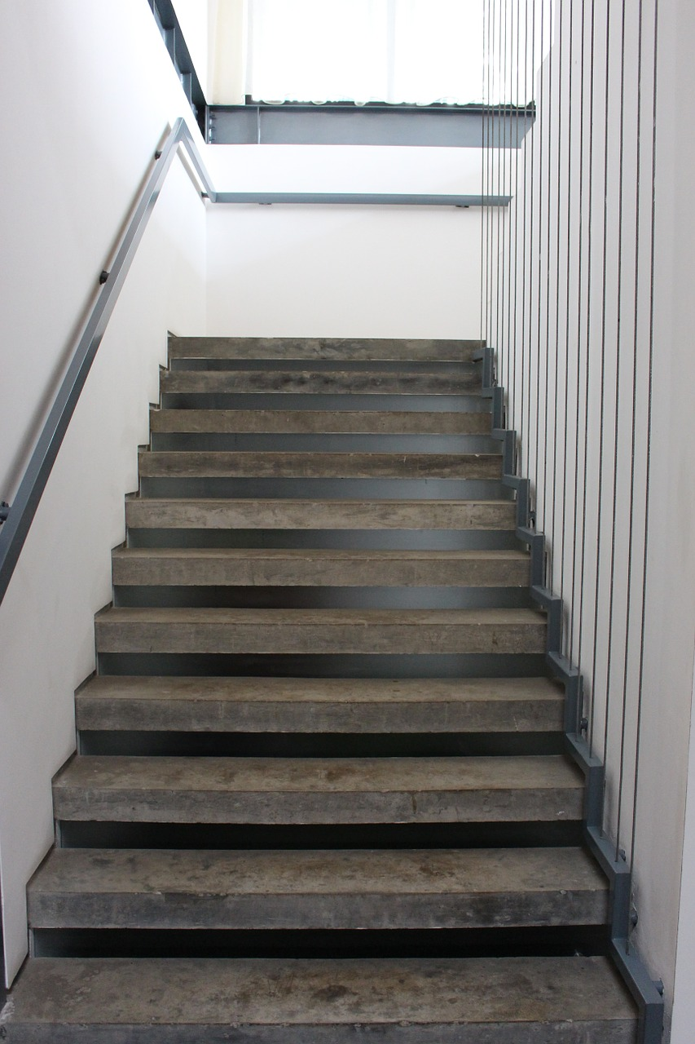
Chapter 19

Slide 5
Goals!
Bob - expanding to 3 sentences
John - talking slower and catching errors
Bill - limit to 3 sentences
Larry - just keep working on reading and memory independently
V - speaking and reading louder
Harry - limit to 3 sentences
Ted - read one question aloud and “add” on to others’ comments
How did we do today?

Slide 6
