Slide 1
The Five Wishes of
Mr. Murray McBride
Chapters 17-19

Slide 2
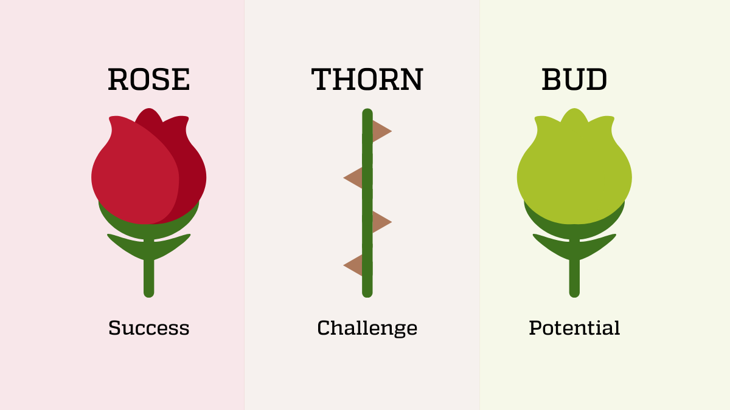

Slide 3
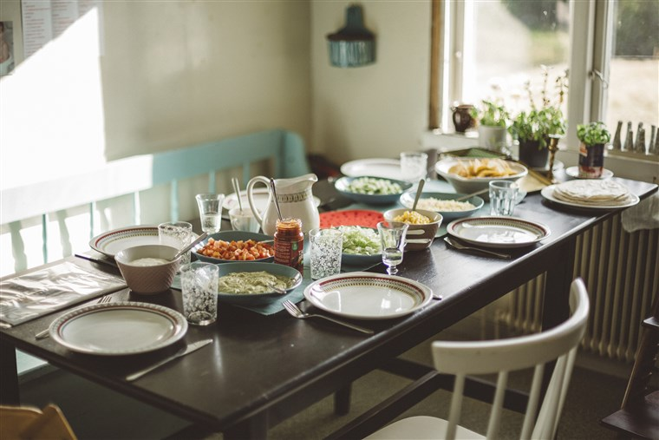
Chapter 17

Slide 4
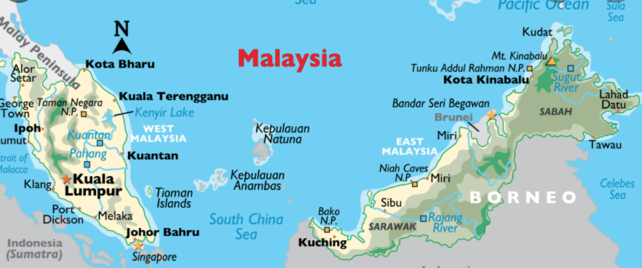
Chapter 18

Slide 5
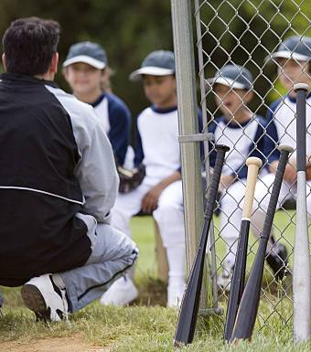
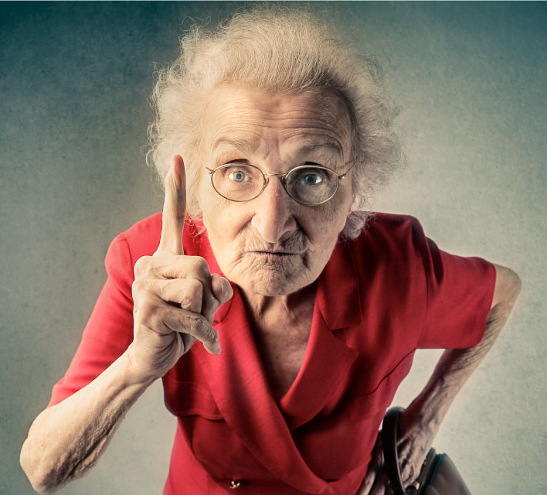
Chapter 19

Slide 6
Worksheet A, Question 1
On page 95, Della and Tiegan describe their motto as “a reminder of how to live”. What is their motto? Why do Della and Tiegan have a motto? What does Murray think about their motto? Do you have a motto? If yes, share with the group! If no, why not?

Slide 7
Worksheet B, Question 1
What is Della and Tiegan’s life motto?
SBK - sincere, beautiful and knowledgeable
CSW - courage, strength and wisdom
SBK - strong, brave and kind
CFI - creative, fun and intelligent
LLL - live, laugh and love

Slide 8
Worksheet A, Question 2
Jason surprises Anna by inviting a guest over for dinner. What is Anna’s reaction? Is Jason’s plan successful? Have you ever been set up on a blind date? How did you meet your husband/wife/partner?

Slide 9
Worksheet B, Question 2
Why does Jason invite Doctor Lester over for dinner?
To thank him for helping treat his heart condition
To introduce him to his friend Tiegan
Because his mom asked him to set them up on a date
To surprise his mom with a new boyfriend
So Doctor Lester can teach him and Tiegan baseball

Slide 10
Worksheet A, Question 3
In Chapter 19, Murray compares the game of baseball to how it used to be. He describes: “These fields aren’t full of kids, they’re full of machines.” What is Murray noticing? Do you agree with him? What other things have changed that make that make life more stressful and less fun for kids?

Slide 11
Worksheet B, Question 3
On a scale of 1-10, how much baseball has Jason actually been able to play during his life? 1 2 3 4 5 6 7 8 9 10
On page 105, Murray describes the kids playing baseball as:
Soldiers
Machines
Athletes
Robots
Teammates

Slide 12
Worksheet A, Question 4
Jason and Murray spend a lot of time together and are learning more and more about each other’s lives. How has their friendship impacted them so far? How might it impact the people around them, such as Tiegan or Chance?

Slide 13
Worksheet B, Question 4
Jason and Murray spend a lot of time together and are learning more and more about each other’s lives. In your opinion, who else has their friendship impacted? Circle all that apply.
Tiegan
Chance
Anna
Father James
Jason’s father

Slide 14
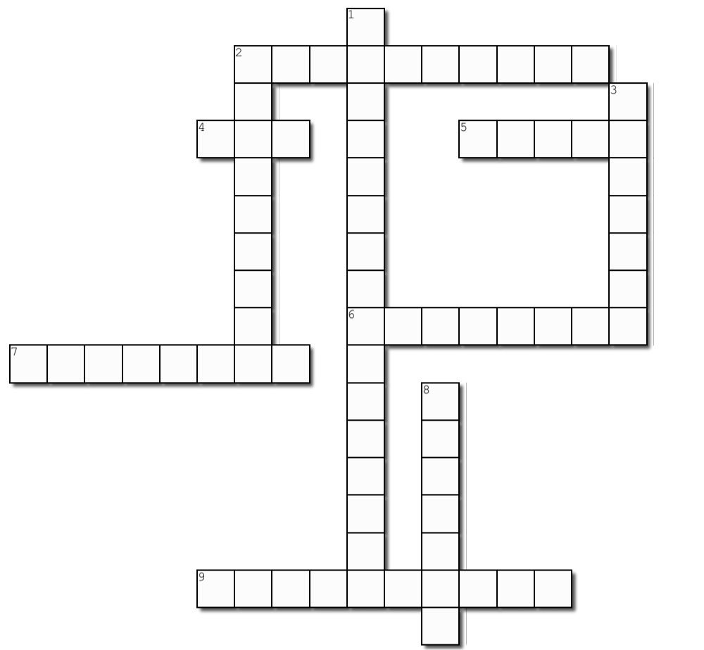
1 Down
The subject of Murray's email in Chapter 18
(two words, p. 101)

Slide 15
BATTING
PRACTICE
1 Down
The subject of Murray's email in Chapter 18
(two words, p. 101)
Batting practice

Slide 16
2 Across
Tiegan smells like 'a ______ patch at
harvest time'
(p. 103)

Slide 17
S T R A W B E R R Y
2 Across
Tiegan smells like 'a ______ patch at
harvest time'
(p. 103)
Strawberry

Slide 18
2 Down
Murray tells Jason and Tiegan to ______ when Old Lady Willamette sees them playing baseball in her garden
(p. 107)

Slide 19
SKEDADDLE
2 Down
Murray tells Jason and Tiegan to ______ when Old Lady Willamette sees them playing baseball in her garden
(p. 107)
Skedaddle

Slide 20
3 Down
Great-Grandma Pepper played on the Rockford ______ (p. 95)

Slide 21
3 Down
PEACHES
Great-Grandma Pepper played on the Rockford ______ (p. 95)
Peaches

Slide 22
4 Across
Doctor Lester thinks Anna is a ____ grandmaster
(p. 100)

Slide 23
4 Across
Z E N
Doctor Lester thinks Anna is a ____ grandmaster
(p. 100)
Zen

Slide 24
5 Across
What does Murray feel while playing the video game with Jason? (p. 96)

Slide 25
5 Across
P R I D E
What does Murray feel while playing the video game with Jason? (p. 96)
Pride

Slide 26
6 Across
What kind of doctor is Derek Lester?
(p. 99)

Slide 27
6 Across
What kind of doctor is Derek Lester?
(p. 99)
Plastics
P L A S T I C S

Slide 28
7 Across
One of the body parts that hurts when Murray throws the baseball
(p. 106)

Slide 29
7 Across
One of the body parts that hurts when Murray throws the baseball
(p. 106)
Shoulder
S H O U L D E R

Slide 30
8 Down
'But anyone listening could tell you there's nothing but love behind it. Nothing but pure, beautiful _______' (p. 93)

Slide 31
8 Down
'But anyone listening could tell you there's nothing but love behind it. Nothing but pure, beautiful _______' (p. 93)
Loyalty
L
O
Y
A
L
T
Y

Slide 32
9 Across
Murray describes the car ride with Chance to Jason's house as _________ (p. 92)

Slide 33
9 Across
Murray describes the car ride with Chance to Jason's house as _________ (p. 92)
Uneventful
U N E V E N T F U L

