Slide 1
The Five Wishes of Mr. Murray McBride
Chapters 17-19
March 5, 2021

Slide 2
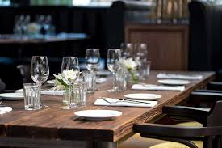
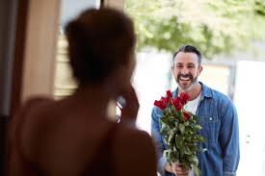
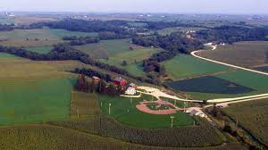
Chapter 17-19 Recap
Chapter 17: dinner party
Chapter 18: Dr. Lester arrives
Chapter 19: Old Lady Willamette’s Farm

Slide 3
Question 1
What is Della and Tiegan’s life motto?
SBK - sincere, beautiful and knowledgeable
CSW - courage, strength and wisdom
SBK - strong, brave and kind
CFI - creative, fun and intelligent
LLL - live, laugh and love

Slide 4
Question 2
Why do Della and Tiegan have a motto?
What does Murray think about their motto?
Do you have a motto?
If yes, share with the group!
If no, why not?

Slide 5
Question 3
Jason surprises Anna by inviting a guest over for dinner.
What is Anna’s reaction?
Is Jason’s plan successful?
Have you ever been set up on a blind date?
How did you meet your husband/wife/partner?

Slide 6
Question 4
On page 105, Murray describes the kids playing baseball as:
Soldiers
Machines
Athletes
Robots
Teammates

Slide 7
Question 5
In Chapter 19, Murray compares the game of baseball to how it used to be. He describes: “These fields aren’t full of kids, they’re full of machines.”
What is Murray noticing?
Do you agree with him?
What other things have changed that make that make life more stressful and less fun for kids?

Slide 8
Question 6
Jason and Murray spend a lot of time together and are learning more and more about each other’s lives.
How has their friendship impacted them so far?
How might it impact the people around them, such as Tiegan or Chance?

Slide 9
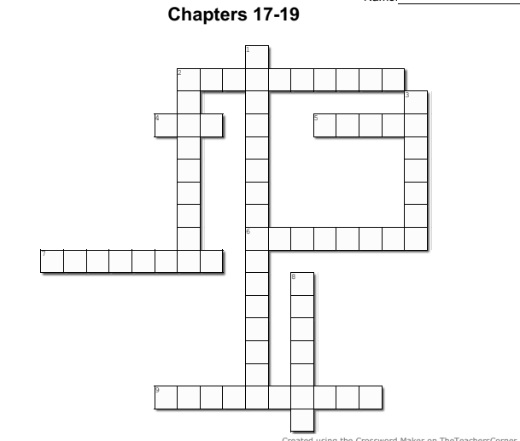
2 Across
2. Tiegan smells like 'a ______ patch at harvest time' (p. 103)

Slide 10
2 Across
S t r a w b e r r y
2. Tiegan smells like 'a ______ patch at harvest time' (p. 103)

Slide 11
1 Down
S t r a w b e r r y
1. The subject of Murray's email in Chapter 18 (two words, p. 101)

Slide 12
1 Down
b
S t r a w b e r r y
tt in g
1. The subject of Murray's email in Chapter 18 (two words, p. 101)
Pract ice

Slide 13
4 Across
b
S t r a w b e r r y
tt in g
4. Doctor Lester thinks Anna is a ____ grandmaster (p. 100)
Pract ice

Slide 14
4 Across
b
S t r a w b e r r y
tt in g
Z e n
4. Doctor Lester thinks Anna is a ____ grandmaster (p. 100)
Pract ice

Slide 15
2 Down
b
S t r a w b e r r y
tt in g
Z e n
Murray tells Jason and Tiegan to
______ when Old Lady Willamette sees them playing baseball in her garden (p. 107)
Pract ice

Slide 16
2 Down
b
S t r a w b e r r y
k
tt in g
Z e n
Murray tells Jason and Tiegan to
______ when Old Lady Willamette sees them playing baseball in her garden (p. 107)
daddle
Pract ice

Slide 17
5 Across
b
S t r a w b e r r y
k
tt in g
Z e n
5. What does Murray feel while playing the video game with Jason? (p. 96)
daddle
Pract ice

Slide 18
5 Across
b
S t r a w b e r r y
k
tt in g
Z e n
P r i d e
5. What does Murray feel while playing the video game with Jason? (p. 96)
daddle
Pract ice

Slide 19
3 Down
b
S t r a w b e r r y
k
tt in g
Z e n
P r i d e
3. Great-Grandma Pepper played on the Rockford ______ (p. 95)
daddle
Pract ice

Slide 20
3 Down
b
S t r a w b e r r y
k
tt in g
P
Z e n
P r i d e
3. Great-Grandma Pepper played on the Rockford ______ (p. 95)
daddle
aches
Pract ice

Slide 21
8 Down
b
S t r a w b e r r y
k
tt in g
P
Z e n
P r i d e
8. 'But anyone listening could tell you there's nothing but love behind it. Nothing but pure, beautiful _______' (p. 93)
daddle
aches
Pract ice

Slide 22
8 Down
b
S t r a w b e r r y
k
tt in g
P
Z e n
P r i d e
8. 'But anyone listening could tell you there's nothing but love behind it. Nothing but pure, beautiful _______' (p. 93)
daddle
aches
Pract ice
Loyal ty

Slide 23
7 Across
b
S t r a w b e r r y
k
tt in g
P
Z e n
P r i d e
7. One of the body parts that hurts when Murray throws the baseball (p. 106)
daddle
aches
Pract ice
Loyal ty

Slide 24
7 Across
b
S t r a w b e r r y
k
tt in g
P
Z e n
P r i d e
7. One of the body parts that hurts when Murray throws the baseball (p. 106)
daddle
aches
Pract ice
S h o u l d
r
Loyal ty

Slide 25
9 Across
b
S t r a w b e r r y
k
tt in g
P
Z e n
P r i d e
9. Murray describes the car ride with Chance to Jason's house as _________ (p. 92)
daddle
aches
Pract ice
S h o u l d
r
Loyal ty

Slide 26
9 Across
b
S t r a w b e r r y
k
tt in g
P
Z e n
P r i d e
9. Murray describes the car ride with Chance to Jason's house as _________ (p. 92)
daddle
aches
Pract ice
S h o u l d
r
Loyal ty
U n e v
n
f u l

Slide 27
6 Across
b
S t r a w b e r r y
k
tt in g
P
Z e n
P r i d e
6. What kind of doctor is Derek Lester? (p.99)
daddle
aches
Pract ice
S h o u l d
r
Loyal ty
U n e v
n
f u l

Slide 28
6 Across
b
S t r a w b e r r y
k
tt in g
P
Z e n
P r i d e
6. What kind of doctor is Derek Lester? (p.99)
daddle
aches
Pract ice
l a s t i c
S h o u l d
r
Loyal ty
U n e v
n
f u l

Slide 29
Highs & Lows

Slide 30
Next Week
Chapters 20-25
Email with any questions!

