Slide 1
The Five Wishes of Mr. Murray Mcbride
2/26/21

Slide 2
Goals:
Ted: sustain reading for 15 minutes
Elizabeth: take notes and/or read chapter twice
Bob: reading without audio, reading in the morning
Larry: finding your own reading errors before cued
John: Greater understanding of passage without needing to read it multiple times. Read key parts for a second time

Slide 3
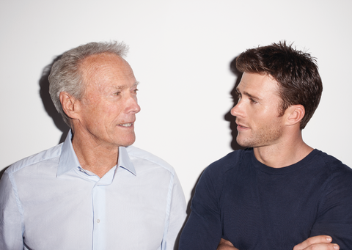
Chapter 13 Summary

Slide 4
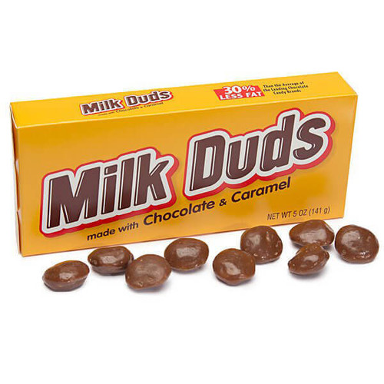
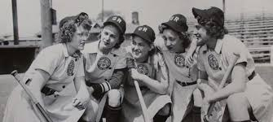
Chapter 14 Summary

Slide 5
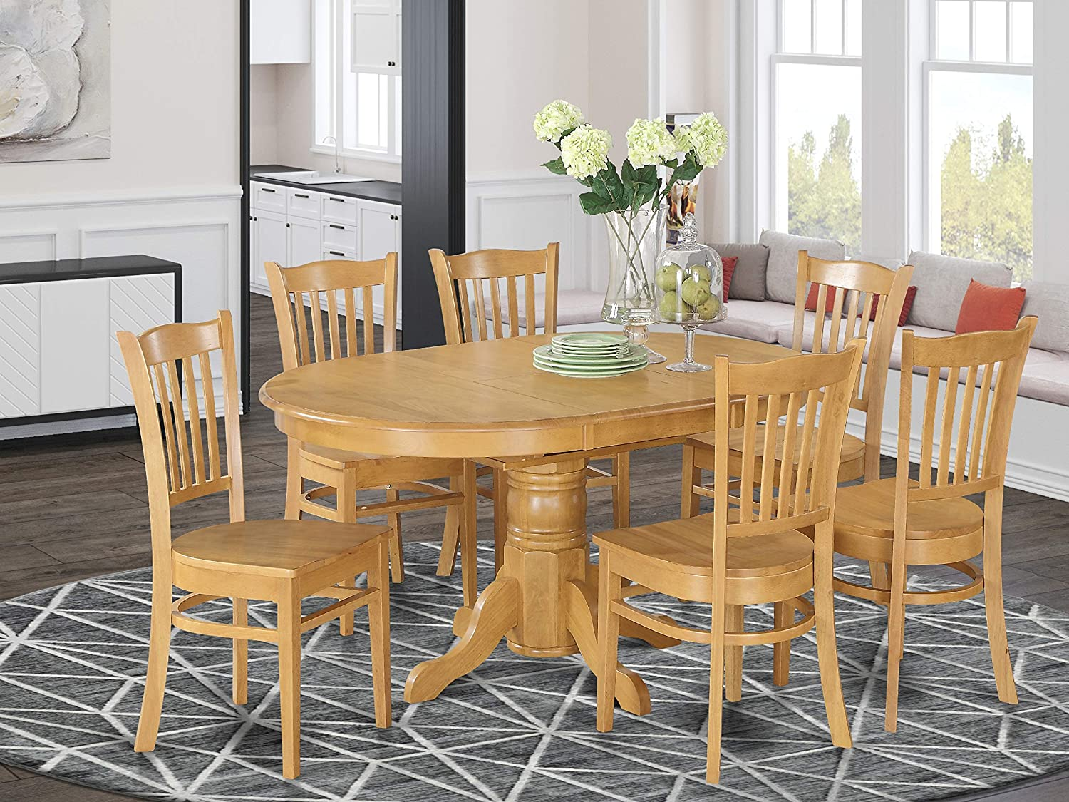
Chapter 15 Summary

Slide 6
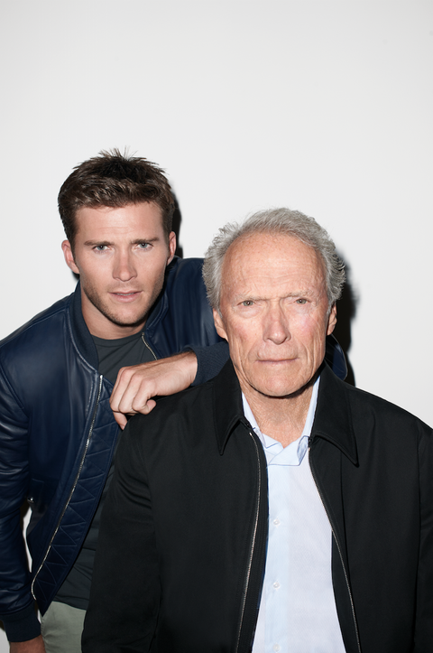
Chapter 16 Summary

Slide 7
Question 1 part A
1. Murray decides to meet Jason’s father properly (pages 73-74). Jason’s father doesn’t seem to think that Murray is helping Jason, and is rude to Murray. Murray decides that Jason’s dad is “misguided” and “got his priorities mixed up” (page 74). What does Murray think his priorities should be? Do you think that Murray sees a bit of himself in Jason’s father? Why or why not? Has there been a time in your life that you’ve had your “priorities mixed up”?

Slide 8
Question 1 Part B
1. Murray decides to meet Jason’s father properly (pages 73-74). Jason’s father doesn’t seem to think that Murray is helping Jason, and is rude to Murray. Murray decides that Jason’s dad is “misguided” and “got his priorities mixed up” (page 74). What does Murray think his priorities should be?
Finding a new step-mom for Jason
Doing things to make Jason happy (“it’s about Jason”)
Making his next million

Slide 9
Question 2 part A
2. Murray meets Tiegan and Jason at the hospital for one of Jason’s treatments. When the doctor checks Jason’s vitals, Jason lies about how often he uses his oxygen (page 81). Do you think Murray should have spoken up and told the doctor the truth? Why or why not? Have you ever been put in a situation where you had to lie or withhold the truth from someone? How did this make you feel?

Slide 10
Question 2 part B
2. Murray meets Tiegan and Jason at the hospital for one of Jason’s treatments. When the doctor checks Jason’s vitals, Jason lies about how often he uses his oxygen (page 81). Do you think Murray should have spoken up and told the doctor the truth? Think about the reason why you chose your answer.
Yes, Murray should have told the doctor.
No, Murray should not have told the doctor.

Slide 11
Question 3 part A
3. Jason, Murray, and Tiegan have an email exchange regarding dinner (pages 85-87). Murray has a hard time understanding Jason’s email, so Tiegan interprets it for him in standard English. What does this say about Tiegan’s character? How are Tiegan and Jason different? What role do you think Tiegan will play in the story?

Slide 12
Question 3 Part B
3. Jason, Murray, and Tiegan have an email exchange regarding dinner (pages 85-87). Murray has a hard time understanding Jason’s email, so Tiegan interprets it for him in standard English. How are Tiegan and Jason different? (circle all that apply)
Tiegan and Jason are both young children
Tiegan is more formal with Murray than Jason is
Tiegan sees that Murray is “old-fashioned” and that he doesn’t understand modern language
Jason and Tiegan each have their own wish lists
Murray only enjoys talking to Tiegan

Slide 13
Question 4 part A
4. Murray and Chance have an argument, and Chance says some disrespectful things towards his grandfather (pages 90-91). Chance apologizes, and Murray forgives him, thinking “Way I was raised, you forgive family. No matter what” (page 91). Do you agree with this statement? Would you have forgiven Chance if he had been that disrespectful to you? Has there ever been a time that you’ve felt like you have been too forgiving?

Slide 14
Question 4 part B
4. Murray and Chance have an argument, and Chance says some disrespectful things towards his grandfather (pages 90-91). Chance apologizes, and Murray forgives him, thinking “Way I was raised, you forgive family. No matter what” (page 91). Do you agree with this statement?
1 2 3 4 5
Disagree Neutral Agree
Would you have forgiven Chance if he had been that disrespectful to you?
Yes, I would have forgiven him
No, I would not have forgiven him

Slide 15
1 Down
D
E
T
O
U
R
Murray takes a short ______ to the grocery store

Slide 16
2 Across
p o w e r
Murray asks Jason if he is this type of hitter.
power

Slide 17
3 Down
c
o
n
t
e
m
p
t
When Chance speaks to Murray, his voice is full of ________
contempt

Slide 18
4 Across
The subject of Jason’s email - “______’ like a fool”
grubin
g r u b i n

Slide 19
5 Down
Harold Murphy Jr. is in charge of _________ Outreach for the Cubs
community
C
o
m
m
u
n
i
t
y

Slide 20
5 Across
What Murray calls Jason at the hospital
champ
c h a m p

Slide 21
6 Down
Jason’s father’s first name
Benedict
b
e
n
e
d
i
c
t

Slide 22
7 Across
The nickname Murray gives to the employee who helps him find the Milk Duds
Mr. Smiles
s m i l e s

Slide 23
8 Across
It has been _________ months since Murray had worn a suit
seventeen
s e v e n t e e n

Slide 24
9 Across
Tiegan’s great-grandmother played 3 seasons for the ______ Belles
Racine
r a c i n e

