Slide 1
Chapter 18-21 Crossword & Questions

Slide 2
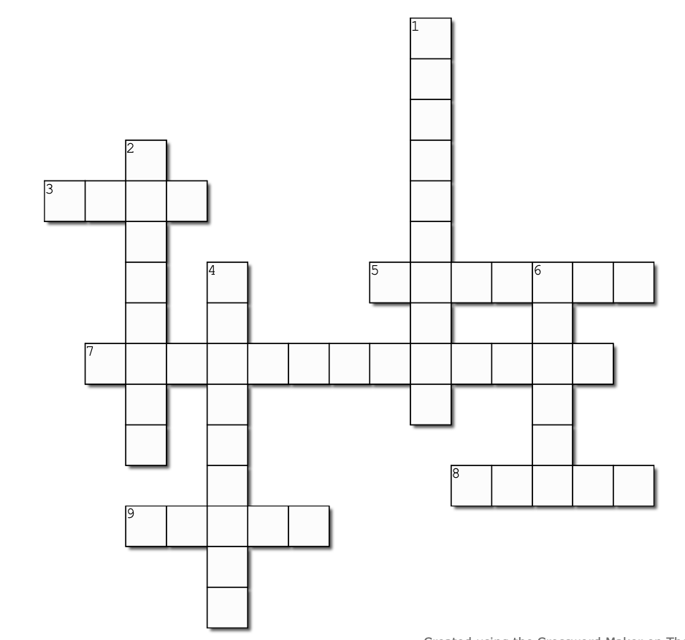
3 across
What does Chief Inspector Aronsson take in his coffee? (p. 285)

Slide 3
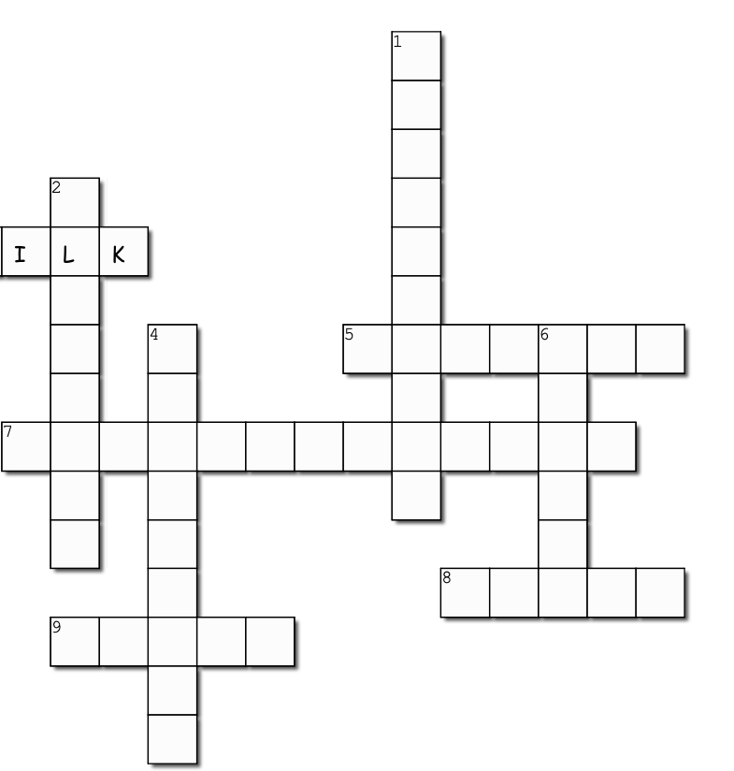
3 across
What does Chief Inspector Aronsson take in his coffee? (p. 285)

Slide 4
5 across
What object does Pike think should go in an ideal drink? (p. 268)

Slide 5
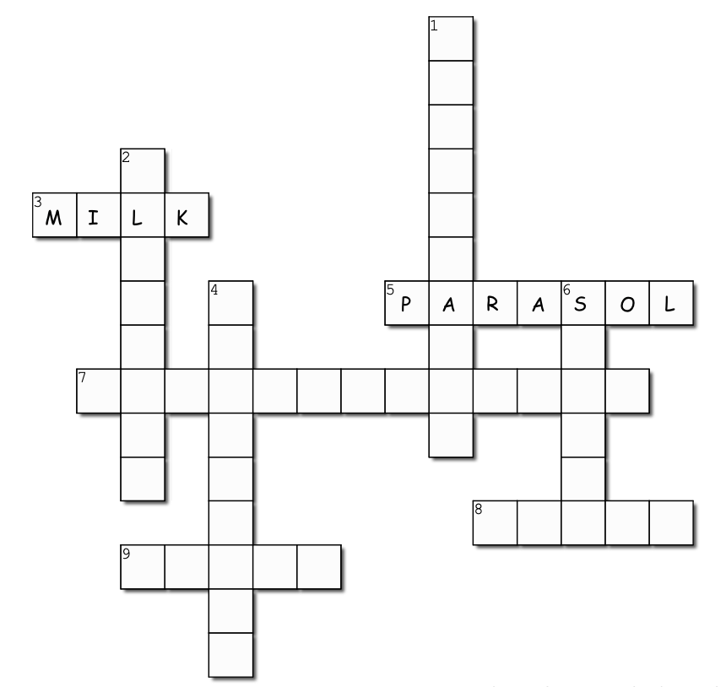
5 across
What object does Pike think should go in an ideal drink? (p. 268)

Slide 6
7 across
Stalin's nickname for Kim Jong Il: the little _________
(p. 256)

Slide 7
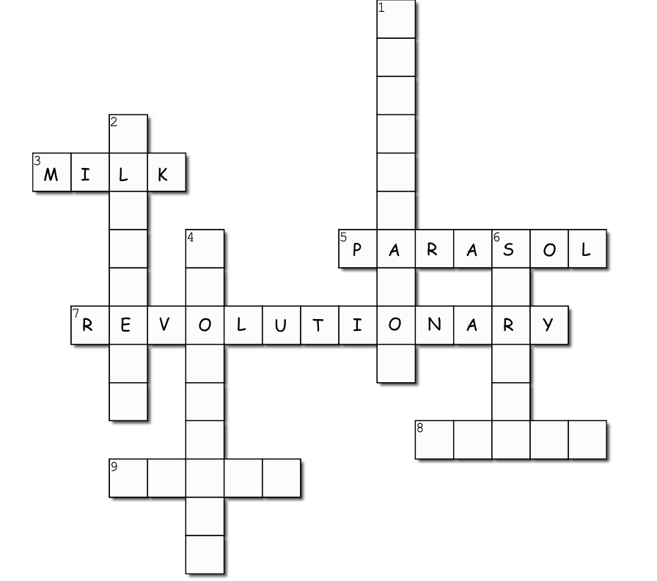
7 across
Stalin's nickname for Kim Jong Il: the little _________
(p. 256)

Slide 8
8 across
The color of Marshal Meretskov's car (p. 247)

Slide 9
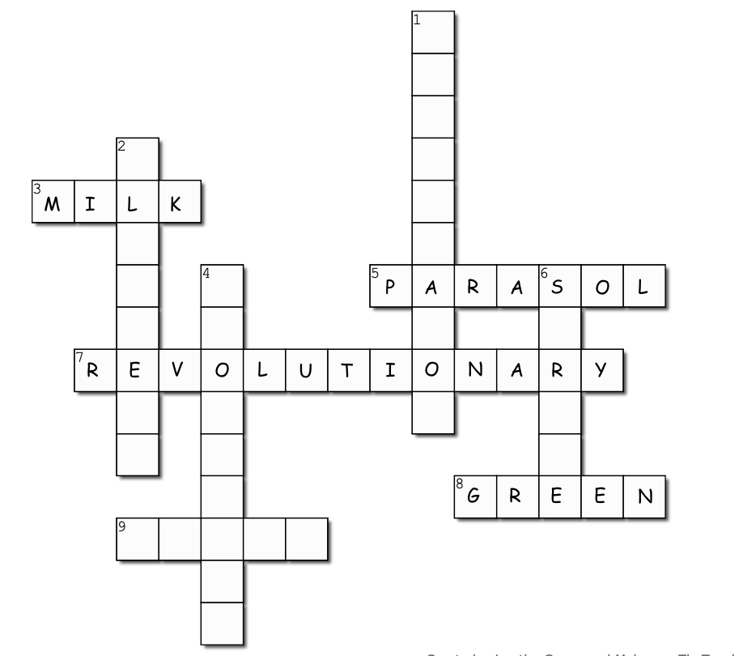
8 across
The color of Marshal Meretskov's car (p. 247)

Slide 10
9 across
What did the Swiss police forbid Herbert from doing? (p. 253)

Slide 11
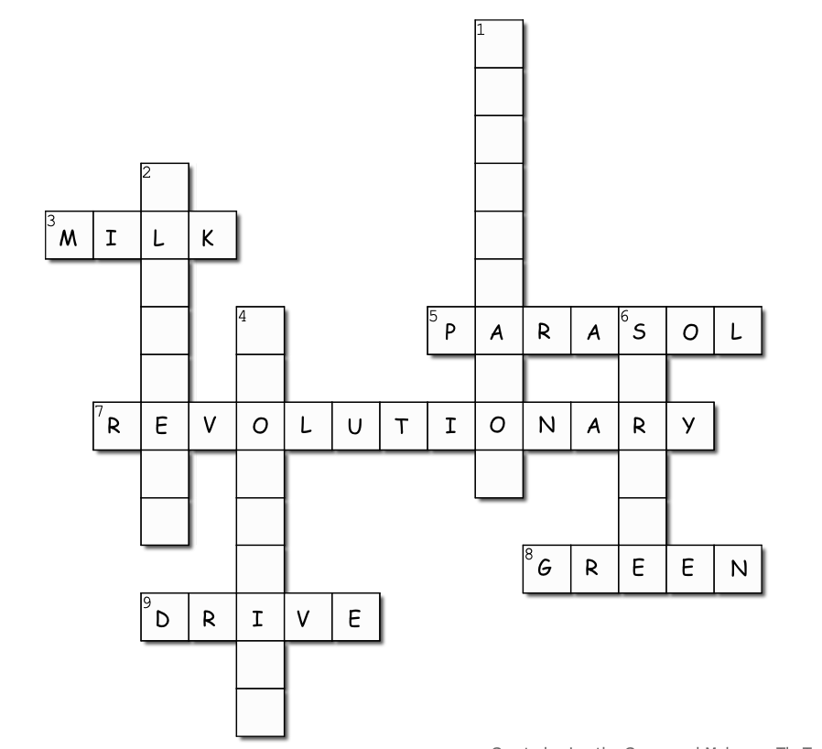
9 across
What did the Swiss police forbid Herbert from doing? (p. 253)

Slide 12
1 down
The job Amanda is offered in Paris (p. 282)

Slide 13
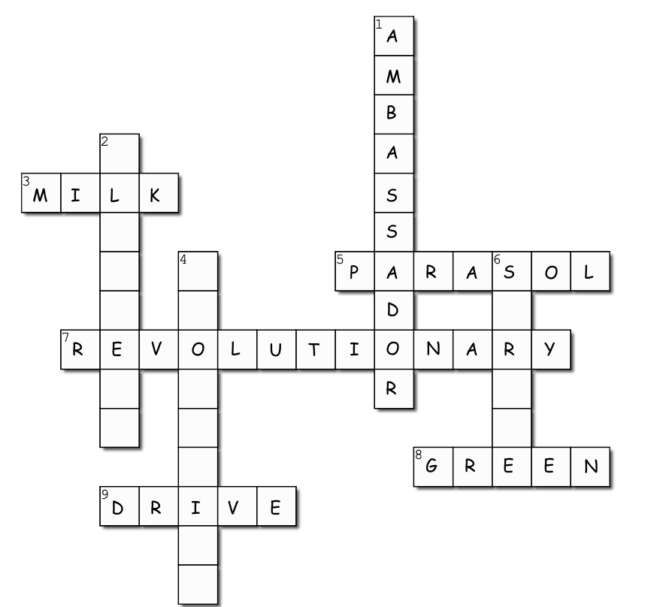
1 down
The job Amanda is offered in Paris (p. 282)

Slide 14
2 down
What is in the container Allan sets on fire in Vladivostok? (p. 242)

Slide 15
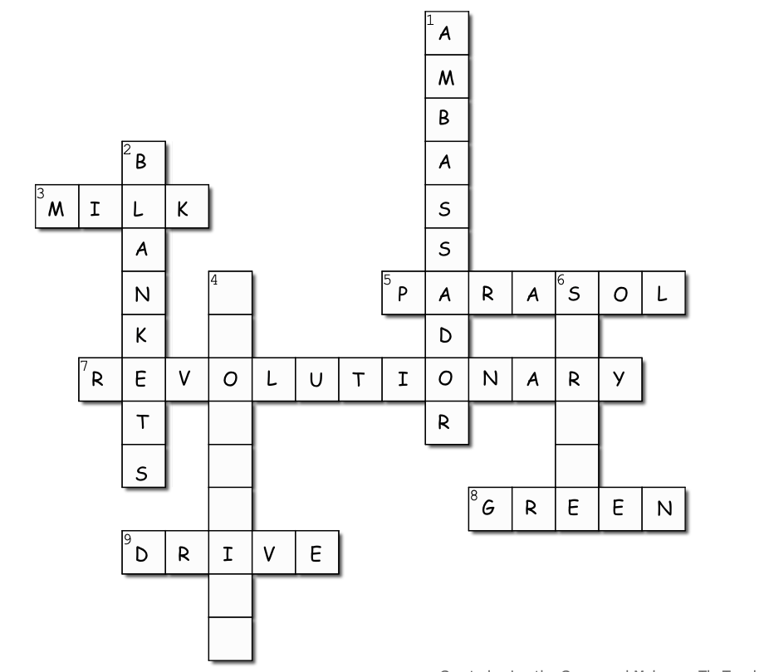
2 down
What is in the container Allan sets on fire in Vladivostok? (p. 242)

Slide 16
4 down
Amanda got her degree in __________
(p. 277)

Slide 17
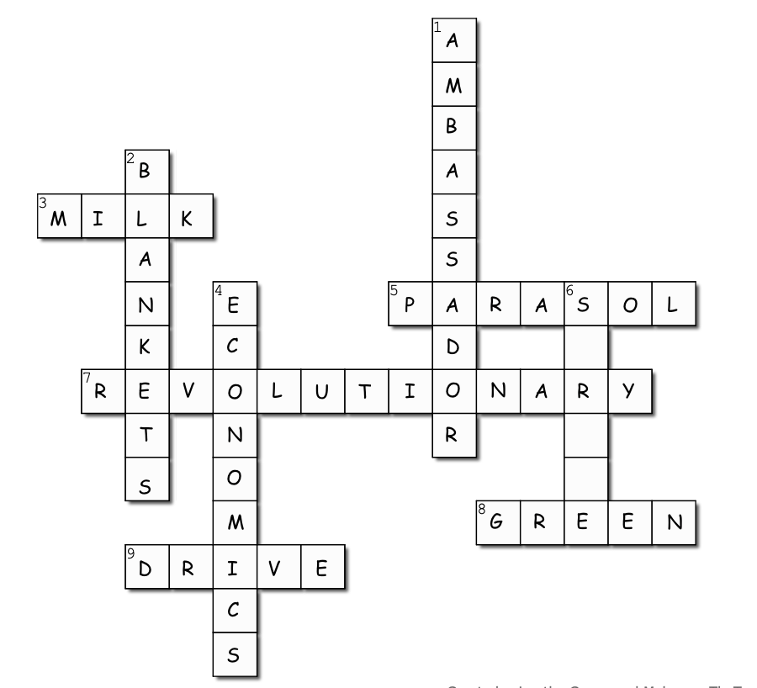
4 down
Amanda got her degree in __________
(p. 277)

Slide 18
6 down
The cause of Stalin's death (p. 244)

Slide 19
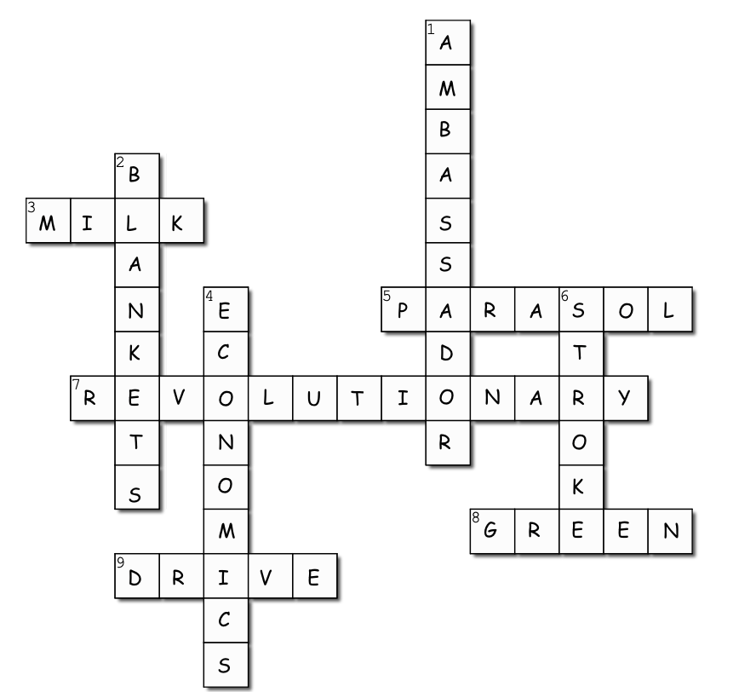
6 down
The cause of Stalin's death (p. 244)

Slide 20
1. Allan’s plan to escape the camp in Vladivostok is not very detailed (p. 239-240). Many of Allan’s plans rely on improvisation.
Do you prefer to make detailed plans, or are you more spontaneous like Allan?

Slide 21
2. Mao Tse-tung offers to arrange for Allan to travel to Bali (p. 265-266).
What is Allan looking for that makes Bali a good choice for his “vacation”?
If you could take a vacation anywhere, where would you want to go?

Slide 22
3. Allan and Pike (the Boss) bond over their ideas of paradise (page 268-269).
What do they think paradise would look like?
What do you think paradise would be?

Slide 23
4. Chief Inspector Aronsson trusts Allan enough to let him go to the kitchen to make coffee after he arrests him (p. 285). He says this is because there is “something calming” about Allan.
How trustworthy do you think Allan is?
What would you do if you were in Allan’s position? Would you try to run away?

