Slide 1
Crashing Through
Chapter 6

Slide 2
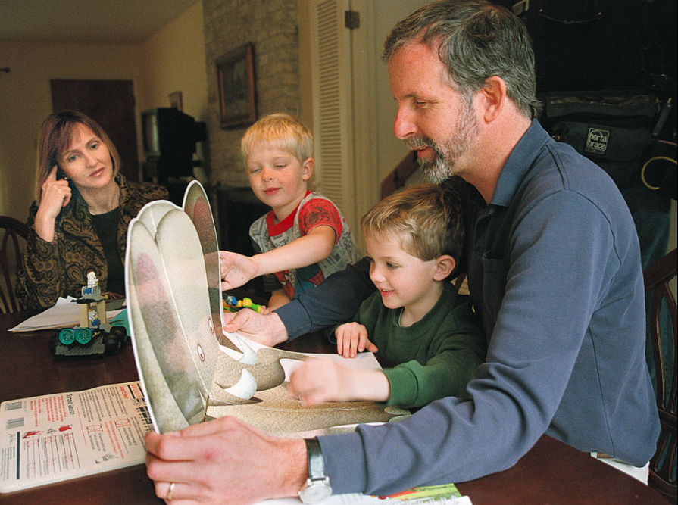
Mike May & His Family

Slide 3
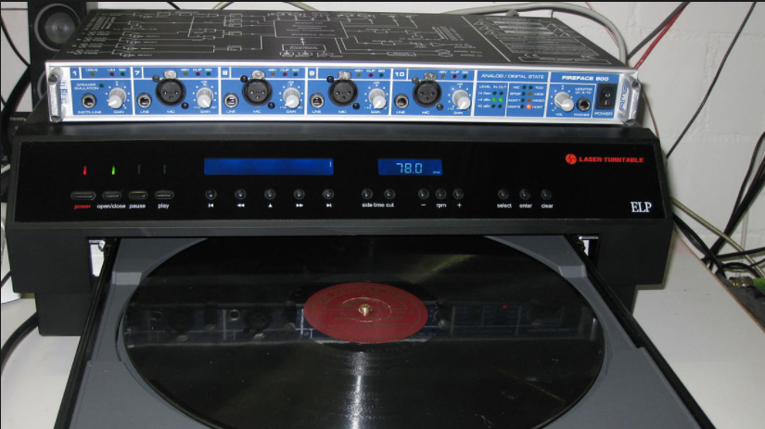
Laser Turntable

Slide 4
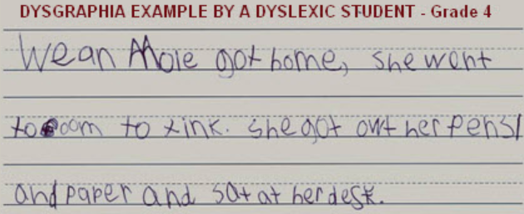
Dysgraphia

Slide 5
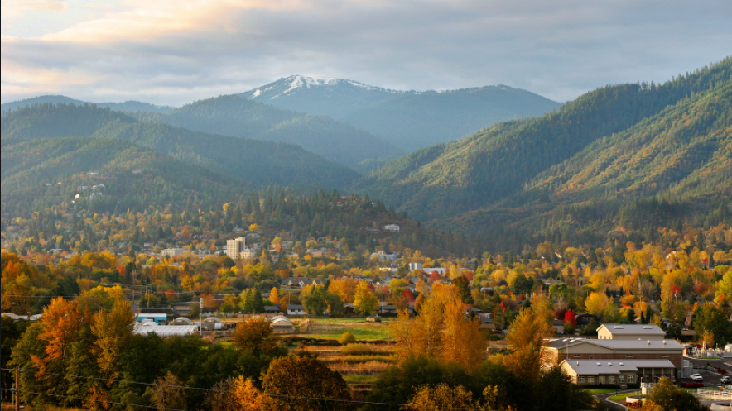
Ashland Oregon

Slide 6
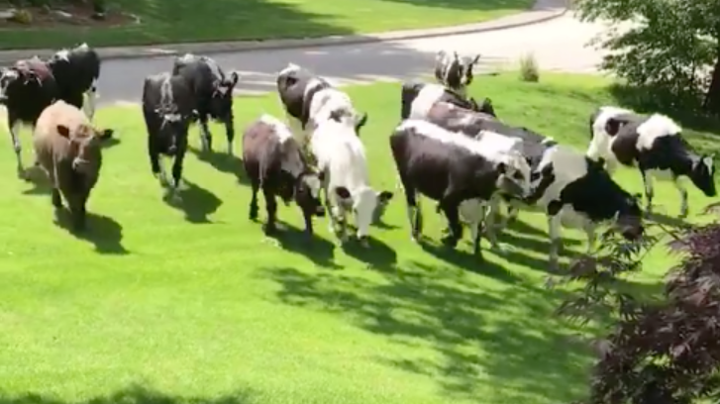
Cows on Lawn

Slide 7
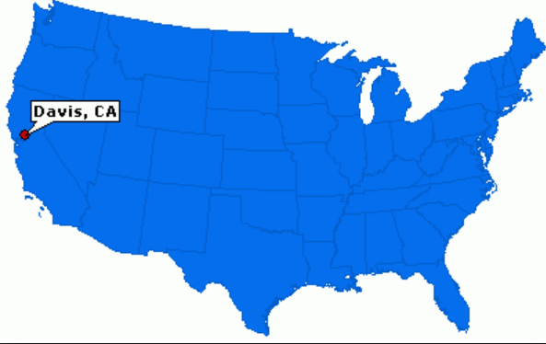
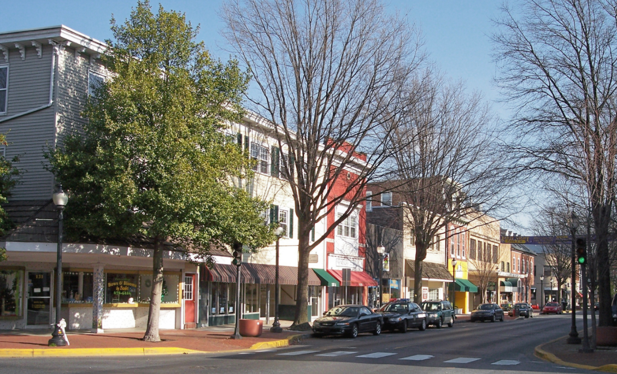
Davis, California

